Slide 1
Instructions for Use of These Slides
The purpose of these slides is to serve as a resource that any radiation oncologist can use when speaking about the role of radiation therapy for oligometastatic disease.
The target audience is medical oncology faculty and fellows. However, any user is welcome to format the slides as needed to fit your target audience.
Please ask attendees to complete either the pre-test or post-test so that we can assess the effectiveness of the slides. If you make significant changes to the content of the slides for your presentation, we prefer that you use the pre-test only.
  Pre-test link: https://redcap.link/oligomets_pre
  Post-test link: https://redcap.link/oligomets_post
Primary Author: Matthew Deek
Peer Reviewer(s): Malcolm Mattes, Austin Sim, Skyler Johnson, Bridget Koontz, Charles Simone, David Marshall
Additional Support: The ASTRO communications committee
Last updated in May 2024 – newer data may impact the accuracy of the content

Slide 2





Radiation for Oligometastatic Cancer:
Contemporary Principles and Future Directions

Slide 3
Halstead Theory on Cancer
Local disease → contiguous spread → lymphatics
“Although it undoubtedly occurs, I am not sure that I have observed from breast cancer, metastasis which seemed definitely to have been conveyed by way of the blood vessels.”
- William Halsted
Notes:
Thoughts on cancer spread go all the way back to 1700s where Lorenz Heister, a German surgeon, first proposed a mastectomy in his book Chigurie. This was furthered by W. Sampson Handley and William Halsted, who believed cancer to start as a local disease that spread and invaded in a contiguous orderly fashion outward and then spread to lymphatics. This is evidenced by Halsted quote…“Although it undoubtedly occurs, I am not sure that I have observed from breast cancer, metastasis which seemed definitely to have been conveyed by way of the blood vessels.”
This belief lead to aggressive locoregional therapy to stop further spread and serves as the conceptual foundation to the Halstead mastectomy.

Slide 4
Systemic Theory of Cancer
“We then concluded that local recurrences following operation were apt to be the result of systemically disseminated cells lodging and growing at a site of trauma rather than because of inadequate surgical technique and that a tumor is a systemic disease, probably from its inception.”
Bernard Fisher, The David A. Karnofsky Memorial Lecture, 1980
Notes:
A radically different theory was hypothesized in 1960-1970s by Bernard Fisher and colleagues, and proposes cancer is a systemic disease and small tumors are just an early manifestation of systemic disease
Systemic theory proposed that the spread of cancer was not orderly, and the route of initial dissemination was essentially irrelevant as the blood stream and lymphatics were so interrelated that it is impractical to consider them as independent routes of neoplastic dissemination . Additionally, unlike Virkow’s hypothesis in the late 1800s, the systemic theory believed regional lymph nodes are not barriers to further tumor cell dissemination

Slide 5
Conflicting Views of Cancer Invasion
Notes:
In 1980’s there were therefore two divergent hypotheses about cancer invasion and metastasis, one being the Halstead theory and the alternative hypothesis put forward by Bernard Fisher

Slide 6
Spectrum Theory of Metastasis
“Both the contiguous and systemic theories of cancer pathogenesis are too restricting…A third paradigm, one that synthesizes the contiguous-systemic dialectic, has been suggested …This thesis argues that cancer comprises a biologic spectrum extending from a disease that remains localized to one that is systemic when first detectable but with many intermediate states.”
Notes:
The diverging opinions on cancer invasion and metastasis lead to new hypothesis by Hellman and Weischelbaum that cancer was instead a spectrum of disease on one end characterized by locally confined disease and the other widely metastatic disease and in between the two many intermediate states.

Slide 7
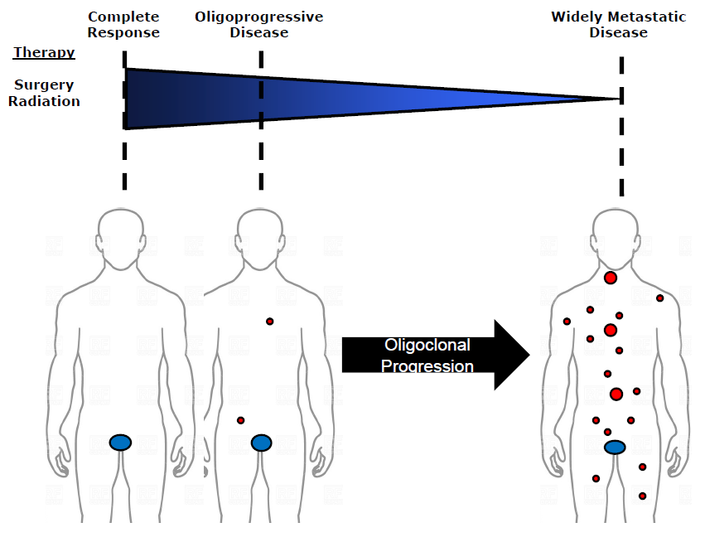
Oligometastasis
Oligometastasis is a state on the spectrum of metastasis characterized by a few number of metastatic lesions
Its biological behavior might be more akin to a locally confined metastatic state rather than a widely systemic process
The few number of lesions and biological behavior make these lesions amenable to local therapies
Oligometastasis
Notes:
One intermediate state hypothesized by the spectrum theory is an oligometastatic state often defined as < 3-5 metastatic lesions.

Slide 8
Oligometastasis
If oligometastatic lesions behavior more akin to locally confined disease, ablation of these lesions might lead to prolonged periods of disease-free survival, and in some cases possibly even cure
Oligometastasis
Cure
Notes:
One intermediate state hypothesized by the spectrum theory is an oligometastatic state often defined as < 3-5 metastatic lesions.

Slide 9
Objectives
Review principles and definition of oligometastatic/oligoprogressive disease
Review technical principles of stereotactic body radiation (SBRT)
Present data on safety of SBRT of oligometastatic lesions
Present data on efficacy of local therapies in oligometastatic disease
Review future research efforts and ongoing trials of oligometastasis
Notes:
Such a state would potentially be amenable to local therapies and if the metastatic sites behave more akin to locally confined disease might event be curable with such an intervention

Slide 10
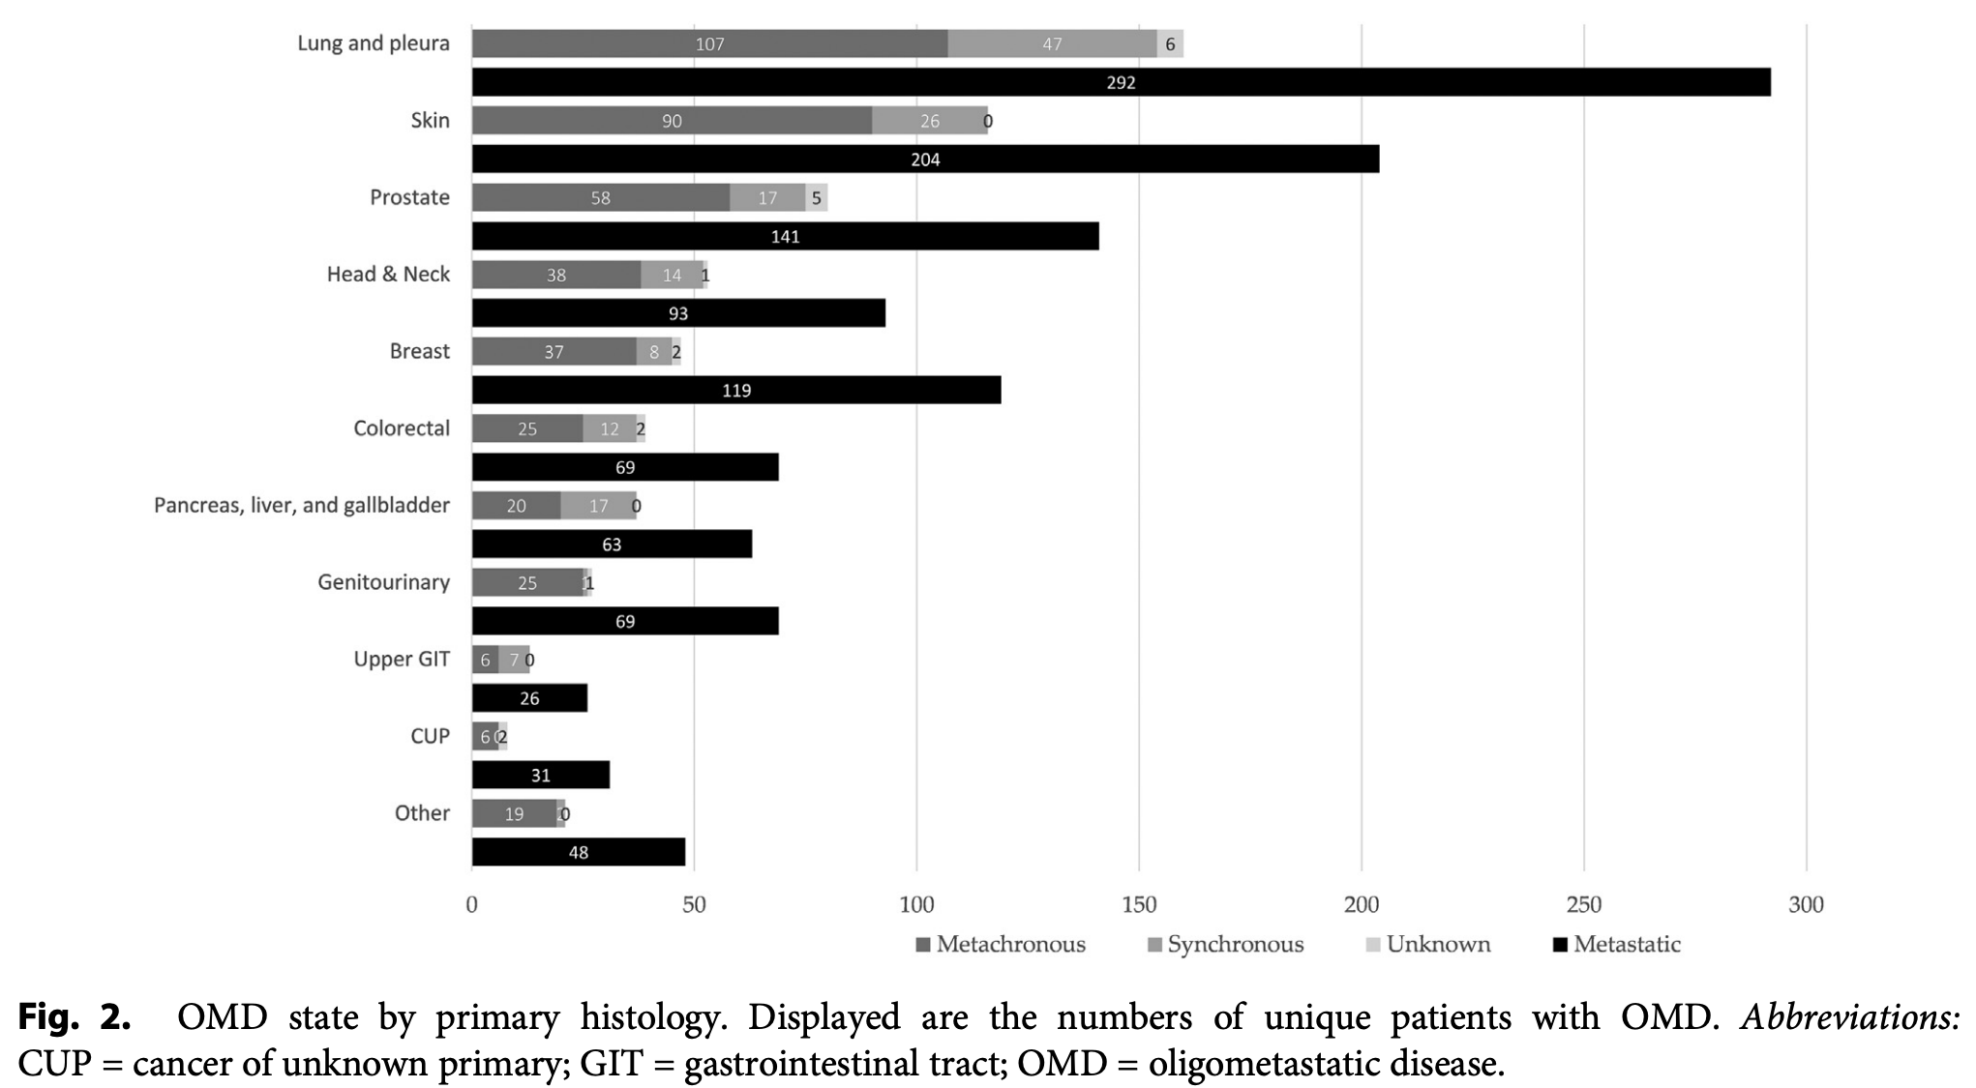
Prevalence of Oligometastatic Disease
Majority (52%) of patient with systemic disease present with oligometastasis, especially patients with metachronous disease (72%)

Slide 11
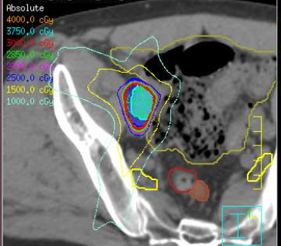
Metastasis Directed Therapy (MDT)
Use of local therapy, most commonly either radiation or surgery, to treat sites of metastatic disease
Most common radiation technique is stereotactic body radiation (SBRT), an extremely precise form of high dose radiation typically given in 5 fractions or less

Slide 12
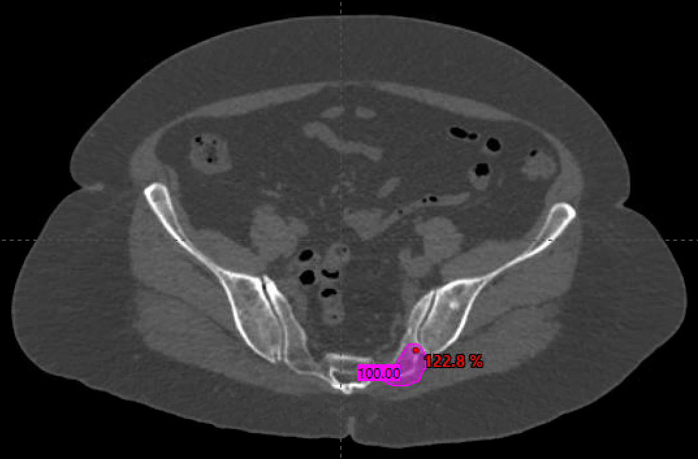
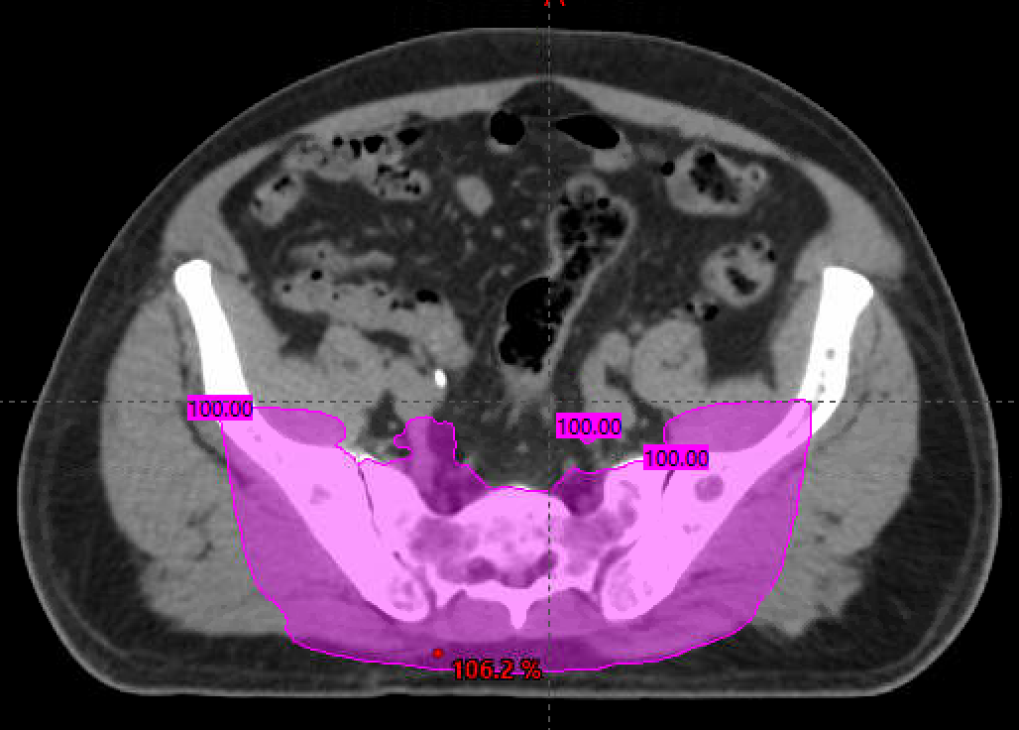
SBRT vs Traditional Palliative RT
SABR/SBRT
- Highly conformal treatment plan
(little normal tissue irradiated)
- High (ablative) doses in 1-5 fractions
(goal to achieve long term local control)
Conventional Palliative RT
- Less conformal treatment plan
- Lower doses in 1-10 fractions
(goal of symptom relief > local control)

Slide 13
Comparison of Local Therapy Modalities
Surgery
Pros
Provides pathologic information
High rates of local control
Cons
Invasive
Longer recovery time
Immunosuppressive
SBRT
Pros
Non-invasive
High rates of local control
Shorter time off systemic therapy
Cons
No pathologic information
Ablation
Pros
Mildly invasive (compared to surgery)
Typically single procedure
Cons
No pathologic information
Inferior local control for larger tumors
Anatomical factors may also favor one modality over another

Slide 14
Early Clinical Evidence
141 patients with resectable hepatic metastases from colorectal cancer retrospectively assessed for outcomes
5 year OS: ~25% for resected vs. 0% for unresected lesions
Adson et al. Arch Surg 1984

Slide 15
Oligometastatic Definitions
Notes:
Three common ”oligo” states:
De novo/synchronous metastasis: patients with metastatic disease at initial diagnosis
Oligorecurrent/metachronous metastasis: patients originally with locally confined disease treated with definitive therapy but subsequently develop metastatic disease
Oligoprogressive metastasis: patients who may have wide spread metastatic disease with control of the majority of metastasis but few number of lesions progressing on systemic therapy

Slide 16
De Novo Oligometastasis
Notes:
Review of data for consolidative radiation in De novo oligometastasis

Slide 17
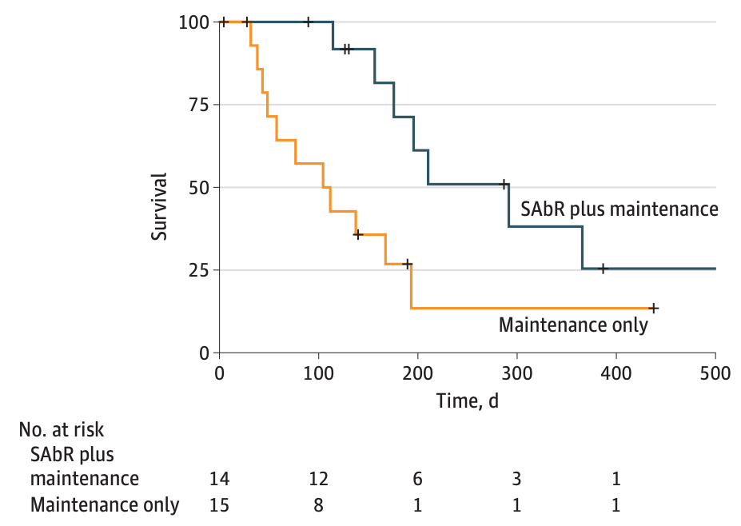
Prospective Evidence for RT in Oligometastasis – De Novo Metastatic Lung Cancer
Gomez et al.
Improved mOS 17 to 41.2 mo
Iyengar et al.
- Improved PFS from 3.5 to 9.7 months
- Closed early after Gomez et al. reported
Notes:
Two early trials of radiation in oligometastatic de novo NSCLC showed benefits in oncologic outcomes. Patient were treated with initial systemic therapy and were then randomized to either receive consolidative radiation vs. maintenance systemic therapy. Gomez et al. showed survival benefit with consolidative radiation and once OS benefit was reported, Iyengar et al. was closed early, but did show PFS benefit. Important to note these trials were run pre-immunotherapy era.

Slide 18
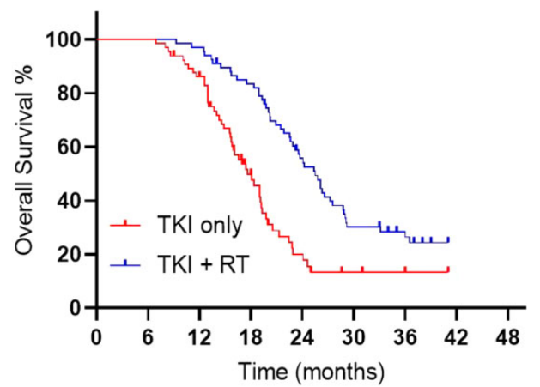
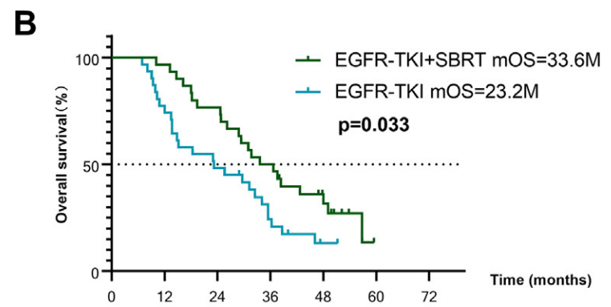
RT for Oligometastatic EGFRmt Lung Cancer
SINDAS trial
- Phase III study
-mOS 25.5 vs 17.6 mo
-pre Osimertinib
Peng et al.
- Phase II study
-mOS 33.6 vs 23.2 mo
-pre Osimertinib
Wang et al. JNCI 2022; Peng et al. Radiother Oncol 2023
Notes:
Advent of targeted agents has changed the treatment landscape for metastatic NSCLC. However, even with improvements in systemic therapy such as EGFR targeting agents, several prospective trials have shown continued survival benefit to consolidative RT in oligometastatic NSCLC.

Slide 19
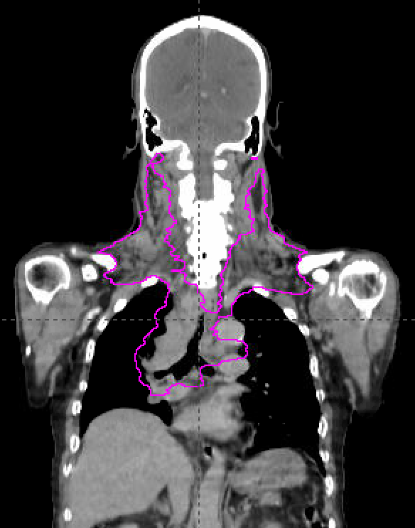
Case #1
69-year-old with NSCLC, M1 due to bilateral cervical lymph node involvement
Locally advanced with compression of SVC
Treated with chemoRT (60 Gy/30 fx) to all gross disease
Notes:
Highlights that oligometastatic disease may include non-regional (M1) lymph nodes.

Slide 20
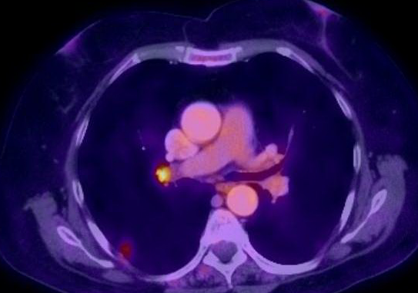
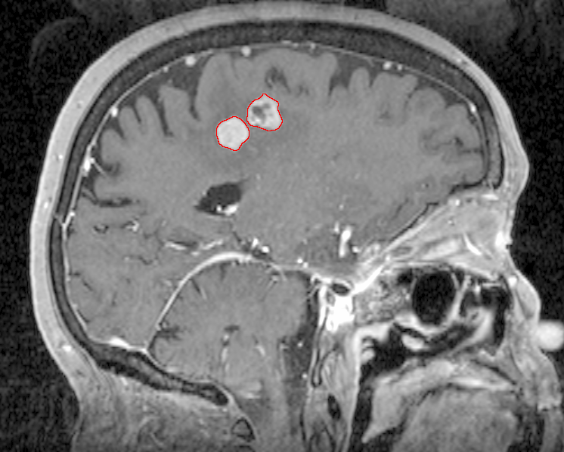
Case #2
64F active smoker p/w difficulty writing and right foot weakness.
MRI brain showed two enhancing lesions
PET/CT showed a 1.3cm RLL nodule (SUV 2.9) and a 1.1 x 0.9cm right hilar LN (SUV 3.8)
CT-guided biopsy showed NSCLC

Slide 21
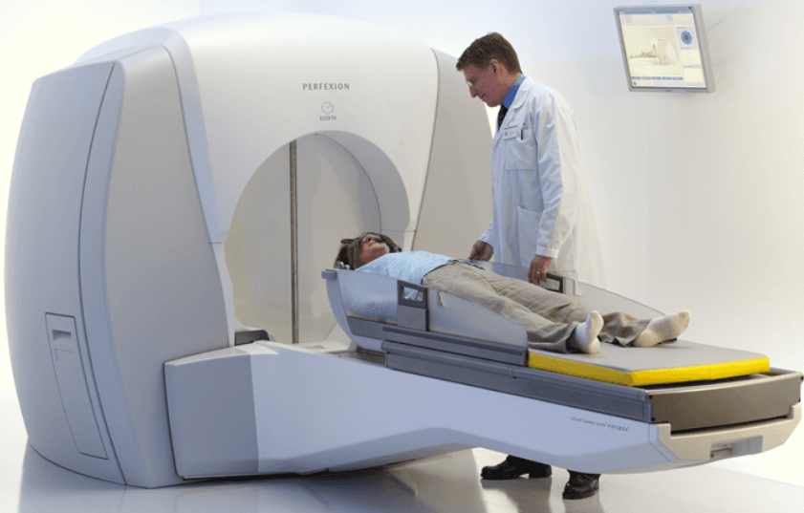
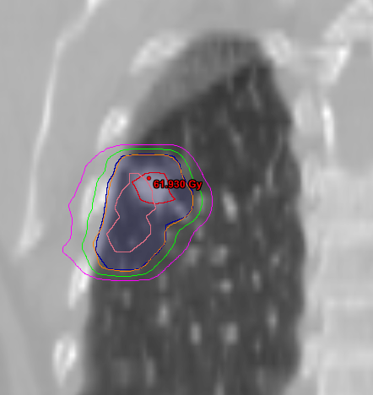
Case #2
Stereotactic Radiosurgery (SRS) to four brain metastases
Two cycles carboplatin/pemetrexed → SD in lymph node but PD in lung nodule
SBRT to the RLL nodule
Five cycles carboplatin/Nab-Paclitaxel (d/c’d due to intolerance)
Follow-up imaging → no evidence of disease in body or brain for > 40 months since diagnosis

Slide 22
Metachronous Oligometastasis
Notes:
Review of data for consolidative radiation in metachronous oligometastasis

Slide 23
RT in Metachronous Oligometastatic Prostate Cancer
STOMP trial
- ADT free survival 21 vs 13 months
ORIOLE trial
- 6 months progression 19% vs 61%
Notes:
Two of the first studies of MDT in metachronous oligometastatic castration sensitive prostate cancer were STOMP and ORIOLE. Both enrolled patients with three or fewer lesions and randomized to MDT or observation. STOMP showed MDT prolonged time to initiation of ADT from 13 to 21 months compared to observation while ORIOLE demonstrated at 6 months rates of progression were 61% in the observation arm compared to only 19% in the MDT arm.

Slide 24
SBRT in Metachronous Oligometastasis
SABR COMET
Metachronous oligometastatic disease
Included prostate, breast, lung, CRC, and 33% ‘other’ histologies
MDT improved 5 yr OS from 17.7% to 42.3%
Palma et al. Lancet 2019; Palma et al. JCO 2020
Notes:
SABR COMET randomized patients with metachronous oligometastatic disease of various histologies to standard of care systemic therapy +/- MDT. 5 year OS was improved from 17.7% to 42.3% with MDT.

Slide 25
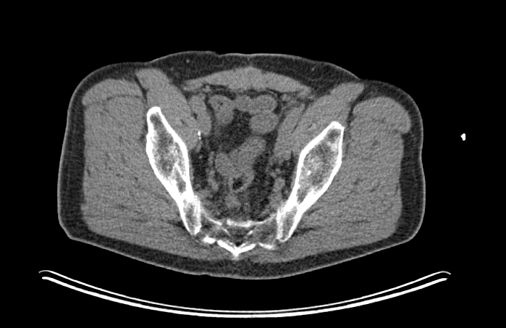
Case #3
75-year-old male with Gleason grade group 1 prostate cancer s/p radical prostatectomy, and later salvage prostate bed RT for biochemical recurrence
Three years later he had another biochemical recurrence (PSA-doubling time 5 months). PSMA PET scan showed two hypermetabolic pelvic lymph nodes
Treated with SBRT alone (no ADT), 40 Gy/5 fractions

Slide 26
Case #3
Significant PSA decline (and still declining) almost one year post SBRT. Remains on observation

Slide 27
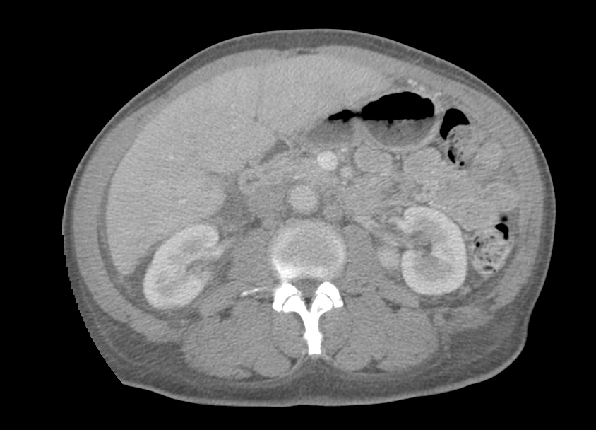
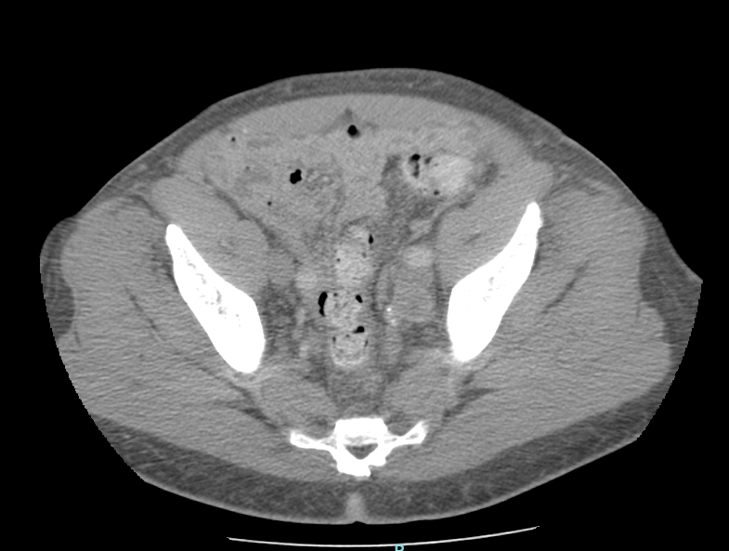
Case #4
71-year-old with a history of pT4N1 Gleason grade group 5, iPSA 54.9 prostate cancer s/p radical prostatectomy with positive margins followed by adjuvant RT, 70.2 Gy in 39 fractions
PSA rose after adjuvant RT. Poor tolerance to ADT requiring hospitalization for CHF. PSA rose to 17 ng/mL on ADT break. Imaging showed pelvic and PA lymph nodes
Treated with IMRT using simultaneous integrated boost to 55 Gy in 20 fractions
PSA decreased to undetectable

Slide 28
Oligoprogression
Notes:
Oligoprogression represents growth of a few number of lesions in the background of otherwise controlled systemic disease. It is thought to be due to acquired resistance to targeted therapy in some tumor cells.

Slide 29
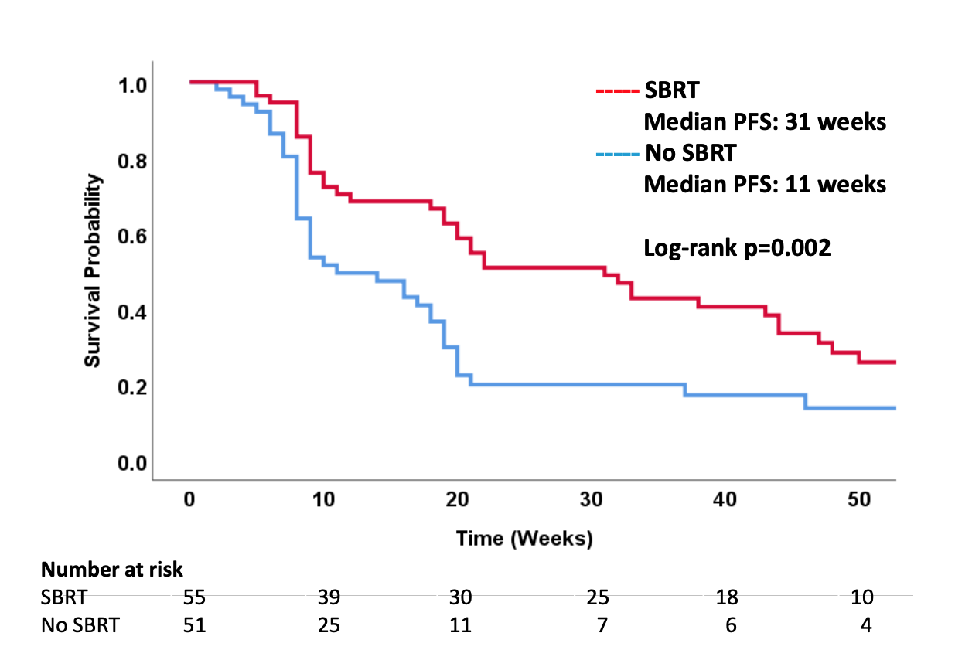
Metastasis Directed Therapy for Oligoprogression
CURB trial
Oligoprogressive disease treated with systemic therapy +/- SBRT
Included lung and breast cancer
Improved mPFS from 11 to 31 weeks
Benefit seen in lung, but not breast histologies

Slide 30
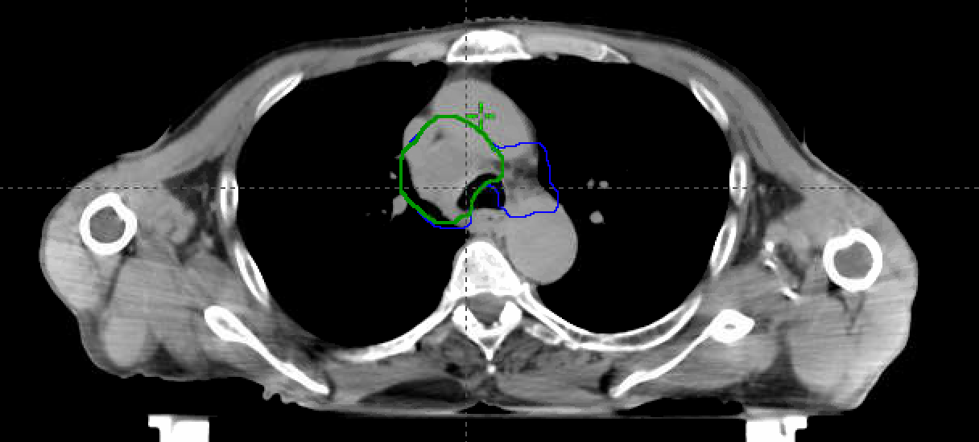
Case #5
60-year-old with metastatic head and neck cancer on pembrolizumab
Oligoprogressive mediastinal lymph node
Treated 50 Gy/15 fractions. Field abutted and had mild overlap with prior H&N radiation field

Slide 31
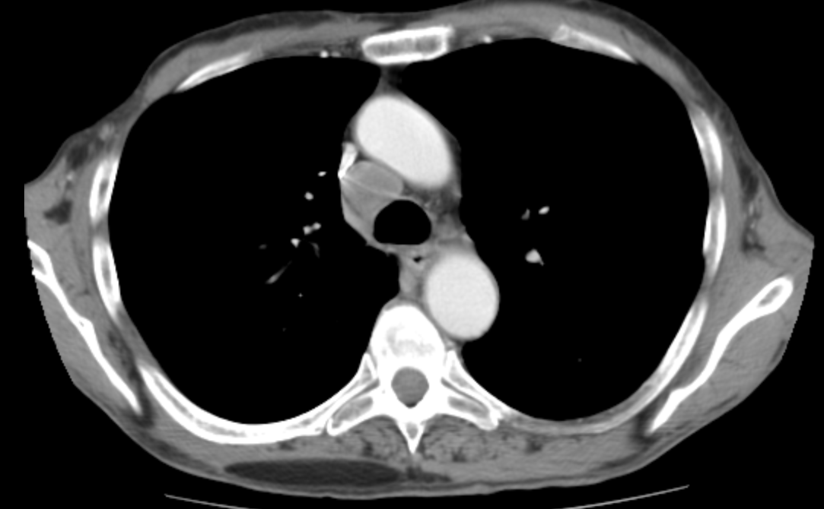
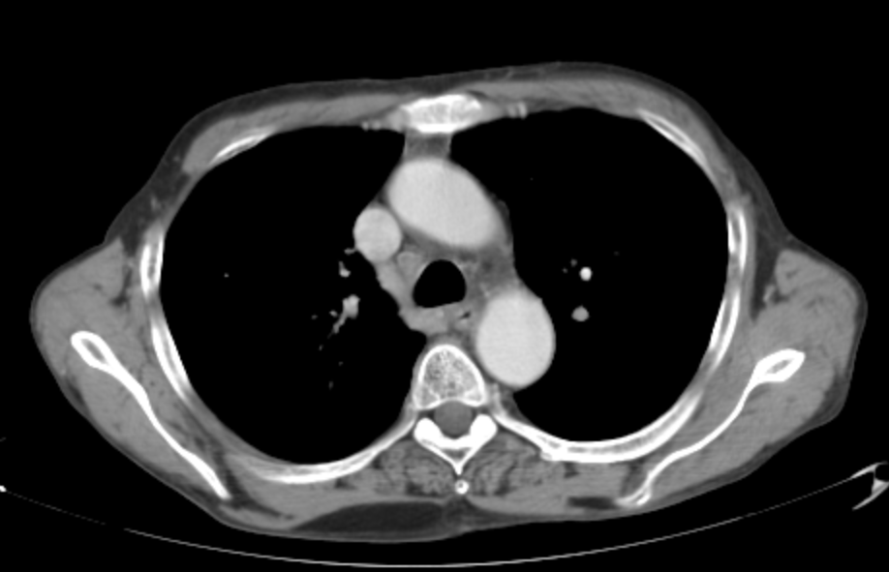
Case #5
Complete response to RT; Now on observation after 2 years of pembrolizumab

Slide 32
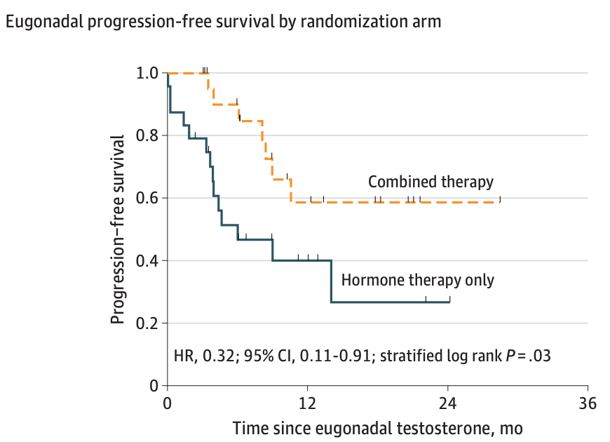
MDT Combined with Systemic Therapy
EXTEND trial
- Oligomet castration sensitive prostate cancer randomized ADT +/- MDT
- Eugonadal PFS improved with MDT from 3.7 to 6.1 months (HR 0.32, p = 0.03)
Both arms of SABR COMET also received standard of care systemic therapy
Tang et al., JAMA Onc 2023
Notes:
Future work needs to focus on how to best integrate systemic therapy with MDT. One options is to attempt to prolong the efficacy of systemic therapy with MDT while simultaneously allowing for breaks in therapy in order to reduce possible side effects. One example of such an approach is the EXTEND study which randomized patients with castration sensitive prostate cancer receiving intermittent ADT to ADT +/- MDT. Addition of MDT was able to extended eugonadal PFS and time off ADT for patients.

Slide 33
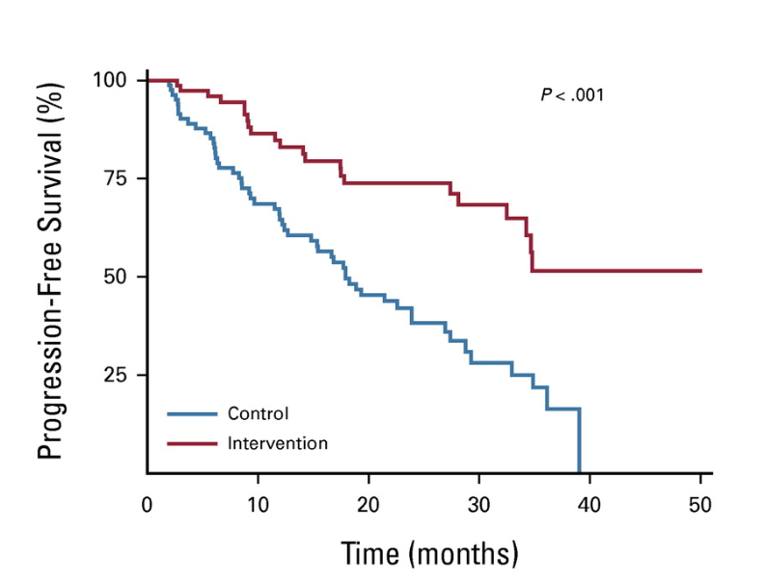
MDT Combined with Systemic Therapy
ARTO Trial
- Oligometastatic castration resistant prostate cancer randomized abiraterone +/- MDT
- Median PFS improved with MDT from 17 months to not reached (HR 0.35, p <0.001)
Francolini et al., JCO 2023
Notes:
Future work needs to focus on how to best integrate systemic therapy with MDT. One options is to attempt to prolong the efficacy of systemic therapy with MDT while simultaneously allowing for breaks in therapy in order to reduce possible side effects. One example of such an approach is the EXTEND study which randomized patients with castration sensitive prostate cancer receiving intermittent ADT to ADT +/- MDT. Addition of MDT was able to extended eugonadal PFS and time off ADT for patients.

Slide 34
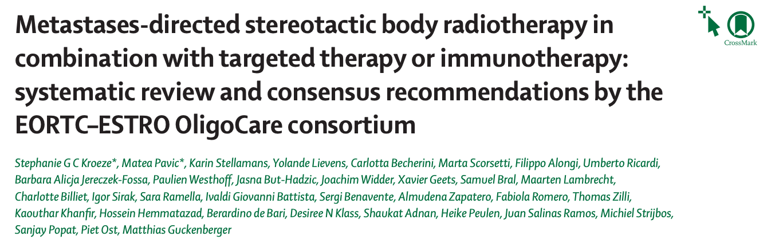
MDT Combined with Systemic Therapy
Guideline available for sequencing SBRT with systemic therapy, but often able to be delivered with minimal interruption of treatment
Some combinations seem to be associated with higher risk (anti-EGFR and VEGF, BRAF/MEK inhibitors) so caution needed
Kroeze et al., Lancet Oncol 2023, Anker et al., IJROBP 2016, Wang et al., JAMA Onc 2019
Notes:
MDT can often be safely in between cycles of systemic therapy. Guidelines exist to help sequence SABR and systemic therapy.
anti-VEGF has the longest washout period (can use as an explicit example)

Slide 35
MDT can be Delivered in Few Number of Treatment
Trial | Histology | Site | Fractionation
SABR COMET | Various histologies | Various sites | 3 – 8 fractions (1 fraction brain)
ORIOLE | Prostate | Various sites | 3– 5 fractions
STOMP | Prostate | Various site | 3 fractions
Gomez et al. | Lung | Various sites | 3 fractions
SAFRON | Various | Lung | 1 or 4 fractions
Zelefsky et al. | Various | Bone or Node | 1 or 3 fractions
Notes:
MDT can often be delivered in few number of fractions with good efficacy

Slide 36
Lesion Local Control is High After MDT
Study | Dose | Histology | Outcome
Siva et al. | >90% received > BED10 60 Gy | Mix | 5-year LR: 8%
Zelefsky et al. | BED10 81.6 (single fractions) | Mix | 3-year LR: 5.8%
Nuyttens et al. | BED10: 132 Gy | Mix (lung metastases) | 2-year LR: 9%
Deek et al. | Median BED3: 116 Gy | Prostate | 2-year LR: 7.4%
Henke et al. | Median BED10: 100 Gy | Mix (abdominal metastases) | 6-month LR: 11%
Benson et al. | Median BED10: 70 Gy | CRC | 3-year LR: 31.5%
BED, Biologically Effective Dose
Notes:
Use of SABR translate into high rates of local control of treated lesions. BED represents biological equivalent dose, which is a conversion factor that allows comparison of dose between different radiation fractionation schedules.
LR: local recurrence

Slide 37
Toxicity is Low with MDT using SBRT Techniques
Study | Number of patients | Location | toxicity
Chalkidou et al. | 1,422 | Mix | Most common Grade 3: fatigue 2%; Grade 5:0%
ORIOLE | 54 | Mix | Grade 3 - 5: 0%: (Grade 5: 0%)
STOMP | 62 | Mix | Grade 2 - 5: 0%: (Grade 5: 0%)
Lehrer et al. | 943 | Mix | Grade 3 – 5: 1.2%
SAFRON | 87 | Lung | Grade 3 – 5: 5% (grade 5: 1.1%)
SABR COMET | 99 | Mix | Grade 2 – 5: 29% (grade 5: 4.5%)
Notes:
Thousands of patients have been treated with SABR with very low toxicity. Several grade 5 events were noted on SABR COMET, but this is not in line with other studies which showed much lower rates of severe toxicity. Thus, SABR can safely be administered to patients.

Slide 38
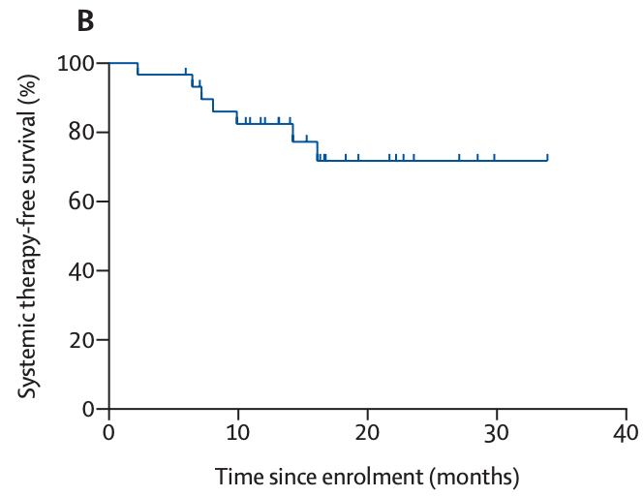
MDT Without Systemic Therapy
Controversial; Most studied in prostate cancer to avoid or delay systemic therapy (STOMP, ORIOLE, EXTEND)
RCC (Tang et al. 2021)
- Phase II (30 patients) treated with MDT alone
- One year systemic therapy free survival 77%; patients could be treated with multiple rounds of MDT
EORTC 40983
- CRC with liver mets; Phase III randomized to resection +/- neoadjuvant chemo
- No difference in OS (HR 0.88, p = 0.34); PFS (0.81, = 0.07)
Notes:
Using MDT to delay time to systemic therapy is controversial. Several studies have shown its potential feasibility in prostate cancer and renal cell carcinoma. Within colorectal cancer with liver metastases, there was no benefit to adding systemic therapy to patients undergoing resection of metastatic lesions.

Slide 39
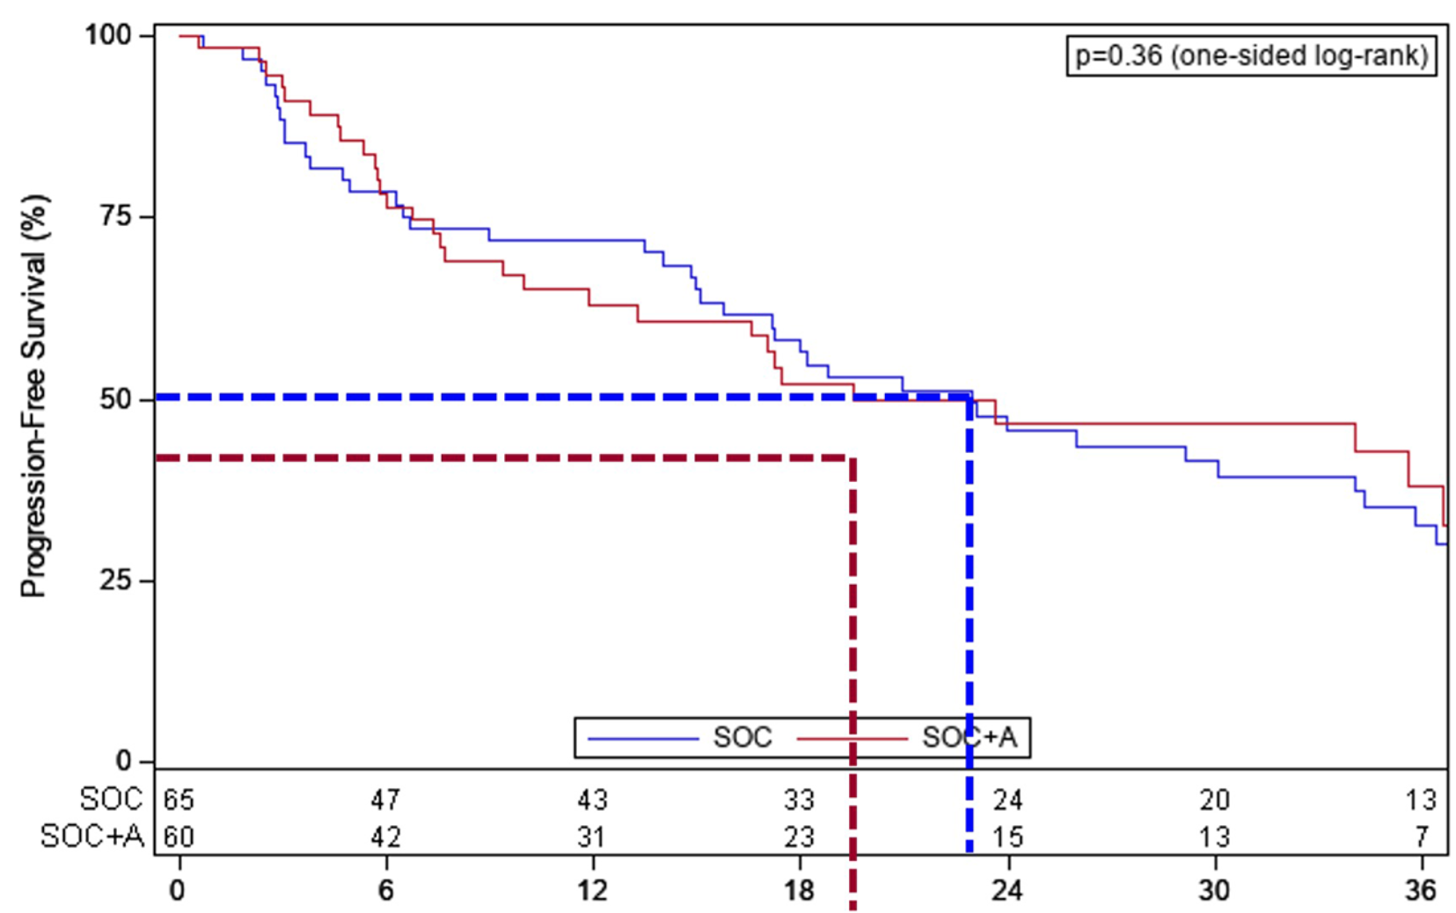
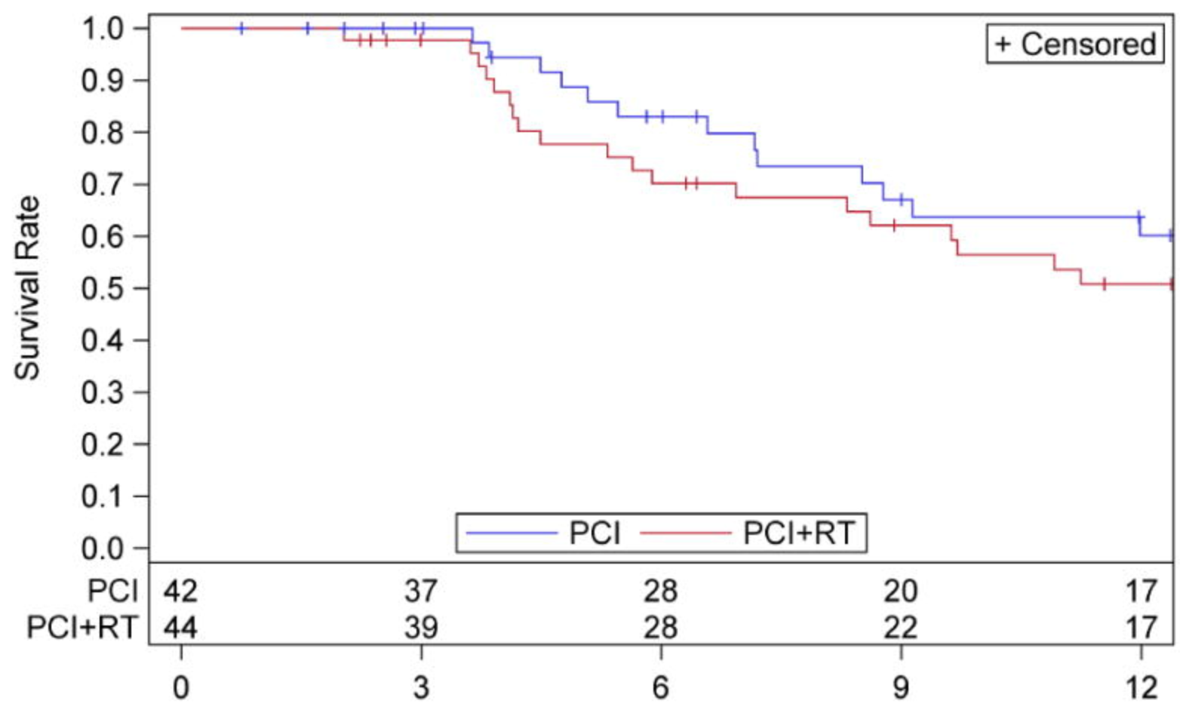
Unsuccessful Trials of MDT
BR-002
- Phase II/III trial oligometastatic breast randomized to systemic therapy +/- SBRT
- mPFS 23 vs 19.5 mo (p = 0.36)
RTOG 0937
- Phase II trial extensive stage small cell lung cancer randomized to systemic therapy +/- consolidative radiation
- One year OS 60 vs 50% ( p = 0.21)
Notes:
Despite all the success of MDT, there have been several unsuccessful trials such as in breast and small cell lung cancer. More work is needed to continue to understand optimal treatment paradigms
May consider also mentioning HORRAD trial (Boeve 2019)
- 432 men with primary bone M1 prostate cancer randomized to ADT +/- prostate RT (70Gy/35fx)
- RT → No difference in median OS or TTP (trend towards improvement if < 5 mets)

Slide 40
Other Randomized Trials of MDT
Trial | Site | Treatment | Outcome
EORTC 40004 | CRC with liver metastases | Systemic therapy +/- RFA | 8 year OS: 35.9% vs 8.9%
STAMPEDE | De novo metastatic prostate cancer | Systemic therapy +/- RT to primary | Low volume disease OS: HR 0.68 (0.52 – 0.90)
Notes:
Several other important trials of MDT:
EORTC 40004 showed improved survival with treatment of liver metastases from colorectal cancer
STAMPEDE showed improvements in survival treating the prostate primary in patients with low volume de novo metastatic disease.

Slide 41
Currently Accruing/Recently Completed Trials
Study | Treatment | Histology | Primary endpoint
SABR COMET 3 (Phase III) | Standard of care systemic therapy +/- SBRT | Mixture (metachronous) | Overall survival
NRG – GU 011 (Phase II) | SBRT +/- ADT | Prostate (metachronous | rPFS
NRG – LU 002 (Phase II/III) | Standard of care systemic therapy +/- SBRT | NSCLC | PFS
NRG – LU 007 (Phase III) | Standard of care systemic therapy +/- consolidative RT | Small cell lung cancer | PFS
OligoRARE (Phase III) | Standard of care systemic therapy +/- consolidative RT | Rare histologies | Overall survival
EA2183 (Phase III) | Standard of care systemic therapy +/- consolidative RT | Esophageal and Gastric cancer | Overall survival
A022101 (Phase III) | Standard of care systemic therapy +/- consolidative RT | Colorectal cancer | Overall survival
Notes:
Others include:
GORTC OMET: Stereotactic Radiotherapy Combined With Chemotherapy or Not for Treatment of Oligometastases in HNSCC (OMET)
ECOG-ACRON EA 3211: Combining Radiation Therapy with Immunotherapy for the Treatment of Metastatic Squamous Cell Carcinoma of the Head and Neck

Slide 42
Open Questions in Oligometastasis/Oligoprogression
Which oligometastatic/oligoprogressive patients will benefit from local consolidative therapy (LCT) to all sites of disease?
  How do we biologically think about oligometastasis?
  How do we define oligometastasis?
  What cut offs should be used for treatment (# of lesions vs. # of sites)?
What prognostic factors tell us which patients are most likely to benefit?
Can we develop predictive biomarkers to decide treatment intervention?
Notes:
Yes, but probably the minority.

Slide 43
How to Select Patients for Local Consolidation
Number of lesions: prospective trials have typically defined “oligo” as < 3-5 lesions, though some subsites (prostate cancer) use other definitions of disease burden (e.g., STAMPEDE trial).
Performance status: is patient able to tolerate addition therapy?
Lesion location:
  Is site amenable to ablative radiation?
  Prognostic and predictive significance related to benefit of MDT?
Goals of treatment
  Prolong efficacy or delay initiation of systemic therapy: best for more indolent disease
  Avoid morbidity from local disease: best for rapidly growing, locally advanced or lesions in high-risk areas

Slide 44
Is the Oligometastatic State a Real Biologic Entity?
Emerging evidence, especially within prostate cancer trials with observation arms, suggests an oligometastatic state does indeed exist, but our biological understanding is still lacking.
In order to develop metastases, several processes are required, including loss of cell adhesion, increased motility, and invasiveness, followed by entry into the circulation with colonization of new organs.
Cancer cells that are efficient at some, but not all, of these components may be inefficient colonizers of distant sites, resulting in an oligometastatic state.

Slide 45
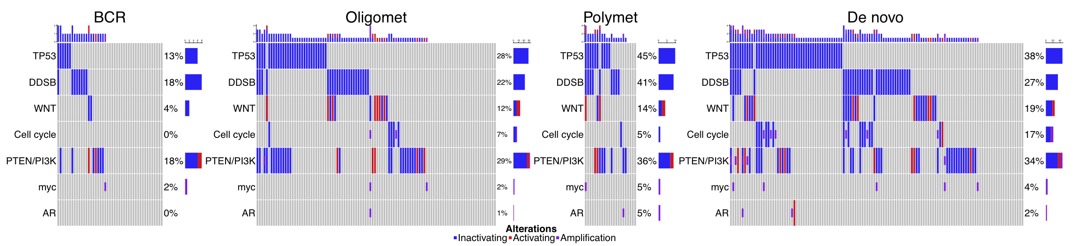
Future Directions: Can we Develop Biological Definitions of Disease Volume?
Notes:
Future efforts will need to biologically understand oligometastasis. Here it can be seen there are genetic differences across the spectrum of metastasis.

Slide 46
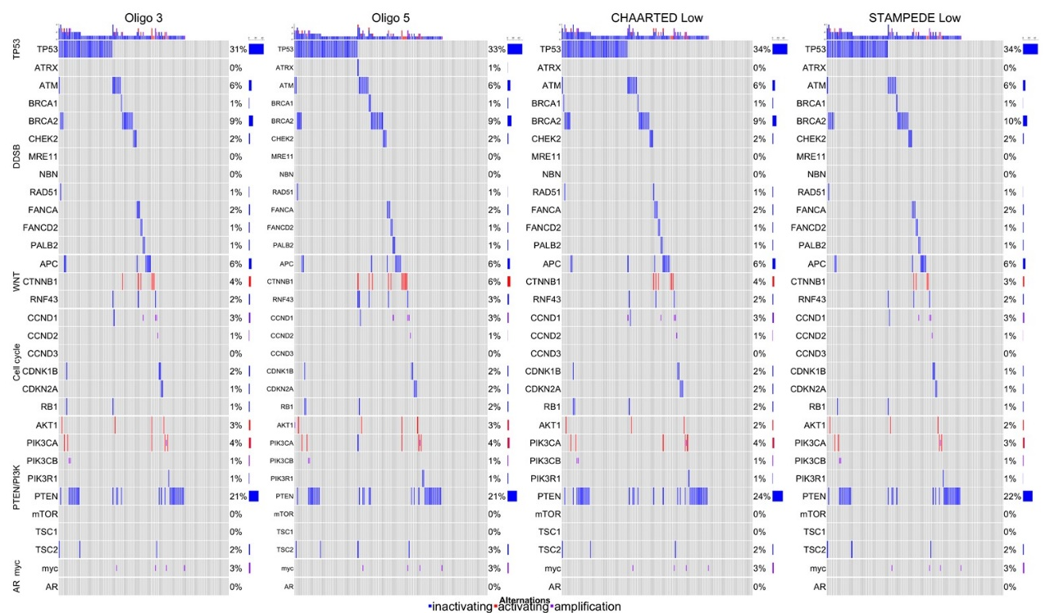
Biology has Strong Correlation with Behavior When Comparing Volume Definitions
Notes:
When comparing underlying genetic composition of patients with oligometastasis as based on several different definitions, biological alterations were similar between all groups, suggesting it’s importance is this disease entity.

Slide 47
Future Directions: Biomarkers
High-risk (HR) mutations are prognostic in metachronous omCSPC following MDT (analysis of STOMP and ORIOLE trials)
HR mutation = TP53, BRCA1/2, Rb1, ATM
HR: 1.90, p = 0.02
Deek et al., JCO 2022
Notes:
Biomarkers can provide prognostic information about treatment response. Patients treated on STOMP and ORIOLE with high-risk mutation in TP53, BRCA1/2, Rb1, and ATM had worse prognosis with MDT. These patients will need novel therapeutic strategies.

Slide 48
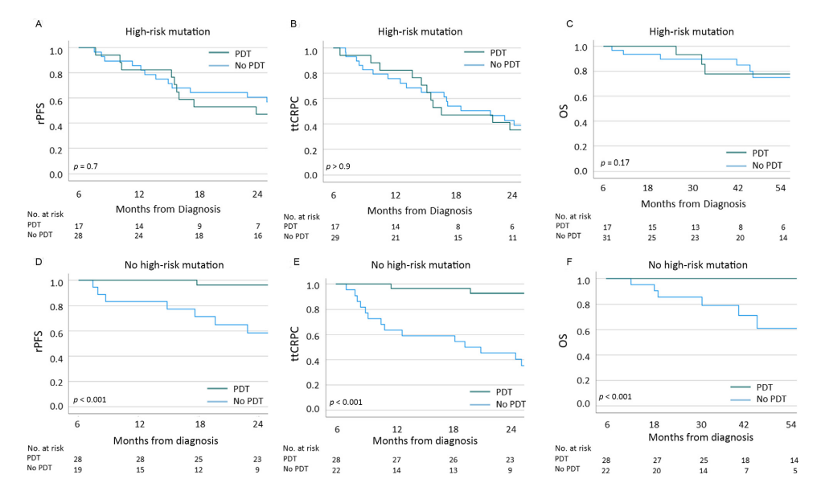
Future Directions: Biomarkers
HR mutations are predictive for treatment response for patients with low volume de novo metastatic prostate cancer treated with prostate directed therapy

Slide 49
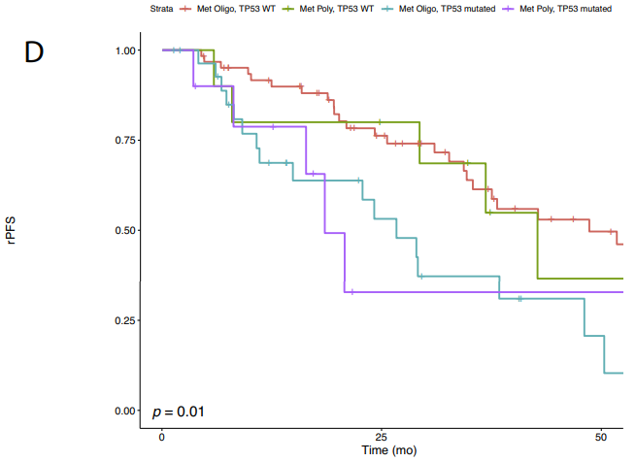
Oligometastasis: Lesion Number
Trials have typically limited to < 3-5 lesions, thought the metastatic spectrum is a continuum and patients with more lesions might benefit from local consolidative therapy
Several clinical trials including SABR COMET 10 and ARREST-2 are enrolling patients with higher volume metastatic disease to assess the benefit of MDT

Slide 50
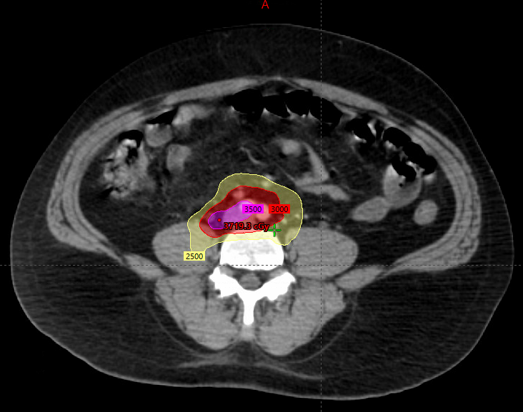
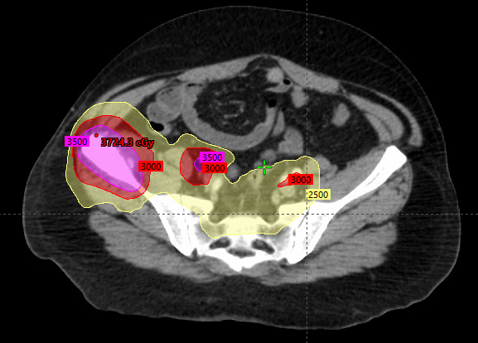
Case #6
62-year-old with mCRPC on Abiraterone with rising PSA (doubling time 1 month). On PSMA, three bone lesions noted in the pelvis, in addition to multiple pelvic and para-aortic lymph nodes
Treated with radiation using a simultaneous integrated boost technique (35 Gy to gross disease, 30 Gy to high-risk CTV, and 25 Gy to para-aortic and pelvic lymph nodal regions)
PSA declined from 4.21 ng/mL to undetectable after radiation

Slide 51
Takeaway Points
Inappropriately selected patients, local therapies are effective in metastatic disease and associated with mild toxicity profiles
Different paradigms can be used based on disease status
Accruing trials will continue to provide insight

Slide 52
References
1. Palma DA, Olson R, Harrow S, et al. Stereotactic ablative radiotherapy versus standard of care palliative treatment in patients with oligometastatic cancers (SABR-COMET): a randomised, phase 2, open-label trial. Lancet. May 18 2019;393(10185):2051-2058. doi:10.1016/S0140-6736(18)32487-5
2. Tsai CJ, Yang JT, Shaverdian N, et al. Standard-of-care systemic therapy with or without stereotactic body radiotherapy in patients with oligoprogressive breast cancer or non-small-cell lung cancer (Consolidative Use of Radiotherapy to Block [CURB] oligoprogression): an open-label, randomised, controlled, phase 2 study. Lancet. Jan 13 2024;403(10422):171-182. doi:10.1016/S0140-6736(23)01857-3
3. Francolini G, Allegra AG, Detti B, et al. Stereotactic Body Radiation Therapy and Abiraterone Acetate for Patients Affected by Oligometastatic Castrate-Resistant Prostate Cancer: A Randomized Phase II Trial (ARTO). J Clin Oncol. Dec 20 2023;41(36):5561-5568. doi:10.1200/JCO.23.00985
4. Peng P, Gong J, Zhang Y, et al. EGFR-TKIs plus stereotactic body radiation therapy (SBRT) for stage IV Non-small cell lung cancer (NSCLC): A prospective, multicenter, randomized, controlled phase II study. Radiother Oncol. Jul 2023;184:109681. doi:10.1016/j.radonc.2023.109681
5. Tang C, Sherry AD, Haymaker C, et al. Addition of Metastasis-Directed Therapy to Intermittent Hormone Therapy for Oligometastatic Prostate Cancer: The EXTEND Phase 2 Randomized Clinical Trial. JAMA Oncol. Jun 1 2023;9(6):825-834. doi:10.1001/jamaoncol.2023.0161

Slide 53
References
6. Deek MP, Van der Eecken K, Sutera P, et al. Long-Term Outcomes and Genetic Predictors of Response to Metastasis-Directed Therapy Versus Observation in Oligometastatic Prostate Cancer: Analysis of STOMP and ORIOLE Trials. J Clin Oncol. Oct 10 2022;40(29):3377-3382. doi:10.1200/JCO.22.00644
7. Wang XS, Bai YF, Verma V, et al. Randomized Trial of First-Line Tyrosine Kinase Inhibitor With or Without Radiotherapy for Synchronous Oligometastatic EGFR-Mutated Non-Small Cell Lung Cancer. J Natl Cancer Inst. Jun 8 2023;115(6):742-748. doi:10.1093/jnci/djac015
8. Gomez DR, Tang C, Zhang J, et al. Local Consolidative Therapy Vs. Maintenance Therapy or Observation for Patients With Oligometastatic Non-Small-Cell Lung Cancer: Long-Term Results of a Multi-Institutional, Phase II, Randomized Study. J Clin Oncol. Jun 20 2019;37(18):1558-1565. doi:10.1200/JCO.19.00201
9. Iyengar P, Wardak Z, Gerber DE, et al. Consolidative Radiotherapy for Limited Metastatic Non-Small-Cell Lung Cancer: A Phase 2 Randomized Clinical Trial. JAMA Oncol. Jan 11 2018;4(1):e173501. doi:10.1001/jamaoncol.2017.3501
10. Hellman S, Weichselbaum RR. Oligometastases. J Clin Oncol. Jan 1995;13(1):8-10. doi:10.1200/JCO.1995.13.1.8

