Slide 1
Instructions for Use of These Slides
The purpose of these slides is to serve as a resource that any radiation oncologist can use when speaking about the role of radiation therapy in treating skin cancers
The target audience is residents/fellows in the fields of Dermatology or Medical Oncology
However, any user is welcome to format them as needed for your target audience.
Please ask attendees to complete either the pre-test or post-test so that we can assess the effectiveness of the slides. If you make significant changes to the content of the slides for your presentation, we prefer that you use the pre-test only.
Pre-test link: https://is.gd/skin_pre1
Post-test link: https://is.gd/skin_post1
Primary Author(s): Malcolm Mattes
Peer Reviewer(s): Ashley Albert, Sabin Motwani, J. Ben Wilkinson, Anesa Ahamad, Caleb Dulaney, Benjamin Farnia, Aryavarta Kumar, Christopher Barker
Additional Support: The ASTRO communications committee and ARRO communications subcommittee
Last updated in April 2020– newer data may impact the accuracy of the content of these slides

Slide 2
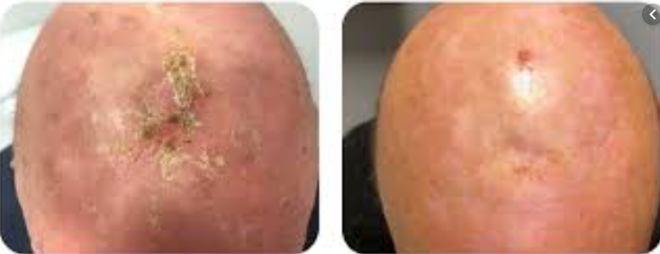
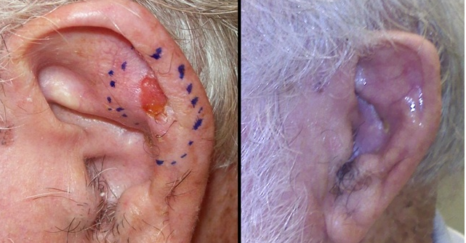
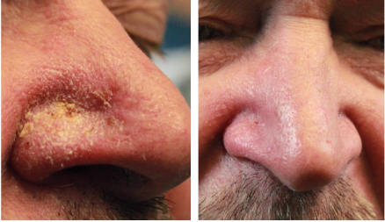
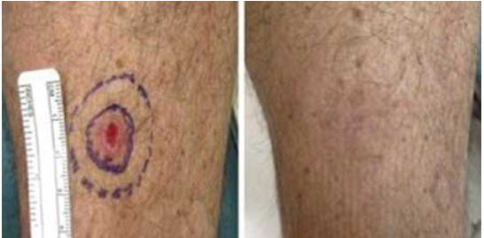
Radiation Therapy as a Component of Multidisciplinary Skin Cancer Management

Slide 3
Learning Objectives
Understand basic principles of radiation therapy and the modalities used to deliver it for skin cancer
Discuss indications for definitive and adjuvant radiation therapy in the management of keratinocyte skin cancer
Understand expected skin toxicity from radiation and its management
Discuss the role of radiation therapy in the management of other cutaneous conditions

Slide 4
Background Information

Slide 5
Terminology
RT is used to treat cancer in the following ways:
Definitive RT is used instead of surgery as the primary curative treatment modality for the primary tumor and/or regional lymph nodes
Adjuvant RT is used after definitive surgery in patients at high risk of recurrence of their primary tumor and/or regional lymph nodes
Neoadjuvant RT is used before definitive surgery to downstage and enable a complete surgical resection
Palliative RT is used in metastatic patients for symptom relief
Each of these forms of radiation may be applicable to patients with skin cancer

Slide 6
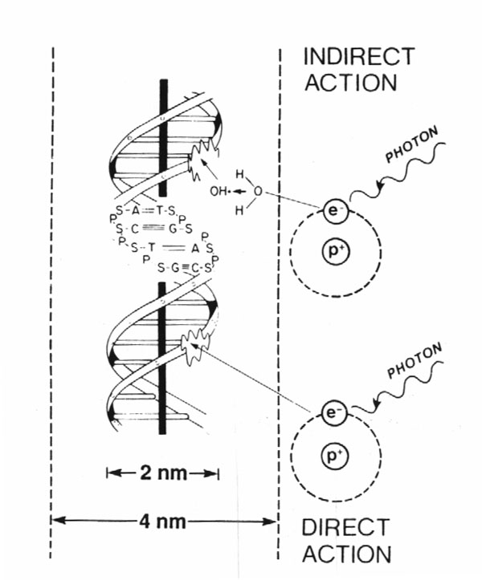
How Does Radiation Work?
80%
X-rays interact with water
radiolysis
free radicals
bind to and damages DNA
mitotic catastrophe
cell death
20%
Cancer cells are more susceptible to RT due to impaired DNA repair pathways

Slide 7
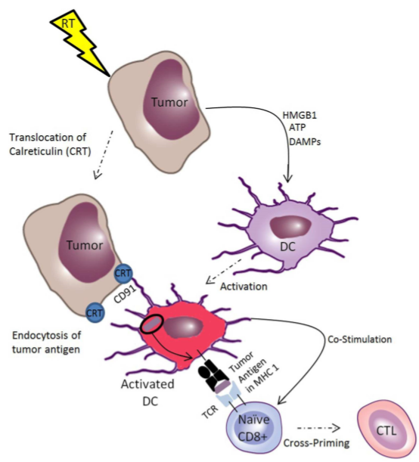
Radiation May Also Help Promote an Immune Response
Relevant to advanced melanoma and SCC, which are commonly treated with immune checkpoint inhibitors

Slide 8
Radiation Dosing
Gray (Gy) is the unit of RT dose
1 Gy = 100 centiGray (cGy)
The dose from 1 cGy roughly equals 1 CT scan
Dose prescription depends on:
Goal of treatment (curative > palliative)
Amount of disease (gross > microscopic)
RT sensitivity of tumor (melanoma > SqCC or BCC)
RT sensitivity of surrounding normal tissue

Slide 9
The Total Dose is Delivered in a Series of Daily Fractions
The biological effectiveness (or potency) of a RT regimen depends on both total dose and dose/fraction
Fractionation allows for DNA repair in normal tissue
Common prescriptions of definitive RT for keratinocyte carcinomas:
60-70 Gy in 30-35 fractions of 2 Gy
55 Gy in 20 fractions of 2.75 Gy
50 Gy in 15 fractions of 3.33 Gy
30 Gy in in 5 fractions of 6 Gy
Lower dose/fraction → less long-term toxicity
Especially important in areas with very thin dermis (like the eyelid) or for larger field size
Pts typically treated 2-5 days/week (skin brachytherapy 2/week) 30-45 min/visit
Notes:
Need to fix formatting on the “30-45 min visit”

Slide 10
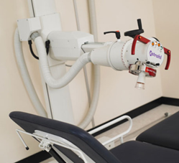
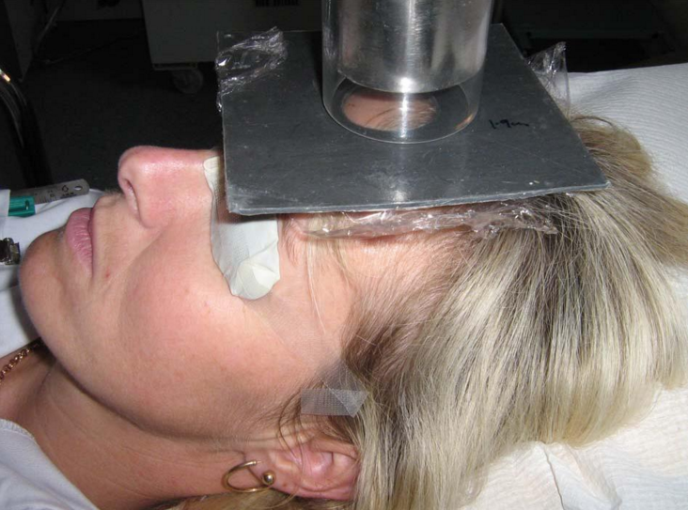
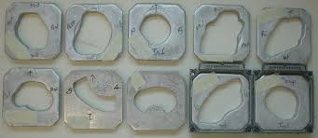
Methods of Radiation Delivery For Skin Cancer
Superficial or Orthovoltage Units
deliver low energy
X-rays
Linear Accelerators deliver electrons or high energy X-rays

Slide 11
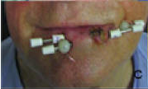
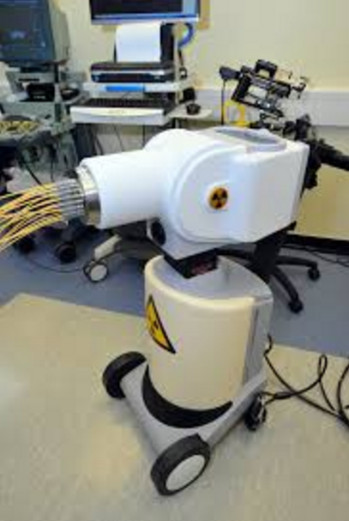
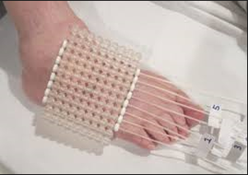
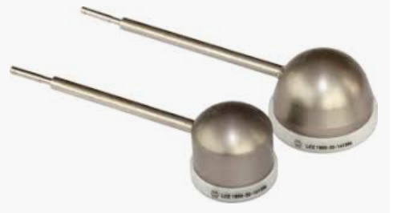
Methods of Radiation Delivery For Skin Cancer
Brachytherapy uses a radioactive source to deliver gamma rays
Notes:
Different types of applicators for varying tumor sizes and locations

Slide 12
Orthovoltage X-Rays vs. Electrons
Both are comparably effective for most superficial skin cancers (Locke et al)
Electrons are more commonly used since generated by a standard Linac found in essentially all US radiation oncology departments
Superficial or orthovoltage X-ray machines are not as widely available
The physical properties of the orthovoltage “dose distribution” enables slightly tighter margins around a tumor, however:
Not appropriate if tumor thickness >1cm ($↑$ skin dose)
Not appropriate if bone invasion ($↑$ absorption)
Delivers more dose to cartilage and bone

Slide 13
Potential Indications to Use Brachytherapy
When protracted daily fractionation is inconvenient for the patient
When the tumor has a more convex/irregular surface contour
Per institutional expertise

Slide 14
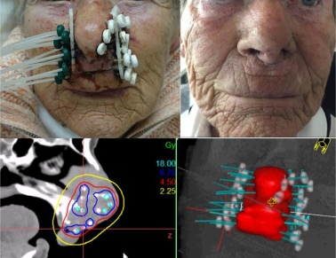
Examples of Brachytherapy
Interstitial brachytherapy may be useful for periorofacial tumors
Interstitial brachytherapy to treat a SCC of the columella

Slide 15
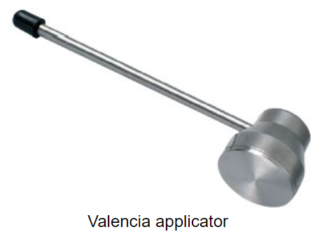
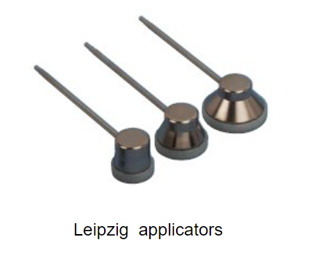
Examples of Brachytherapy
Surface applicators may be useful for small, superficial tumors on a flat surface

Slide 16
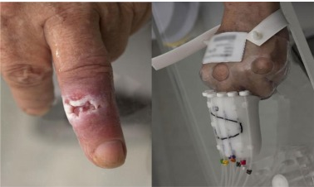
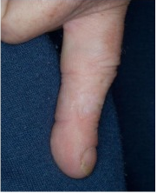
Examples of Brachytherapy
Surface molds may be useful for superficial tumors <4mm thickness on curved surfaces like the shin or hand

Slide 17
Cutaneous BCC and SCC Management

Slide 18
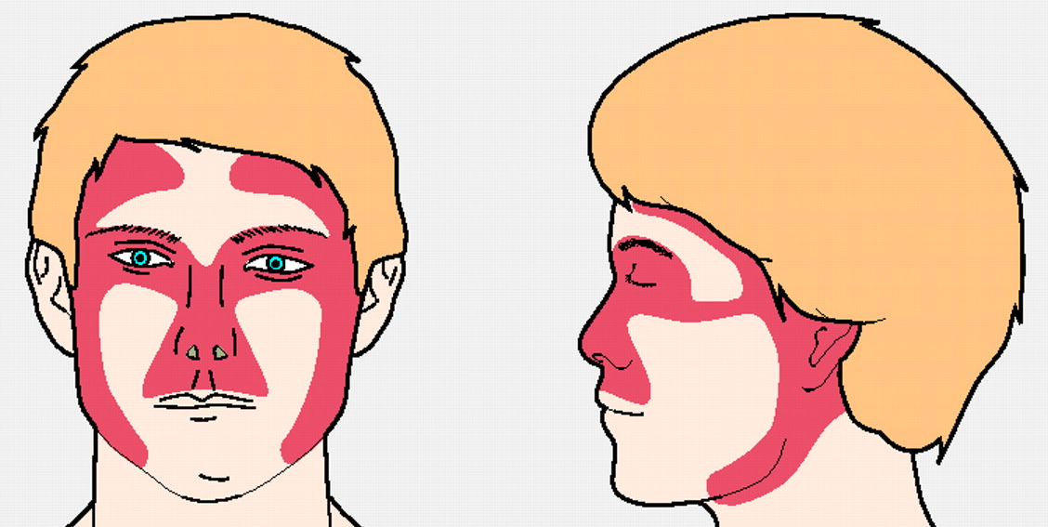
Risk Stratification Based on Tumor Location
Areas L (low), M (medium), and H (high) correlate with recurrence risk after definitive treatment
Area H includes the mid-face where the embryonic fusion planes lie (easier for a tumor to penetrate)

Slide 19
NCCN High Risk Features for any Keratinocyte Skin Cancer
Location/size:
Area L > 20mm
Area M > 10mm
Area H (any size)
Poorly defined borders
Recurrent tumor (vs. primary)
Immunosuppression
Site of Prior RT
Perineural involvement

Slide 20
Additional High-Risk Features for Recurrence for BCC
Aggressive growth pattern
Having mixed infiltrative, micronodular, morpheaform, basosquamous, sclerosing, or carcinosarcomatous differentiation

Slide 21
Additional High-Risk Features for Recurrence for SCC
Site of chronic inflammatory process
Rapid tumor growth
Neurologic symptoms
Poorly differentiated
Adenoid (acantholytic), adenosquamous(showing mucin production), desmoplastic, or metaplastic (carcinosarcomatous) subtypes
Depth of invasion > 6mm or into SubQ fat
Lymphatic or vascular involvement

Slide 22
Management of Keratinocyte Skin Cancers
Surgery is often most effective and efficient
However, consideration of function, cosmesis and patient preference may lead to choosing RT.
Shared decision-making between patient and providers is optimal
Cosmetic benefits of RT are most significant for tumors on or around the lips, nose, ears and eyelids.

Slide 23
Factors That May Favor Definitive RT Over Surgery
Older patients (less risk of late side effects)
Medically inoperable or debilitated patient
Larger (>5mm) central face tumor
especially eyelids, tip/ala of the nose, lips
Larger (>5mm) eyelid tumors where negative margins are not possible
Larger tumor of the ear, forehead, or scalp
Upper lip tumors
Notes:
Contrary to early reports that involvement of bone or cartilage is a contraindication to RT, excellent control rates with good cosmesis, function preservation, & rare complications are achieved with modern techniques & equipment.

Slide 24
Factors Favoring Definitive Surgery Over RT
Prior RT to an involved area
Genetic conditions predisposing to skin cancer
Nevoid basal cell carcinoma (Gorlin) syndrome, xeroderma pigmentosum, ataxia telangiectasia, Li-Fraumeni syndrome
Conditions that increase risk of RT side effects
connective tissue diseases like scleroderma
Tumors of trunk and extremities, including dorsum of hand, bony prominences, belt line, below knees/ elbows
Larger/multifocal/deep tumors may have a better cure rate with surgery, though at the expense of functional/cosmetic impairment
Young Age
Notes:
- Areas subjected to greater trauma & tension are more prone to breakdown & ulceration due to atrophy & poor vascularity of irradiated tissue.
In basal cell nevus syndrome, RT may induce numerous skin cancers.
While no specific age is recommended for surgery, pts who are younger have been recommended surgery over RT due to cumulative risk of secondary malignancies over lifetime

Slide 25
Comparing Outcomes of Treatment Modalities
Summary of Reported Studies | Low Risk Tumors Local Control | High Risk Tumors Local Control
Surgical Excision with Post-Operative Margin Assessment | 90-95% | 83-88%
Mohs Micrographic Surgery | 99% | 90-94%
Radiation Therapy | 90-96% | 80-88%

Slide 26
Results of Treatment
Randomized evidence comparing RT to surgery for BCC of the face favors surgery in terms of both cosmesis and local control (Avril et al 1997, Petit et al 2000)
However, nuances in patient selection may favor RT in some cases
A more recent matched-pair cohort analysis of 369 patients (Patel et al 2017) treated with electron brachytherapy vs. Mohs showed 3Y-LC rates of 99-100% in both groups
Meta analysis (Drucker et al. 2018) of 40 RCTs show surgical treatments and external-beam radiation have low recurrence rates for the treatment of low-risk BCC
Locally advanced tumors (i.e. those involving cartilage, bone, nerve and/or muscle) have lower cure rates (50-80%)

Slide 27
Radiation Target Volume
Typically covers entire tumor (or tumor bed) plus a 1-2 cm margin radially and 0.5-1cm in depth
May consider tighter margins if adjacent to critical normal structures
May consider more generous margins to cover a larger area of potential microscopic extension
Larger tumor (>2cm), high grade tumor, recurrent tumor, tumor with indistinct borders, sclerosing BCC histology, location along embryonic fusion planes

Slide 28
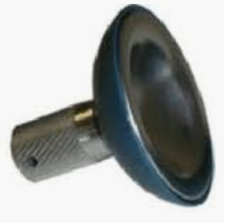
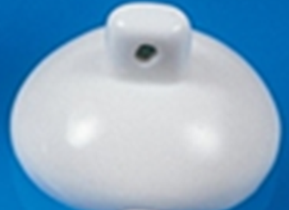
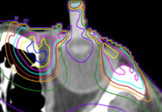
Special Scenarios: The Eye
Areas outside of the tumor volume to shield/spare:
Lacrimal gland, to avoid xeropthalmia and keratoconjunctivitis
Lacrimal duct to avoid stricture and epiphora
The uninvolved eyelid to avoid ectropia or epilation of the eyelashes
A tungsten eye shield can protect the superficial structures of the eye and lens
Topical anesthetic facilitates shield placement
Antibiotic ointment after removal
Alternatively, can rotate the lens and cornea out of the beam by having the patient stare away from the beam during Tx
Brachytherapy can offer unique dosimetric advantages when treating periorbital, perioral, and nasal cutaneous targets
The above complications often can be treated with minor surgical procedures

Slide 29
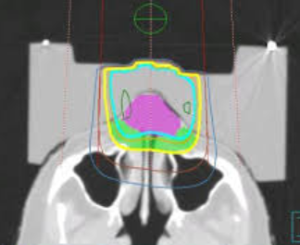
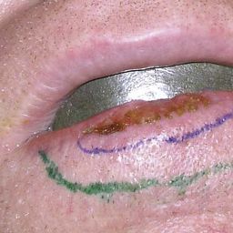
Special Scenarios
Nose
Sloping surface → may use tissue equivalent material on outside to ensure a flat surface and homogeneous dose
Lead strips coated with either wax or dental acrylic placed directly in the nose to shield the nasal septum and canal
Brachytherapy can also be used to treat these tumors instead of external beam radiotherapy
Mouth
Similar shields are placed under the lip to protect the gingiva and oral mucosa.
Brachytherapy can also be used to treat these tumors instead of external beam radiotherapy

Slide 30
Special Scenarios
Ear
A shield can be used behind the ear to treat auricle lesions
To minimize the irregular shape, may try to flatten the ear or put water in the concha and external auditory canal
Elderly Patients
Brachytherapy may be preferred if patient has limited mobility, and positioning for daily external beam RT may be challenging

Slide 31
Adjuvant RT for Basal Cell Carcinoma and Squamous Cell Carcinoma

Slide 32
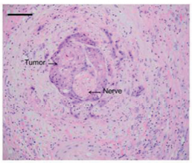
Indications for Adjuvant RT to Tumor Bed for SCC
Close or positive margins than cannot be cleared surgically
Clinically or radiographically apparent perineural invasion (PNI)
Recurrent SCC s/p prior margin-negative resection
pT3-4 (>4cm, PNI, deep invasion >6mm or beyond subQ fat, or invasion of bone, skull base, or foramen)
Desmoplastic or infiltrative tumors in chronically immunosuppressed patient
Squamous cell carcinoma with perineural invasion
Notes:
If a skin graft was used & post-op RT is required, the whole graft is covered and RT starts 6-8 weeks after graft placement

Slide 33
Indications for Adjuvant RT to Tumor Bed for BCC
Less data for adjuvant RT for BCC than SCC, since SCC is more aggressive
Usually recommended for:
Close or positive margins than cannot be cleared surgically
Recurrence s/p prior margin-negative resection
Locally advanced or neglected tumors involving bone or muscle

Slide 34
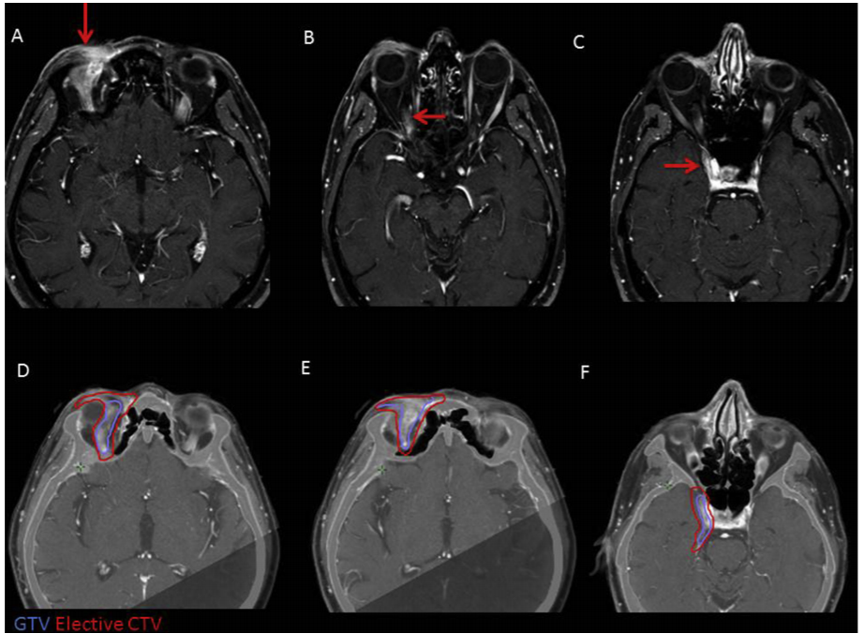
Addressing Perineural Invasion in Adjuvant RT
For clinical PNI or involvement of a named nerve of the H and N, cover nerve at risk to the base of skull
For microscopic PNI, may not need to cover as much
Right supraorbital SCC with tumor spread along the frontal branch of V1 to the superior orbital fissure (red arrow) is covered into the cavernous sinus in this case.
Notes:
Guidelines for PNI: Bakst RL, Glastonbury CM, Parvathaneni U, et al. Perineural Invasion and Perineural Tumor Spread in Head and Neck Cancer. Int J Radiat Oncol Biol Phys. 2019 Apr 1;103(5):1109-1124.

Slide 35
Management of Positive Lymph Nodes
If operable → regional LND
Adjuvant RT for multiple involved LNs or extranodal extension
If inoperable → definitive RT
Minimal evidence for concurrent chemotherapy
Regional nodes are generally not treated electively in node-negative patients with high-risk primary tumors
May consider elective nodal RT if already treating tumor bed, and target volume overlaps much of draining lymphatics
Notes:
The speaker may choose to say a few words on what nodal volumes should be include, how to decide the extent of your nodal volumes, and lymphedema associated with nodal RT. More information on these topics was not included because the authors felt it was too detailed for this talk.

Slide 36
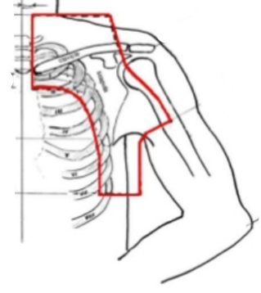
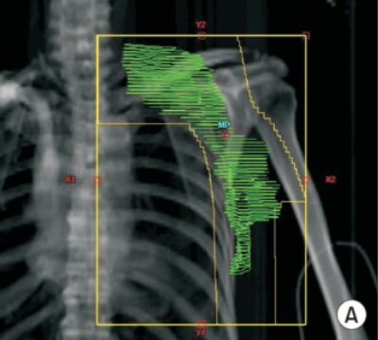
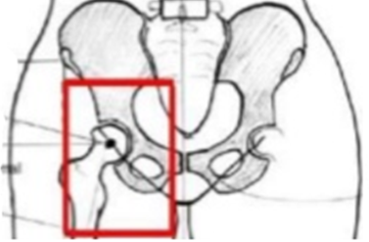
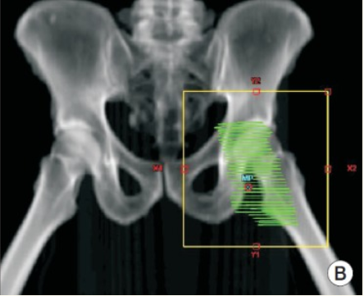
Nodal Regions

Slide 37
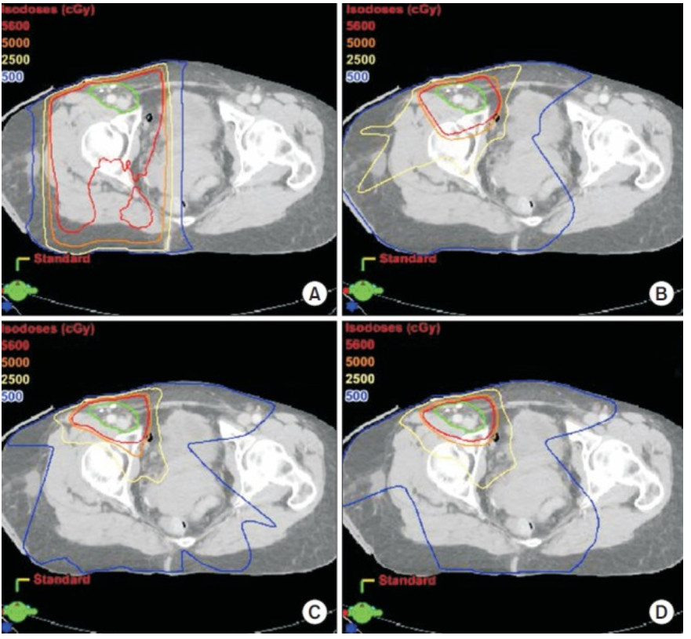
Nodal RT Techniques
3-D CRT
AP/PA
VMAT
Recent advancements in radiation techniques provide better sparing of normal structures.
IMRT
Notes:
Wide availability of these techniques.

Slide 38
Radiotherapy Toxicity

Slide 39
Radiation Toxicity
Depends on:
Site of the body being irradiated
Total dose and dose/fraction
Technique of radiation delivery
Classified as:
Acute effects – within days or weeks, in tissues with rapid turnover
Common, easier to treat
Late effects – after months or years, primarily in slowly proliferating tissues
Less common, harder to treat
Usually what limits our dose prescription

Slide 40
Acute Skin Toxicity from RT
Erythema
Earliest noticeable radiation effect
Dry Desquamation (peeling)
Occurs at intermediate dose levels
Moist desquamation
Expected at doses required to control skin cancers
Due to death of basal cells in the epidermis; new cell proliferation does not keep up with cell loss → exposure of the dermis + serous oozing
Epidermal re-growth occurs from the periphery and from the more resistant epithelial cells around hair follicles (this new skin is thin and atrophic so take extra care to prevent injury)
Healing occurs within 3-5 weeks following Tx, but in severe cases symptoms may last months

Slide 41
Management of Acute Skin Toxicity
Prevention:
Avoid friction/trauma (e.g. shaving, scratching or sun exposure)
Avoid cosmetics or harsh cleansers (especially if contain alcohol)
For erythema or dry desquamation:
Emollients (lotions, creams, or ointments)
Gentle cleansing with mild soap and patted dry
Topical corticosteroids (controversial)
For moist desquamation:
Dilute H₂O₂ or 1% aqueous gentian violet to dry the lesion and prevent infection
Silver sulfadiazine 1% cream promotes healing.
For minimally exudative wounds → Hydrogel or Hydrocolloid dressing
For highly exudative wounds → burn pads, alginate, or foam dressing
For infected wounds → ion silver pads or powder, topical ABx

Slide 42
Other Acute Skin Toxicities
Hyperpigmentation due to melanocyte stimulation
Usually resolves within 3 months but can become permanent in some patients
Temporary alopecia occurs when hair follicles shed and cells move into resting phase of cell cycle.
Usually hair grows back in 3-5 months
Radiation Recall is an acute inflammatory response in a previously irradiated field following administration of a systemic drug (anthracyclines, taxanes, alkylating agents, anti-metabolites, gemcitabine, hormonal therapies, immunotherapy, antimicrobials, etc.)
May occur days to years after RT
Onset is days to 2 months after drug administration

Slide 43
Long Term Cosmetic Outcomes are Often Very Good
However, like any cancer treatment modality, radiation can cause long term toxicity too.

Slide 44
Potential Long Term Skin Toxicity from Definitive RT
Telangiectasia formation due to capillaries being reduced in number and dilated
Destruction of melanocytes, hair follicles, and sebaceous/sweat glands in the RT field may → permanent hypopigmentation or alopecia
Chronic dermatitis can develop months-years after RT

Slide 45
Other Potential Late Toxicity from Definitive RT
Radiation necrosis of the skin
Can occur months to years after RT
Due to poor vascularity and atrophy, and usually precipitated by trauma
3% incidence using < 4 Gy/fraction
Chondronecrosis or osteonecrosis
Currently very uncommon using modern techniques and equipment, even if tumor involves cartilage or bone
RT-induced malignancy (in treated field)
Typically occur 5+ years after RT
May behave more aggressively

Slide 46
Radiation Therapy for Other Malignant and Benign Cutaneous Conditions

Slide 47
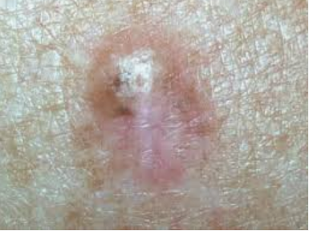
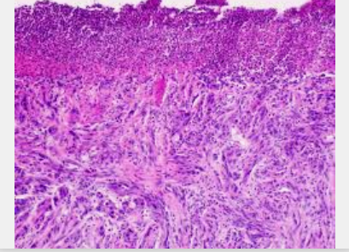
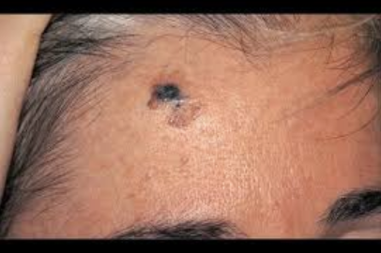
Malignant Melanoma
Surgery is the primary treatment modality
Adjuvant primary tumor bed RT may be considered for desmoplastic melanoma with high-risk features:
H and N location, extensive neurotropism
pure desmoplastic melanoma histology
close margins that cannot be re-resected
prior local recurrence
Notes:
Images are of desmoplastic melanoma

Slide 48
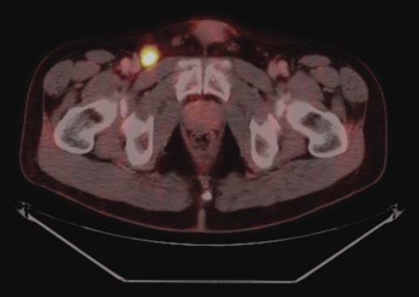
Malignant Melanoma
Adjuvant nodal bed RT may be considered for high-risk nodal features:
Extranodal extension
> 1 parotid node
> 2 cervical or axillary nodes
> 3 inguinofemoral nodes
> 3cm cervical or axillary node
> 4cm inguinofemoral node
prior nodal recurrence

Slide 49
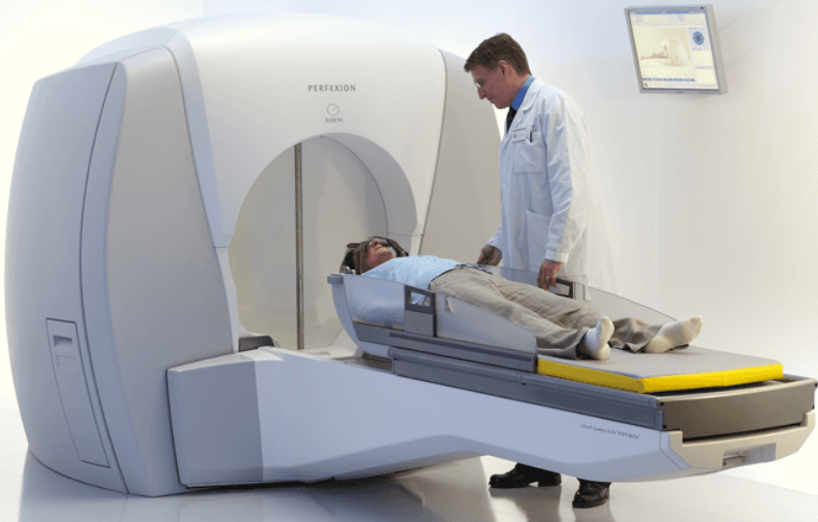
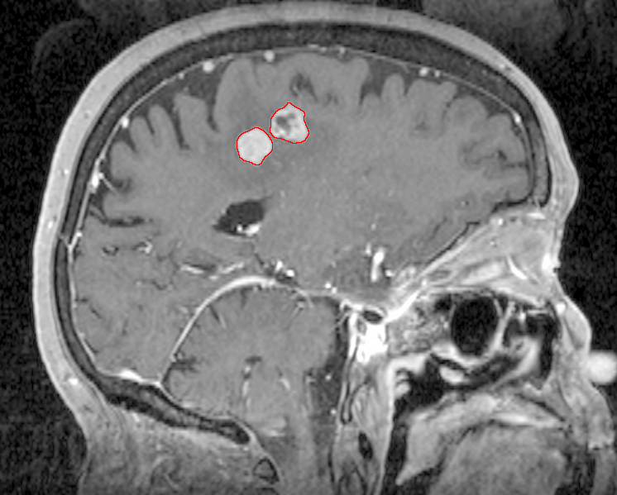
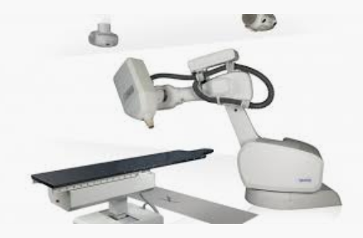
Other Indications for RT for Melanoma
Palliative RT is commonly used for brain or visceral metastasis
Radiosurgery (high dose/fraction) is preferred
Definitive RT to the primary tumor and/or involved nodes is rarely used
May be indicated if patient medically inoperable
SBRT for oligometastatic disease
Immunotherapy does not need to be held during RT, but BRAF and MEK inhibitors do

Slide 50
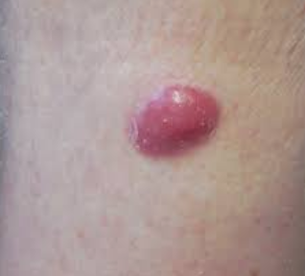
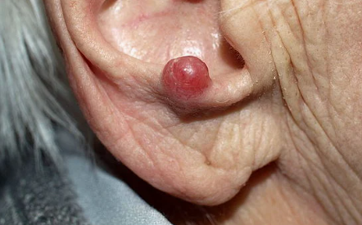
Merkel Cell Carcinoma
Surgery is the primary treatment modality
Usually WLE with 1-2cm margins
If SLN or FNA is pathologically positive → full regional LND and/or RT

Slide 51
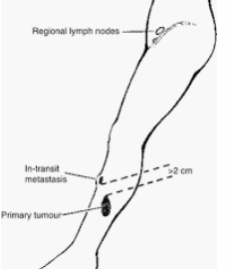
Adjuvant RT for Merkel Cell Carcinoma
25-30% of patients have local recurrence after surgery alone → Most patients get adjuvant RT (50-66Gy)
Observation without RT may be considered for tumors < 1cm without any high-risk features
Target volume includes larger margins (3-5cm) to cover in-transit metastases

Slide 52
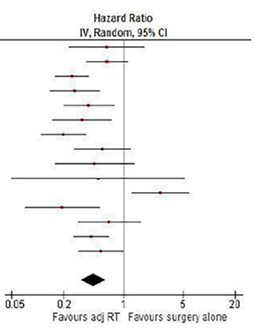
Data Supporting Adjuvant RT for
Merkel Cell Carcinoma
Petrelli et al (2019)
Meta-Analysis of 17,179 patients across 29 studies
RT → $↑$DFS (HR 0.45)
RT → $↑$OS (HR 0.81)

Slide 53
Keloids
Adjuvant RT given shortly after surgical excision substantially lowers recurrence rate

Slide 54
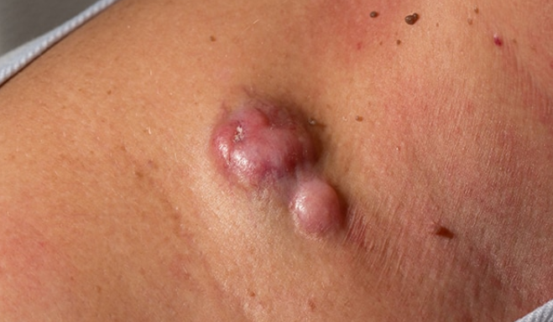
Dermatofibrosarcoma Protuberans
Adjuvant RT indicated if (+) margins
Definitive RT only if unresectable

Slide 55
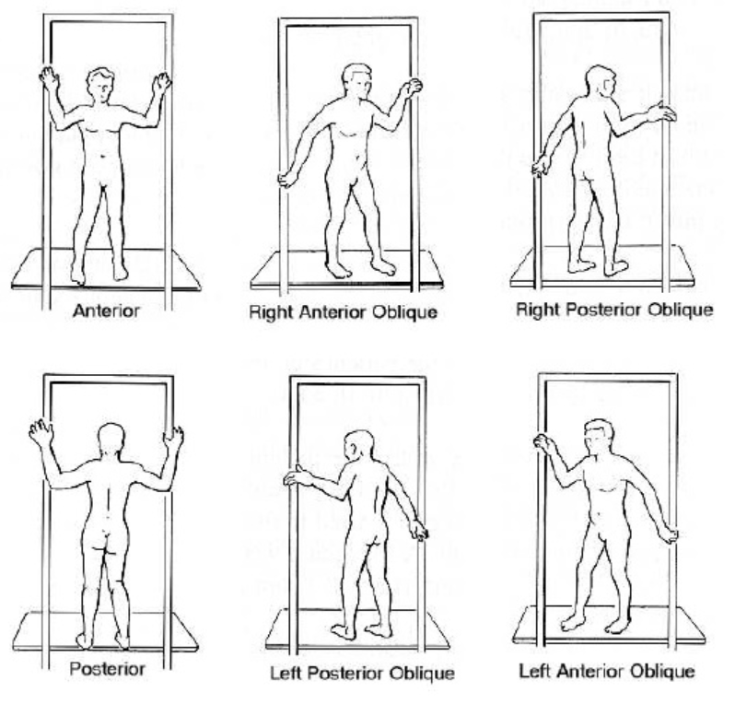
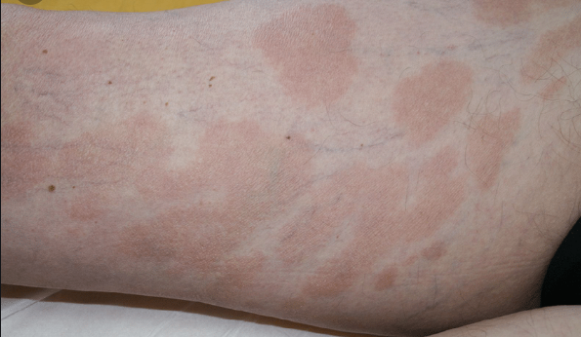
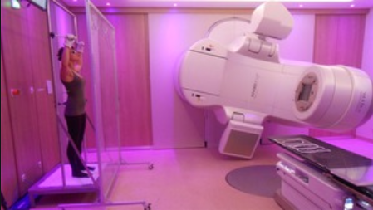
Cutaneous T-Cell Lymphoma or Mycosis Fungoides
Total Skin Electron Beam Therapy

Slide 56
Take-Home Points
Though surgery is the mainstay of treatment for most cutaneous malignancies, RT has an integral role in the definitive and adjuvant management for a variety of patients and tumor types.
The expected cosmetic benefits of definitive RT for keratinocyte carcinomas is likely to be most significant for larger tumors on or around the lips, nose, ears and eyelids.
Multidisciplinary consultations and shared decision-making are appropriate for patients with keratinocyte carcinomas of borderline operability, or when surgery would render a relatively poor cosmetic outcome.
Post-op RT for cutaneous SCC is recommended for T3-4 stage, gross PNI, close or positive margins, and recurrence after a prior margin-negative resection.

Slide 57
References
NCCN: https://www.nccn.org/professionals/physician_gls/default.aspx
UpToDate: https://www.uptodate.com/home
Albert A, Knoll MA, Conti JA, Zbar RIS. Non-Melanoma Skin Cancers in the Older Patient. Curr Oncol Rep. 2019 Jul 29;21(9):79.
Avril MF, Auperin A, Margulis A, Gerbaulet A, Duvillard P, Benhamou E, Guillaume JC, Chalon R, Petit JY, Sancho-Garnier H, Prade M, Bouzy J, Chassagne D. Basal cell carcinoma of the face: surgery or radiotherapy? Results of a randomized study. Br J Cancer. 1997;76(1):100-6.
Bakst RL, Glastonbury CM, Parvathaneni U, et al. Perineural Invasion and Perineural Tumor Spread in Head and Neck Cancer. Int J Radiat Oncol Biol Phys. 2019 Apr 1;103(5):1109-1124.
Baxter J, Patel A, Varma S. Facial basal cell carcinoma. BMJ. 2012 Aug 21;345:e5342.
Guinot JL, Rembielak A, Perez-Calatayud J,et al. GEC-ESTRO ACROP recommendations in skin brachytherapy. Radiother Oncol. 2018 Mar;126(3):377-385.
Henderson MA, Burmeister BH, Ainslie J, et al. Adjuvant lymph-node field radiotherapy versus observation only in patients with melanoma at high risk of further lymph-node field relapse after lymphadenectomy (ANZMTG 01.02/TROG 02.01): 6-year follow-up of a phase 3, randomised controlled trial. Lancet Oncol. 2015 Sep;16(9):1049-1060.

Slide 58
References
Ho C, Argáez C. Mohs Surgery for the Treatment of Skin Cancer: A Review of Guidelines [Internet]. Ottawa (ON): Canadian Agency for Drugs and Technologies in Health; 2019 Mar 20.
Kim, K, Son D, Kim J. Radiation Therapy Following Total Keloidectomy: A Retrospective Study over 11 Years. Archives of Plastic Surgery 2015;42(5):588-95
Likhacheva A, Awan M, Barker CA, et al. Definitive and Postoperative Radiation Therapy for Basal and Squamous Cell Cancers of the Skin: Executive Summary of an American Society for Radiation Oncology Clinical Practice Guideline. Pract Radiat Oncol. 2020 Jan - Feb;10(1):8-20.
Locke J, Karimpour S, Young G, Lockett MA, Perez CA.Radiotherapy for epithelial skin cancer.Int J Radiat Oncol Biol Phys. 2001 Nov 1;51(3):748-55.
Mattes MD, Zhou Y, Berry SL, Barker CA. Dosimetric comparison of axilla and groin radiotherapy techniques for high-risk and locally advanced skin cancer. Radiat Oncol J. 2016 Jun;34(2):145-55.
Patel R, Strimling R, Doggett S, Willoughby M, Miller K, Dardick L, Mafong E. Comparison of electronic brachytherapy and Mohs micrographic surgery for the treatment of early-stage non-melanoma skin cancer: a matched pair cohort study. J Contemp Brachytherapy. 2017 Aug;9(4):338-344.
Petit JY, Avril MF, Margulis A, Chassagne D, Gerbaulet A, Duvillard P, Auperin A, Rietjens M. Evaluation of cosmetic results of a randomized trial comparing surgery and radiotherapy in the treatment of basal cell carcinoma of the face. Plast Reconstr Surg. 2000 Jun;105(7):2544-51.
Petrelli F, Ghidini A, Torchio M, et al. Adjuvant radiotherapy for Merkel cell carcinoma: A systematic review and meta-analysis. Radiother Oncol. 2019 May;134:211-219.
Vatner RE, Cooper BT, Vanpouille-Box C, Demaria S, Formenti SC. Combinations of immunotherapy and radiation in cancer therapy. Front Oncol. 2014 Nov 28;4:325.

