Slide 1
Instructions for Use of These Slides
The purpose of these slides is to serve as a resource that any radiation oncologist can use when speaking about the role of radiation therapy in treating lung cancer.
The target audience is residents/fellows in the fields of pulmonology, thoracic surgery and medical oncology.
However, any user is welcome to format the slides as needed to fit your target audience.
Please ask attendees to complete either the pre-test or post-test so that we can assess the effectiveness of the slides. If you make significant changes to the content of the slides for your presentation, we prefer that you use the pre-test only. Collected data is anonymous and will potentially be used for research purposes.
Pre-test link: https://is.gd/lung_pre1 Post-test link: https://is.gd/lung_post1
Primary Author(s): Malcolm Mattes, MD
Peer Reviewer(s): Shauna Campbell, DO; Skyler Johnson, MD; Sabin B. Motwani, MD; Akshar Patel, MD; Abigail Stockham, MD; Stephen Rosenberg, MD; Mark Waddle, MD
Charles B. Simone, MD: ASTRO Lung Resource Panel
Additional Support: The ASTRO Communications Committee and ARRO Communications Subcommittee
Last updated in October 2019 – newer data may impact the accuracy of the content of these slides

Slide 2
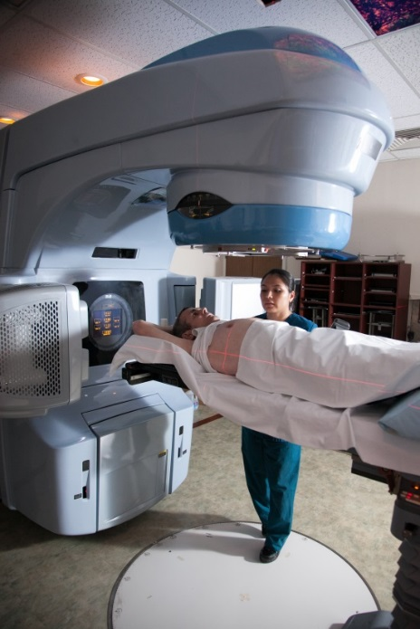
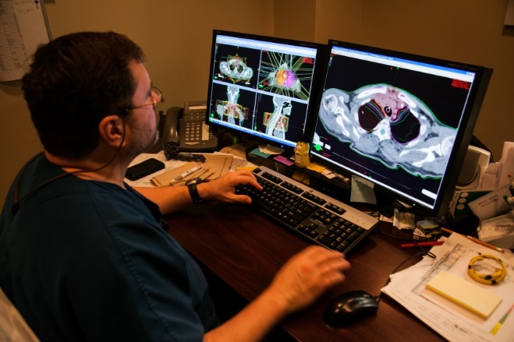
Radiation Therapy As A Component of Multidisciplinary Lung Cancer Management

Slide 3
Learning Objectives
Understand current evidence-based strategies of integrating definitive (curative-intent) radiation therapy into the care of patients with NSCLC and SCLC
Compare surgical to radiation approaches for early-stage and locally-advanced NSCLC
Understand how to diagnose and treat radiation-induced toxicity
Discuss the emerging role of consolidative radiation therapy for oligometastatic NSCLC and extensive SCLC

Slide 4
The Story of Lung Cancer
The Beginning: Prevention
Smoking cessation (combined pharmacologic and behavioral therapy is most effective)
Low-dose CT screening (age 55-74, > 30 pack-years, cessation < 15 years ago)
The Middle: Diagnosis and Treatment
Integration of multidisciplinary care provided by various oncologists
Monitoring for recurrence
Survivorship care
The End: Palliation
Early palliative care involvement
Effective symptom management
Appropriate advance care planning and use of hospice

Slide 5
Treatment Modalities
Surgery
Open vs. VATS or Robotic-assisted Approaches
Lobectomy vs. Pneumonectomy vs. Sublobar Resection
Systemic Therapy
Chemotherapy
Targeted Therapy
Immunotherapy
Radiation
External Beam Radiation Therapy
3-Dimensional Conformal Radiation Therapy (3-D CRT)
Intensity Modulated Radiation Therapy (IMRT)
Stereotactic Body Radiation Therapy (SBRT/SABR)
Proton Therapy (PT)

Slide 6
Understanding Radiotherapy Techniques for Lung Cancer

Slide 7
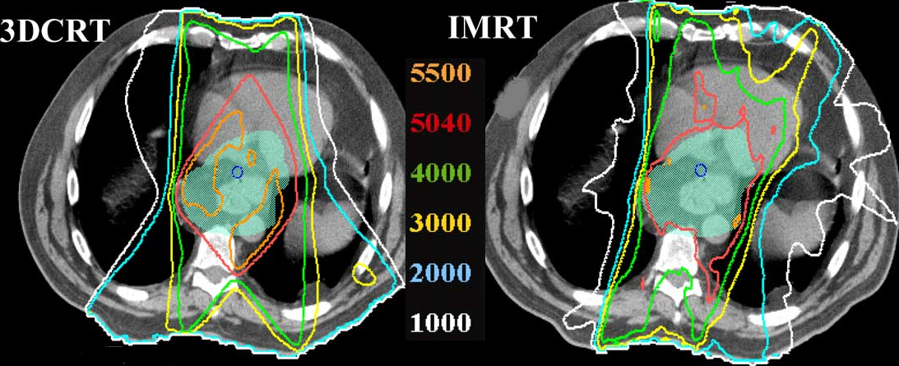
Conventional Fractionation Using 3-D CRT/IMRT
For locally advanced NSCLC or SCLC
Larger target volumes encompassing primary tumor and involved nodes
Target often in close proximity to normal structures. Decrease toxicity by:
Using lower dose/fraction → more repair of normal tissue DNA damage
Typically 1.8-2.0 Gy/fraction in 30-35 fractions, to a total dose of 60-70Gy or 1.5 Gy twice daily to 45 Gy for limited stage SCLC
Using IMRT (or proton therapy) to shape dose away from normal organs
More “conformal” than 3-D CRT

Slide 8
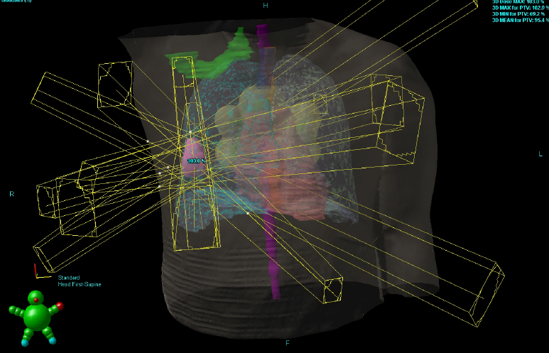
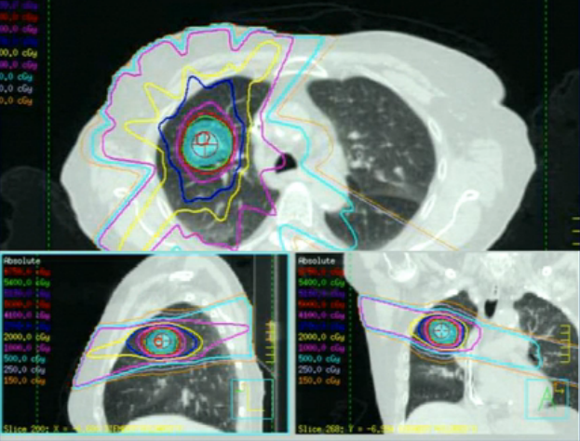
Hypofractionation Using SBRT/SABR
For early-stage NSCLC
Smaller target volume treated with highly conformal SBRT/SABR plan
Risk-adapted dosing based on tumor location
Typically 10-18Gy/fraction in 3-5 fractions (total dose 48-54 Gy)
Ideally achieve Biologically Effective Dose (BED) > 100 Gy

Slide 9
Comparing 3-D CRT/IMRT to SBRT/SABR
 | 3DCRT/IMRT | SBRT/SABR
Target Type | >1 target (e.g., primary + nodes) Any size Close proximity to (or overlapping) critical organs | Single well-defined target Small-medium size Sufficient distance from critical organs
Dose/Fraction | Low | High
# Fractions | 30-35 | 1-5
Biologically Effective Dose | 70-90 Gy | > 100 Gy
Dose Conformity | Moderate - High | Very High
Immobolization | Secure | Very Secure
Image-Guidance | Should be performed daily, especially IMRT/PT | Required Daily
5 Year Local/Lobar Control | 50-75% | 85-95%

Slide 10
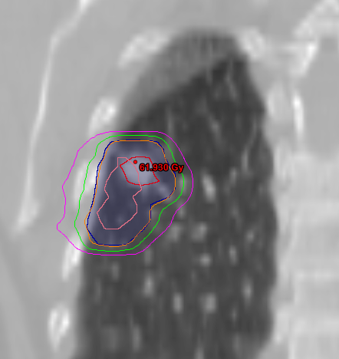
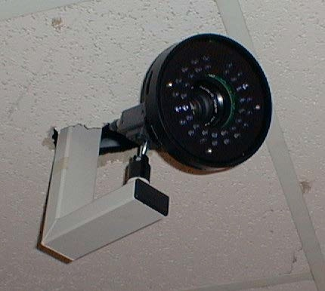
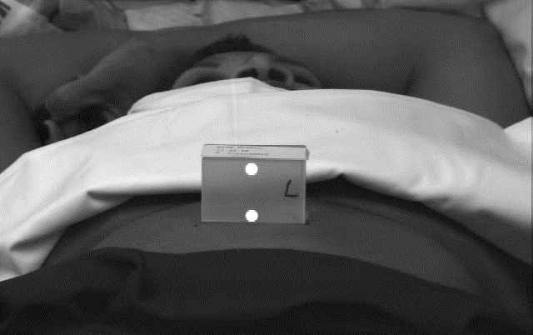
Characterizing Tumor Motion with a 4-D CT
Infrared camera tracks the motion of a reflective marker, measuring respiratory patterns and excursion
CT scan is correlated with respiratory trace
Respiratory trace divided into 8-10 respiratory “phases”
Infrared camera
Reflective respiration monitor
iGTV = envelope of respiratory motion of Gross Tumor Volume

Slide 11
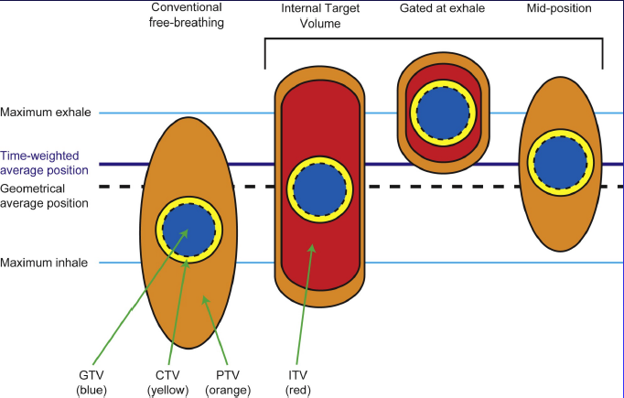
Respiratory Motion Management
Conventional (ITV-based)
Contour and treat full tumor ROM
Accelerator beam gating
Patient breathes normally; beam only on while patient is in a certain phase of the respiratory cycle
Active breathing control
Patient holds breath in a certain position; beam only on in that phase of the respiratory cycle
Dynamic tumor tracking
Patient breathes normally; tumor is tracked; beam always on and moves with tumor
Regardless of the motion management used, an additional “CTV/PTV” margin around our target is needed to ensure that we hit it.

Slide 12
Radiotherapy Toxicity

Slide 13
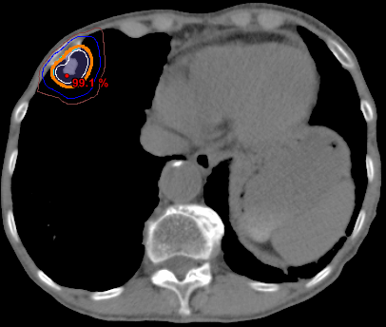
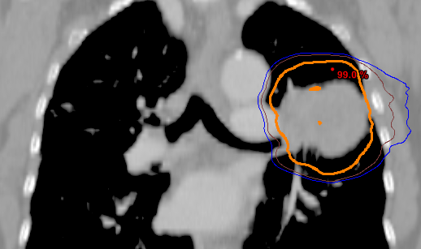
Potential SBRT Toxicity Depends on Tumor Site
Fatigue
Rib fracture, chest wall pain
Skin Erythema/fibrosis
Fatigue
Pneumonitis, atelectasis hemoptysis, fibrosis
Rib fracture, chest wall pain
Risk of toxicity can be mitigated through risk-adapted dose-fractionation

Slide 14
3-D CRT/IMRT Toxicity
Risk and severity of toxicities depends mainly on the location and size of primary tumor and involved lymph nodes, type of concurrent chemotherapy, performance status of patient and RT technique.
Acute Toxicity:
Acute esophagitis:
Starts 3-4 weeks into treatment
Distinguish from thrush and acid reflux
Treat with PPI, magic mouthwash (viscous lidocaine, Mylanta, Benadryl), analgesics ± Diflucan
Fatigue:
Treat with exercise and pulm rehab before, during and after Tx.
Look for other treatable causes (anemia, depression, infection, etc.)
Dry, nonproductive cough
Effect in the trachea and or bronchi
Skin desquamation/dermatitis

Slide 15
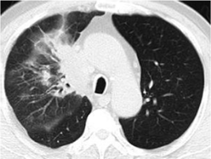
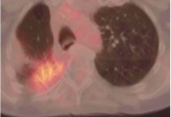
Radiation Pneumonitis
NOT an acute toxicity – a delayed/subacute toxicity
Usually develops 1-12 mo after RT (median 3-6 mo)
Radiographic pneumonitis (grade 1) is common (~66%)
Clinic symptoms (grade 2+) are less common (10-20%)
Nonproductive cough, DOE, chest pain, malaise, +/- fever
CT may show patchy alveolar ground glass or consolidative opacities
PET may show some metabolic activity
Symptoms are usually self limiting, but can be alleviated with prednisone 1 mg/kg/d (up to 60mg daily) for 2 weeks → gradual taper over 3-12 weeks
Notes:
A diagnosis of exclusion: distinguished from recurrence and infection
For minimally symptomatic patients → re-evaluate symptoms, CXR and PFTs at regular intervals (q4-6 weeks), and only initiate Tx if PFTs drop by >10%

Slide 16
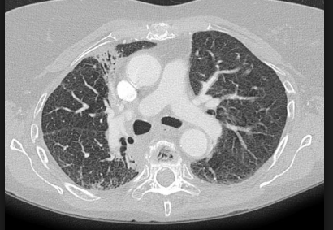
Late Radiation Toxicity
Lung Fibrosis:
Often occurs in areas of prior subacute pneumonitis and high radiation dose region.
Imaging: A visible line that correlates to isodose distribution is diagnostic
Can → major QOL impact
No treatment (? prevention)
Rib fracture (2-3%)
in high dose area
median 18mo after Tx
Esophageal Stricture (1-2%)
Can occur 3-4 years s/p RT
Treated with dilation
Radiation injury to the heart
Pericarditis, ischemia, effusions, etc.

Slide 17
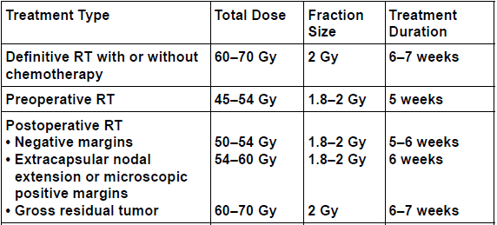
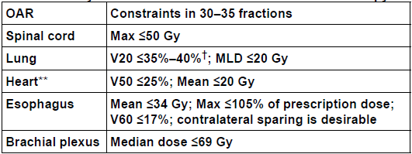
Understanding RT Dose and Risk
Taken from NCCN 1.2020
The total dose administered is just a number!
Tumor location(s) in relation to other organs is much more predictive of toxicity
Pulmonary risk ↑ for lower lobe tumors or when a long length of mediastinum is treated
If you want to understand surgical risk after neoadjuvant RT, talk to a Rad Onc!
It’s better to decide whether patient is likely to go for surgery up-front so that the RT risk is minimized

Slide 18
Management of NSCLC

Slide 19
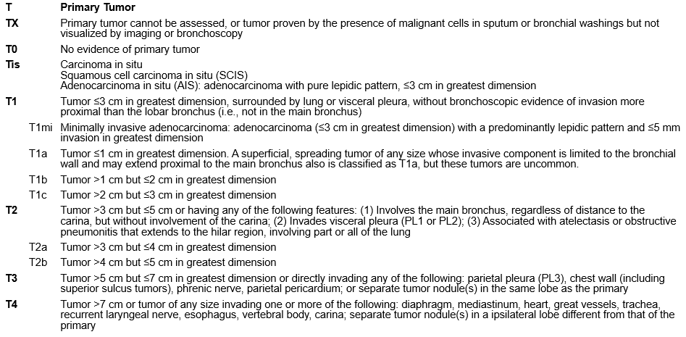
AJCC 8th Edition Staging
Notes:
To understand treatment decisions we need to understand staging

Slide 20
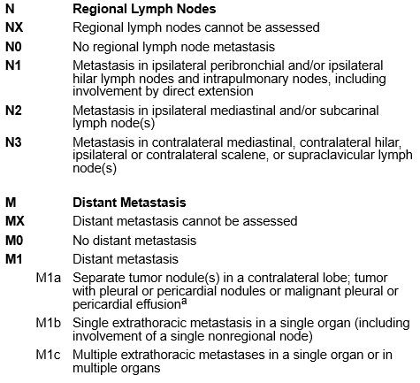
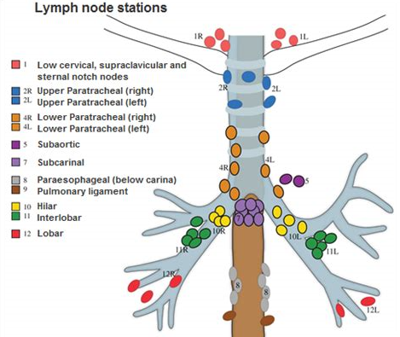
AJCC 8th Edition Staging

Slide 21
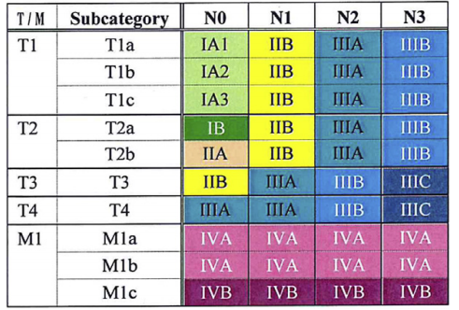
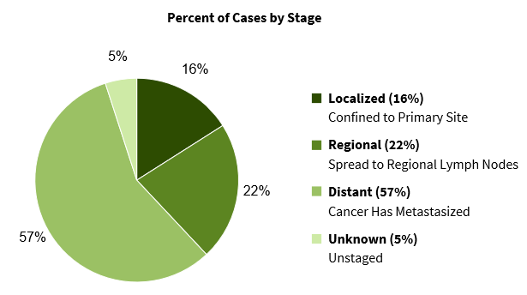
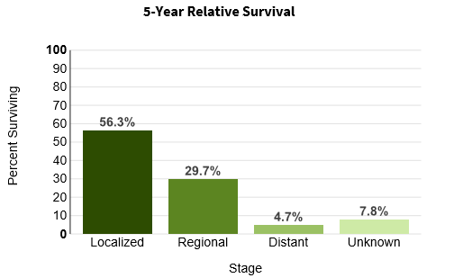
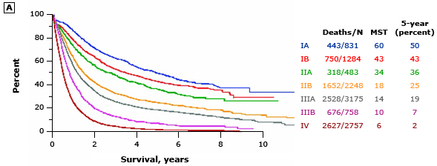
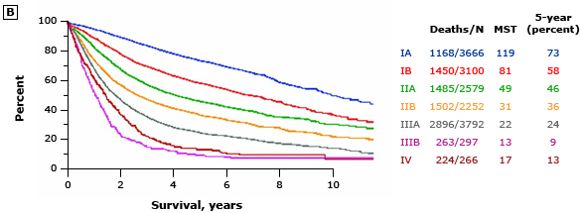
Lung Cancer Incidence and Prognosis
Notes:
Clinically staged patients do worse because of upstaging with surgery (stage migration), and use of surgery in an otherwise healthier patient population (competing morbidities).

Slide 22
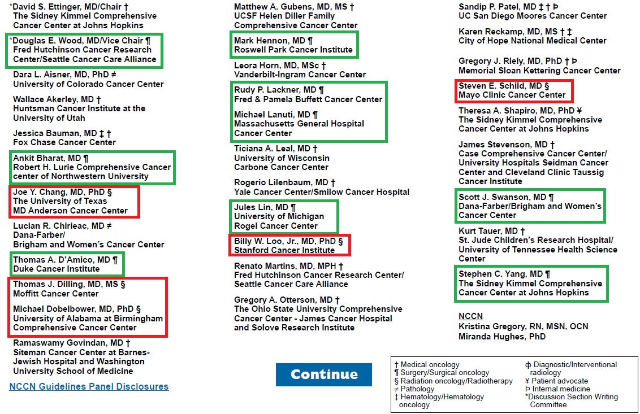
What Do NCCN Guidelines Have to Say?
Authors:
15 Med Oncs
9 Surgeons
5 Rad Oncs
Notes:
They are not perfect, but they do represent frequently updated expert consensus from multidisciplinary physicians

Slide 23
Early-Stage Node-Negative NSCLC
Surgical resection is the preferred local treatment
An anatomical resection with lobectomy or segmentectomy is preferred to wedge resection
Includes sampling of at-risk ipsilateral hilar and mediastinal LN
SBRT for patients who are medically inoperable or refuse surgery
SBRT or Hypofractionated RT for “ultra-central” tumors
No data yet supporting the addition of systemic therapy to SBRT
Other suboptimal options: RFA, cryotherapy, observation

Slide 24
Basic Principles of Surgical Selection
The definition of medically inoperable varies substantially between surgeons
PFTs that suggest a patient should tolerate surgery include:
Pre-op FEV₁ >1.8-2 L (or ≥80% predicted) if patient needs a pneumonectomy
Pre-op FEV₁ >1.2-1.5L if patient needs a lobectomy
Predicted post-op FEV₁ >800 mL (>40% predicted)
DLCO > 50-60%
Resection of tumor in a dominant area of emphysema may have less impact on post-op lung function
Patients with cardiac risk factors should have a preoperative cardiologic evaluation
Contemporary 30-day mortality rates are 1-3% for lobectomy or sublobar resection and 2-11% for pneumonectomy
Active smokers have a mildly increased risk of post-op complications

Slide 25
Outcomes of SBRT for Early Stage NSCLC
 | RTOG 0236 | RTOG 0915 | RTOG 0813
Prospective Study Type | Single Arm Phase II | Randomized Phase II | Single Arm Phase I/II
# of patients | 55 | 94 | 120
Medically Operable? | No | No | No
TNM Stage | cT1-2N0M0 | cT1-2N0M0 | cT1-2N0M0
Tumor Location | Peripheral | Peripheral | Central
RT Dose/Fx | 54Gy/3fx | 34Gy/1fx vs. 48Gy/4fx | 50-60Gy/5fx
Local Control | 93% @ 5 years | 89-93% @ 5 years | 88% @ 2 years
Overall Survival | 40% @ 5 years | 30-41%@ 5 years | 70% @ 2 years
Most recurrences are distant (~30%); most deaths are not cancer related
Toxicity using risk-adapted dosing:
Grade 3 in 10-15%, grade 4 in 3-5%, and grade 5 in < 1%

Slide 26
How Does SBRT Compare to Surgery?
No fully enrolled randomized trials
Selection bias when comparing survival numbers from non-randomized cohorts of patients are difficult to compare with surgery
Radiation patients are generally medically inoperable, or older with worse PS and often don’t undergo full mediastinal staging
Pooled Analysis of STARS and ROSEL Randomized Trials (Chang, Lancet Oncol 2015)
58 pts, operable T1-2a (<4 cm) N0 M0 NSCLC randomized to lobectomy vs. SBRT
Results: SBRT → ↑ 3Y-OS (79→95%) with no difference in RFS (~83%)
Why the difference?
Surgery has higher M&M (G3-5 toxicity (48% vs. 10%).
Grade 3+ toxicities SBRT were all Grade 3, i.e., no Grade 4 or 5
Surgery had 4% Grade 5 toxicity
Abscopal effect from RT?
Notes:
Note: Regarding the point about an abscopal effect, this is purely speculative, however, it is possible that even without immunotherapy SBRT to a primary tumor may help the immune system recognize and eradicate micrometastatic disease.

Slide 27
Hilar LN Positive (cT1-4N1M0) NSCLC
Surgical resection + LND is the preferred local treatment if patient is medically and surgically operable
All patients receive adjuvant chemotherapy
Neoadjuvant therapy may be given if surgically inoperable up-front or superior sulcus tumors
Conventional 3-D CRT or IMRT over 6 weeks with concurrent chemotherapy for patients who are inoperable or refuse surgery
For frail patients, sequential chemo and RT, or RT alone (+/- altered fractionation), are appropriate options
Proton therapy

Slide 28
Mediastinal LN Positive (cT1-4N2M0) NSCLC
Stage IIIA 5Y-OS ~20%
Stage IIIB 5Y-OS ~10%
High risk of distant micrometastatic disease at diagnosis →
Must balance optimizing locoregional control with minimizing morbidity in patient population that is unlikely to be cured (and often in poor health)
Surgical resection is generally NOT recommended as the up-front treatment approach
Multiple randomized trials showed that surgery had no survival benefit, but well selected patients may benefit after neoadjuvant therapy
Treatment options:
Definitive chemo-RT
Neoadjuvant chemo or chemo-RT → surgery

Slide 29
Factors Favoring Use of Surgery in N2 Patients
Single involved LN station > multiple involved stations
Microscopic N2 > clinical N2 (especially if bulky LN >3cm)
Successful downstaging of the mediastinum s/p neoadjuvant therapy
Avoiding pneumonectomy (especially right pneumonectomy)
T3/4 due to size alone > invasion/extension
Good PS, younger age, no weight loss, female gender
Surgery should NOT be pursued for cN3 Patients

Slide 30
Randomized Data Evaluating Surgery for IIIA NSCLC
Intergroup 0139/RTOG 0939/SWOG 93-36 (Albain 2009)
396 pts, stage IIIA (cT1-3pN2)
Randomized to NeoAdj Chemo-RT → Surgery vs. Definitive Chemo-RT
Subset analysis:
Lobectomy vs. matched chemo-RT (MS 2.8 years vs. 1.8 years, SS)
Pneumonectomy vs. matched chemo-RT (MS 1.6 years vs. 2.4 years, NS)
26% mortality rate in pneumonectomy group
Conclusion: Both approaches remain valid options
 | MS | 5Y-OS | M-PFS | 5Y-DFS | Tx-related death | G3-4 esophagitis
NeoAdj→Surgery | 23.6mo | 27% | 12.8mo | 22% | 8% | 10%
Definitive chemo-RT | 22.2mo | 20% | 10.5mo | 11% | 2% | 23%
Significance | NS | NS | SS | SS
Notes:
396 pts, stage IIIA (cT1-3pN2), randomized to NeoAdj→Surgery vs. Definitive Chemo-RT
Surgery arm: Concurrent 45/1.8Gy RT + 2c Cisplatin/Etoposide → restaging CT 2-4 weeks later → if no progression → surgery + LND (3 got wedge, 98 lobectomy, 54 pneumonectomy)
Note: In contemporary practice, many centers get imaging right after 50Gy and get surgical opinion within a week so as not have delays in Tx if not getting surgery
Definitive chemo-RT arm: 61/1.8Gy RT + same cisplatin/etoposide
Both arms got 2c consolidatin cisplatin/etoposide.
Actually received in 55% in surgery arm & 75% in chemo-RT arm.
pCR ~18% (ypN0 predicts a higher 5Y-OS (25% vs. 17%))
In other studies as well, nodal response is most important predictor of survival
Subset analysis: Trimodality therapy was not optimal when a pneumonectomy was required
Lobectomy vs. matched chemo-RT (MS 2.8 years vs. 1.8 years, SS)
Pneumonectomy vs. matched chemo-RT (MS 1.6 years vs. 2.4 years, NS)
Most likely to benefit from surgery: no weight loss, female, only 1 involved LN station
Limitations:
Large number of pneumonectomies in this trial (and almost all Tx-related death in surgery arm had pneumonectomy – 26% mortality in pneumonectomy group)
Note: 26% is actually an outlier compared to most modern pneumonectomy series (2-11%). Possible reasons: varying expertise of surgeons, no requirement to cover the bronchial stump with vascularized tissue flap (minimizes risk of bronchopleural fistula), no protocol guidance on post-op fluid management
Inadequately powered
Conclusion:
OS benefit in patients that had lobectomy, but not in those who got pneumonectomy
Both approaches remain valid options

Slide 31
Randomized Data Evaluating Surgery for IIIA NSCLC
EORTC 08941 (van Meerbeeck, 2007)
579 pts, "unresectable" N2 NSCLC received 3c induction Pt-based chemo
Nonprogressors after chemotherapy randomized to surgery vs. RT
RT arm used older techniques of 3DCRT and included elective nodes
Surgery arm included 47% pneumonectomies; only 50% had R0 resection
Results:
Surgery → ↑ LC but no difference in 5Y-OS (~15%) or MS (16.5mo)
Surgery → ↑ Tx-related mortality (9% vs. <1%)
Conclusions:
Surgery did not improve OS or PFS.
Given low morbidity and mortality, RT should be preferred modality

Slide 32
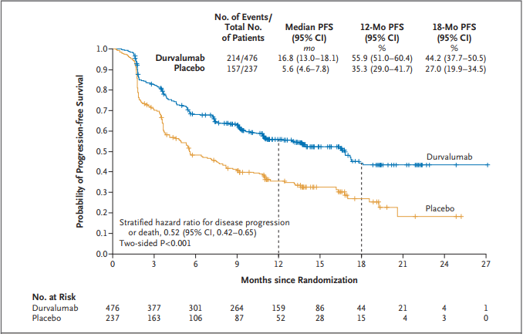
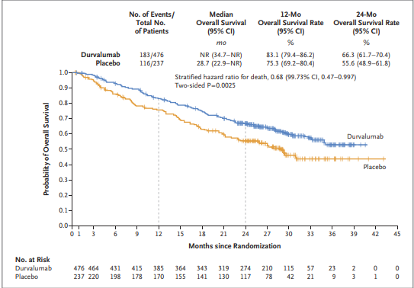
The Future…Immunotherapy May Change Our Approach to Locoregional Management Too
A stronger immune response may be elicited by leaving a tumor in and irradiating it, rather than removing the largest source of antigenic stimulation
PACIFIC Trial, NEJM, 2017
Notes:
No data for it after surgery.
713 patients with unresectable Stage III NSCLC with PS 0-1 and no disease progression after chemo-RT randomized 2:1 to +/- consolidation Durvalumab

Slide 33
Post-Operative Therapy
Adjuvant Chemotherapy:
pN+
pT3-4
+/- pT2a/b N0 if high risk features (>4cm tumor, high grade, LVSI, visceral pleural involvement, or pNx
Adjuvant Radiation:
Positive margin not amenable to re-resection
pN2
+/- pN1 in patient not getting adjuvant chemotherapy

Slide 34
How to Add Chemo to Definitive RT
Both sequential and concurrent chemo → survival benefit
Concurrent chemo → improved local control → improved survival
At expense of ↑ in-field toxicity (especially esophagitis)

Slide 35
What Type of Chemotherapy is Used?
Neoadjuvant/Adjuvant/Sequential:
Cisplatin + (vinorelbine, etoposide, gemcitabine, docetaxel or pemetrexed*)
Carboplatin + (paclitaxel, gemcitabine or pemetrexed*)
Concurrent with RT:
Cisplatin + (etoposide, vinblastine or pemetrexed*)
Carboplatin + paclitaxel (+/- 2 additional full-dose cycles)
Consolidation after chemo-RT:
Durvalumab q2weeks for up to 12 months
* for non-squamous histology only

Slide 36
Reirradiation of the Thorax
Feasibility of treating with curative intent depends on site of primary (P) and recurrent (R) tumors
Advanced treatment techniques are particularly useful for sparing normal tissue (e.g., IMRT, SBRT, protons)
Reirradiating central structures (e.g., esophagus, airway) most challenging
Long-term toxicity is the major concern – impacted by dose/fraction

Slide 37
Survivorship Care
Surveillance H&P + imaging (CT q3-6mo) for recurrence
Manage long term side effects of treatment (e.g., fatigue, dyspnea, pain, etc.)
Other age-appropriate cancer screening
Immunizations (influenza, zoster, pneumococcal)
Health promotion (healthy weight and diet, 30 min moderate intensity physical activity most days, limit alcohol, pulmonary rehabilitation)
Monitor BP, cholesterol, glucose, bone health, dental health, sun protection

Slide 38
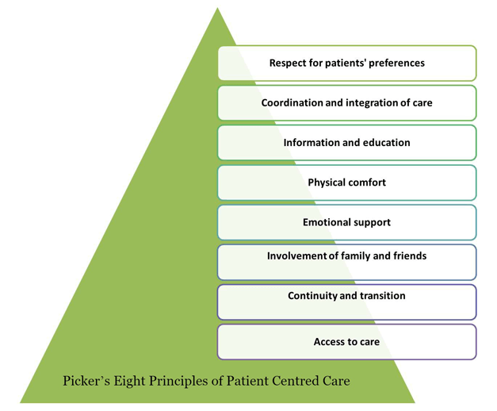
What Is Patient-Centered Care?
In patient-centered care, an individual’s specific health needs and desired health outcomes are the driving force behind all health care decisions and quality measurements.
Patients are partners with their health care providers, and providers treat patients not only from a clinical perspective, but also from an emotional, mental, spiritual, social and financial perspective.
Notes:
This is a human being with values and desire to balance quality of life with oncologic outcome.

Slide 39
Patient-Centered Care In Oncology
The optimal “cancer control” approach is not necessarily the optimal patient-centered approach
Physicians are often not the best judges of patient-centered outcomes (e.g., PROs)
There are multiple examples of where well-selected patients can safely undergo radiation therapy instead of surgery and preserve QOL:
prostate, larynx, pharynx, anus, bladder, advanced cervix, advanced NSCLC, early NSCLC
Multidisciplinary involvement is the best way to ensure patient-centered care and truly informed consent

Slide 40
Management of Stage IV NSCLC

Slide 41
Palliative Radiation For Symptom Relief
Pain
Bone metastases
Neurologic symptoms
Spinal cord compression
Brain metastases
Bleeding
Endobronchial tumor
Dyspnea/Dysphagia
Tumor obstruction causing SVC, respiratory distress or esophageal narrowing

Slide 42
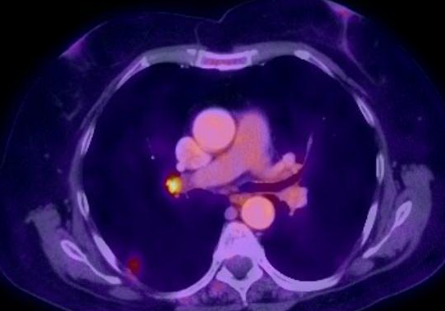
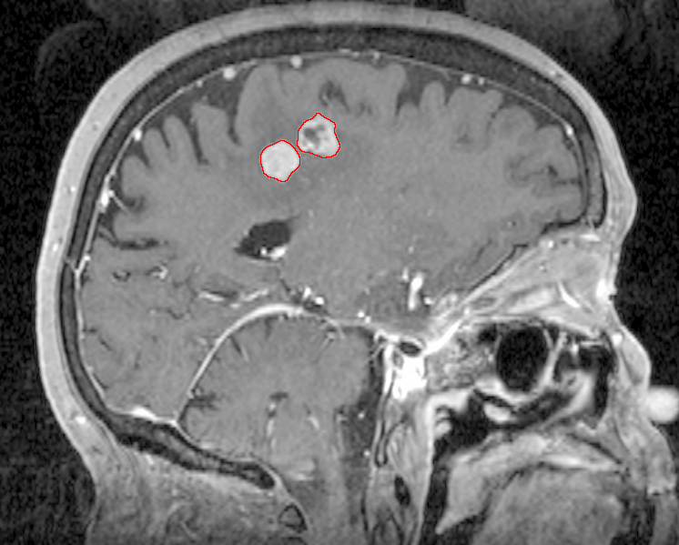
Case Presentation
64F active smoker p/w difficulty writing and right foot weakness
MRI brain showed 2 enhancing lesions
PET/CT showed a 1.3cm RLL nodule (SUV 2.9) and a 1.1 x 0.9cm right hilar LN (SUV 3.8)
CT-guided biopsy showed NSCLC

Slide 43
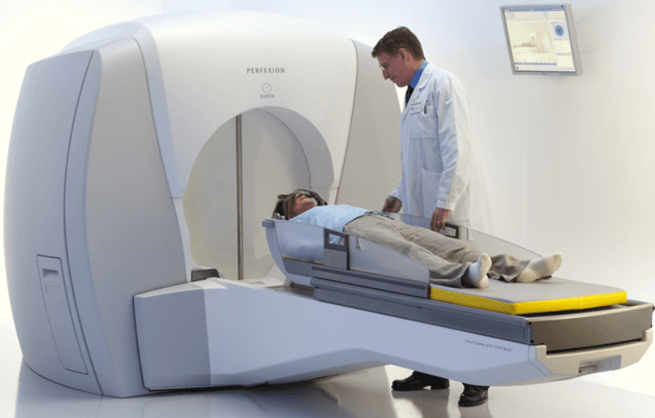
Case Presentation
Stereotactic Radiosurgery (SRS) to 4 brain metastases
2 cycles carboplatin/pemetrexed → SD in lymph node but PD in lung nodule
SBRT to the RLL nodule
5 cycles carboplatin/Nab-Paclitaxel (d/c’ed due to intolerance)
Follow-up imaging → no evidence of disease in body or brain since then (now 40 months since diagnosis)

Slide 44
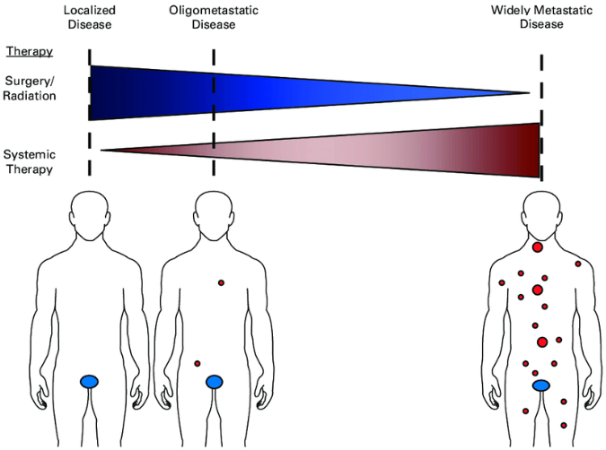
Is all metastatic disease the same?
No! Lung cancer has M1a, M1b and M1c designations because the metastatic state at diagnosis impacts prognosis; a small subset of patients may be cured
“Oligometastatic” refers to a situation where distant metastases may be limited in number (typically defined as < 5 mets in < 3 organs), and potentially curative treatment can be delivered prior to the development of widespread disease

Slide 45
Meta-Analysis of Outcomes of Oligometastatic NSCLC
Ashworth et al, Clin Lung Cancer, 2014
757 pts (from 30 institutions worldwide) with oligometastatic NSCLC (< 5 sites of mets) treated with definitive therapy to primary and all sites of disease
Multivariable cox regression analysis factors predictive of OS:
Synchronous vs. metachronous metastases (P < .001)
N-stage (P < .002)
Adenocarcinoma histology (P < .04)
Recursive partitioning analysis identified 3 risk groups:
Low-risk: metachronous metastases (5-year OS, 47.8%)
Intermediate-risk: synchronous metastases and N0 disease (5-year OS, 36.2%)
High-risk: synchronous metastases and N1/N2 disease (5-year OS, 13.8%)
Notes:
62% metastatectomy

Slide 46
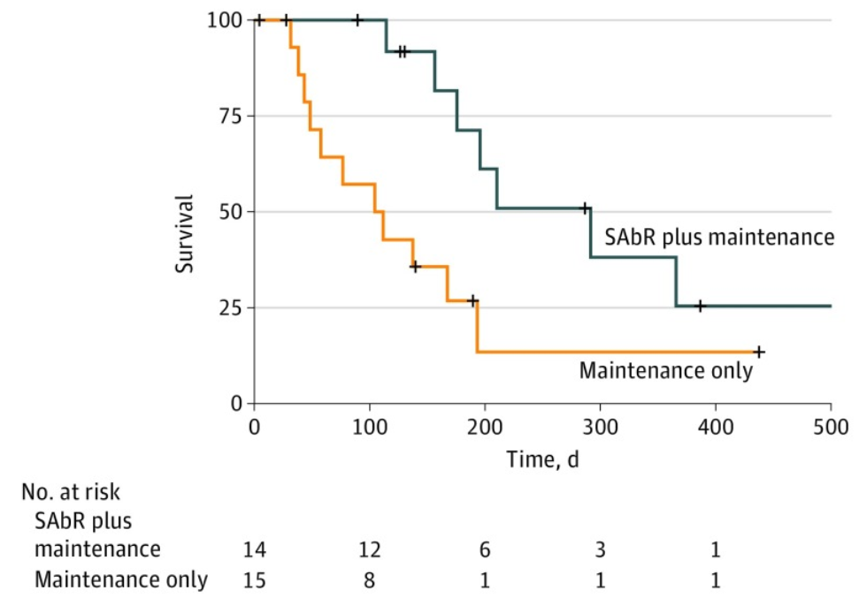
UT Southwestern Randomized Phase II Trial
Iyengar et al, JAMA Oncol, 2018
29 patients, oligometastatic NSCLC with < 5 sites of disease (EGFR/ALK negative), PR or SD after induction chemo, randomized to +/- SAbR
SAbR → ↑ M-PFS (3.5→9.7mo)

Slide 47
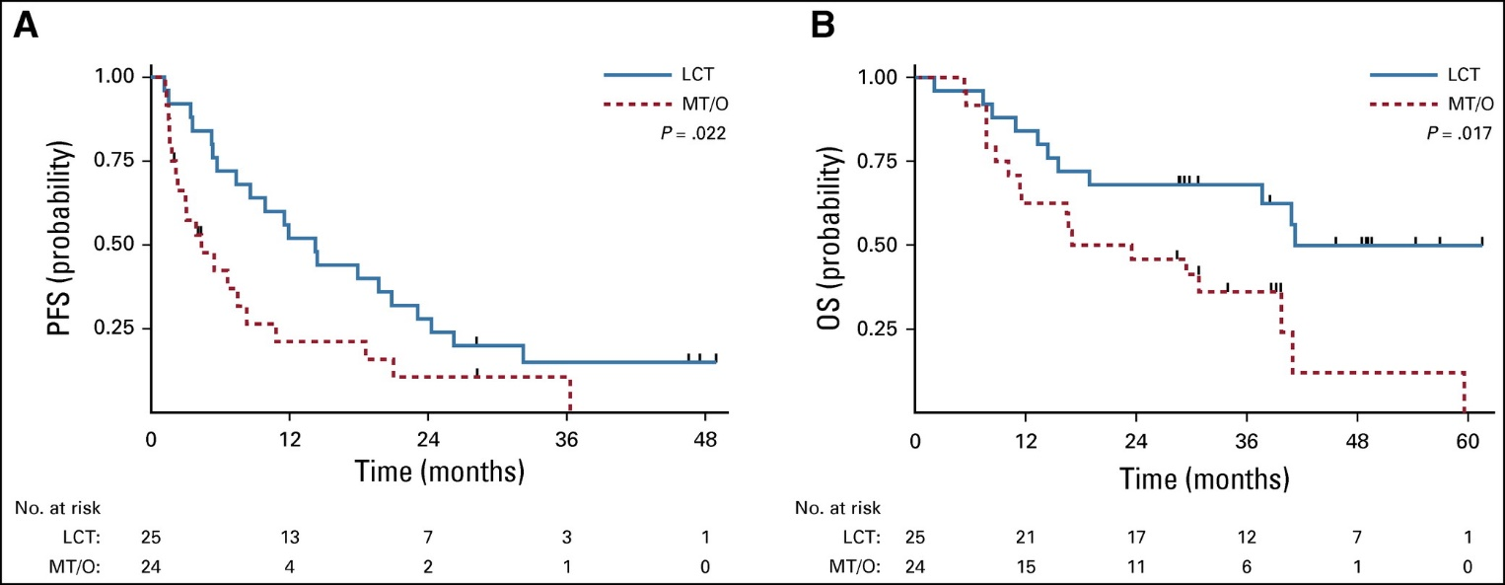
Multi-Institutional Randomized Phase II Trial
Gomez et al, J Clin Oncol, 2019
49 patients with oligometastatic NSCLC with < 3 sites of disease, SD/PR after Pt-based doublet or EGFR/ALK inhibitor, randomized to maintenance systemic therapy +/- local consolidative surgery/RT
RT → ↑ M-PFS (4.4→14.2mo) and M-OS (17→41mo, p=0.02)

Slide 48
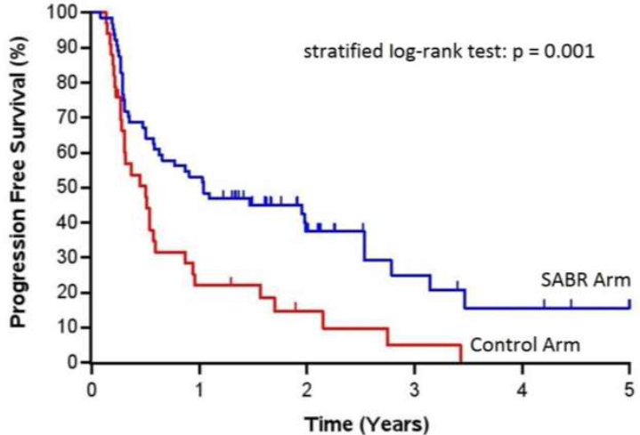
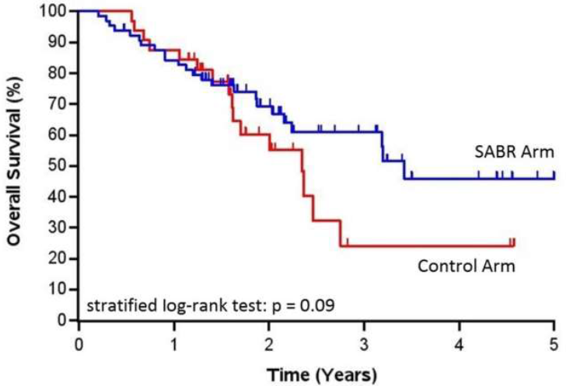
SABR-COMET Randomized Phase II Trial
Palma et al, Lancet, 2019
99 patients, variety of oligometastatic cancers with < 5 sites of disease, PR/SD on systemic therapy, randomized 1:2 to +/- SAbR (at ablative doses)
Most common histologies: breast, lung, colorectal, prostate
SAbR → ↑ M-PFS (6→12mo, p<0.001) & M-OS (28→41mo, p=0.09)
Also ↑ G2 or higher toxicity, but no difference in QOL
Notes:
What were histologies for this trial?

Slide 49
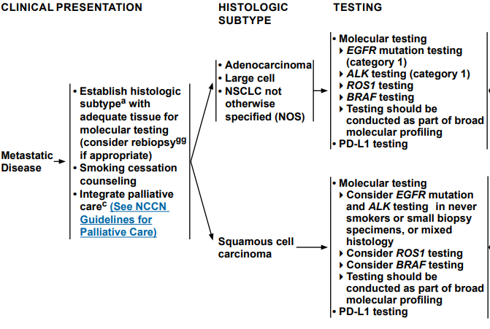
NCCN Guidelines (v1.2020) for Metastatic Disease
**Local therapy (RT, SABR or surgery) to primary and oligometastatic lesions should be considered for [all] patients without progression on systemic therapy**

Slide 50
Targeted Therapies
EGFR Mutation:
First line: Osimertinib (preferred)
If progression → rebiopsy for T790M mutation testing
ALK Rearrangement:
First line: Alectinib (preferred)
ROS1 Rearrangement:
First line: Crizotinib or Entrectinib (preferred)
BRAF V600E Mutation:
First line: Dabrafenib/trametinib
Subsequent Therapy: Dabrafenib/trametinib
PD-L1 Expression > 1% and all of the above negative:
If PD-L1 > 50% → Pembrolizumab monotherapy preferred
If PD-L1 1-49% → Pembrolizumab + chemotherapy preferred
If PD-L1 0% → Variety of platinum-based chemo or chemo-immunotherapy options available
RT can benefit selected patients with oligoprogression on targeted or other systemic therapies.

Slide 51
Management of Small Cell Lung Cancer

Slide 52
Small Cell Lung Cancer
<15% of all lung cancer, poor prognosis
AJCC Staging is preferred (same as NSCLC staging)
Limited stage is M0 and extensive stage is M1
66% of patients present with Stage IV (extensive stage)
Cisplatin (or carboplatin) + etoposide for 4-6 cycles is the backbone of treatment regardless of stage.
70-90% response rate
Initially chemosensitive, but often develops drug resistance

Slide 53
Limited Stage SCLC
cT1-2N0 → Lobectomy + LND → Chemotherapy
Adjuvant RT if LN+
SBRT in medically inoperable patients
All others → Concurrent chemo-RT
Early (with cycle 1 or 2) concurrent RT → small ↑ OS compared to late concurrent or sequential RT
Poor performance status may mandate delays in starting RT
Optimal dose of RT has not been established
45/1.5Gy BID is superior to 45/1.8Gy daily
For daily RT, recommend 60-70/2.0Gy
If CR or PR on reimaging and good PS →
Prophylactic cranial irradiation (PCI) is typically recommended

Slide 54
Extensive Stage SCLC
Chemotherapy+Immunotherapy
Carboplatin + Etoposide + (Atezolizumab or Durvalumab)
Palliative RT to symptomatic sites
Sequencing of chemo and palliative RT depends on extent of symptoms
If CR or PR on reimaging → consider PCI +/- thoracic RT
If patient does not get PCI, then MRI surveillance of the brain
Consolidative thoracic RT for patients with residual thoracic disease after systemic therapy can improve OS

Slide 55
The Future…A Few Examples of Active Clinical Trials in Lung Cancer
NRG LU002: Adds RT (to all sites of disease) to systemic therapy for oligometastatic NSCLC
NRG LU004: Adds immunotherapy to IMRT or 3-D CRT for stage II-III NSCLC with high PD-L1 expression (instead of chemotherapy)
PACIFIC 4 and NRG/S1914: Adds consolidative immunotherapy to SBRT for stage I NSCLC
AEGEAN: Adds neoadjuvant immunotherapy to surgery for resectable stage II-III NSCLC
ALCHEMIST: Evaluating adjuvant use of targeted agents for resected NSCLC
RTOG 1308: Compares proton therapy to photon therapy for LA-NSCLC
NRG LU005: Adds immunotherapy to chemoradiation for limited-stage SCLC
NRG CC003: Hippocampal avoidance PCI for SCLC

Slide 56
Take-Home Points
Radiation therapy plays an important role in the care of all Stage I-III lung cancer patients. Such patients should see a radiation oncologist prior to commencing definitive treatment of their malignancy.
For metastatic lung cancer patients, radiation therapy effectively palliates a variety of cancer-induced symptoms and has an emerging role as an adjunct to systemic therapy in oligometastatic or oligoprogressive disease for NSCLC and for consolidative thoracic therapy in ES-SCLC.
Radiation oncologists use a variety of approaches to minimize toxicity and preserve quality of life. If you think a patient is experiencing radiation-induced toxicity, contact the radiation oncologist to confirm the diagnosis and to help with management.

Slide 57
References
NCCN Guidelines: https://www.nccn.org/professionals/physician_gls/default.aspx
UpToDate: https://www.uptodate.com/home
SEER Cancer Stats: https://seer.cancer.gov/statfacts/html/lungb.html
Gomez DR, Tang C, Zhang J, et al. Local Consolidative Therapy Vs. Maintenance Therapy or Observation for Patients With Oligometastatic Non-Small-Cell Lung Cancer: Long-Term Results of a Multi-Institutional, Phase II, Randomized Study. J Clin Oncol. 2019 Jun 20;37(18):1558-1565.
Palma DA, Olson R, Harrow S, et al. Stereotactic ablative radiotherapy versus standard of care palliative treatment in patients with oligometastatic cancers (SABR-COMET): a randomised, phase 2, open-label trial.cet. 19 May 18;393(10185):2051-2058.
Bezjak A, Paulus R, Gaspar LE, et al. Safety and Efficacy of a Five-Fraction Stereotactic Body Radiotherapy Schedule for Centrally Located Non-Small-Cell Lung Cancer: NRG Oncology/RTOG 0813 Trial.J Clin Oncol. 2019 May 20;37(15):1316-1325.
Detterbeck FC.The eighth edition TNM stage classification for lung cancer: What does it mean on main street?J Thorac Cardiovasc Surg. 2018 Jan;155(1):356-359.
Iyengar P, Wardak Z, Gerber DE et al.Consolidative Radiotherapy for Limited Metastatic Non-Small-Cell Lung Cancer: A Phase 2 Randomized Clinical Trial.JAMA Oncol. 2018 Jan 11;4(1):e173501.
Antonia SJ, Villegas A, Daniel D, et al. Durvalumab after Chemoradiotherapy in Stage III Non-Small-Cell Lung Cancer.N Engl J Med. 2017 Nov 16;377(20):1919-1929.
Videtic GM, Hu C, Singh AK, Chang JY, et al. Randomized Phase 2 Study Comparing 2 Stereotactic Body Radiation Therapy Schedules for Medically Inoperable Patients With Stage I Peripheral Non-Small Cell Lung Cancer: NRG Oncology RTOG 0915 (NCCTG N0927).Int J Radiat Oncol Biol Phys. 2015 Nov 15;93(4):757-64.
Ashworth AB, Senan S, Palma DA, et al. An individual patient data metaanalysis of outcomes and prognostic factors after treatment of oligometastatic non-small-cell lung cancer.Clin Lung Cancer. 2014 Sep;15(5):346-55.
Timmerman R, Paulus R, Galvin J et al. Stereotactic body radiation therapy for inoperable early stage lung cancer.JAMA. 2010 Mar 17;303(11):1070-6.
Albain KS, Swann RS, Rusch VW, et al. Radiotherapy plus chemotherapy with or without surgical resection for stage III non-small-cell lung cancer: a phase III randomised controlled trial.Lancet. 2009 Aug 1;374(9687):379-86.
van Meerbeeck JP, Kramer GW, Van Schil PE, et al. Randomized controlled trial of resection versus radiotherapy after induction chemotherapy in stage IIIA-N2 non-small-cell lung cancer.J Natl Cancer Inst. 2007 Mar 21;99(6):442-50.

Slide 58
Questions?

