Slide 1
Radiation Therapy for IDH-Mutant Grade 2 and Grade 3 Diffuse Glioma: An ASTRO Clinical Practice Guideline Developed in collaboration with the American Association of Neurological Surgeons/Congress of Neurological Surgeons, American Association of Neuropathologists, American Society of Clinical Oncology, and the Society for Neuro-Oncology Endorsed by the Canadian Association of Radiation Oncology, European Society for Radiotherapy and Oncology, and Royal Australian, New Zealand College of Radiologists, and Society for Neuro-Oncology

Slide 2
Citation
This slide set is adapted from the Radiation Therapy for IDH-Mutant Grade 2 and Grade 3 Diffuse Glioma Guideline to be published in the Sept/Oct 2022 issue of Practical Radiation Oncology (PRO)
Web posted link:
https://www.practicalradonc.org/article/S1879-8500(22)00144-8/fulltext#relatedArticles
The full-text guideline is also available on the ASTRO Web site: www.astro.org

Slide 3
Guideline Task Force
Chairs
Helen A. Shih, MD, MS, MPH
Lia M. Halasz, MD
Members
Albert Attia, MD
Daniel J. Brat, MD, PhD
John P. Kirkpatrick, MD, PhD
Nadia N. Laack, MD
Nafisha Lalani, MD, MPH
Emily S. Lebow, MD
Arthur K. Liu, MD, PhD
Heather M. Niemeier, PhD
Joshua D. Palmer, MD
Katherine B. Peters, MD, PhD
Jason Sheehan, MD, PhD
Reena P. Thomas, MD, PhD
Sujay A. Vora, MD
Daniel R. Wahl, MD, PhD
Stephanie E. Weiss, MD
D. Nana Yeboa, MD
Jim Zhong, MD
Lisa Bradfield, staff

Slide 4
Task Force Composition
Radiation oncologist
Drawn from academic and private/community practices
Includes a RO resident and a member of the Guidelines Subcommittee
Related specialties*
Neuro-oncology
Neurosurgery
Neuropathology
Patient representative
*Representatives nominated by specialty societies.

Slide 5
Introduction to Guideline
Controversy exists regarding the indications for radiation therapy in the treatment of IDH-mutant grade 2 and 3 diffuse glioma given the balance of side effects and improvement in progression-free survival.
The recent WHO reclassification of lower grade gliomas from a system based on histological features to one based on IDH mutation and 1p/19q codeletion status creates further controversy.
Our aim is to provide a clinically relevant management guideline:
Defined by WHO 2021 classification.
Based upon the highest quality data.
Best translated by our task force of subject matter experts.

Slide 6
Guideline Scope
To provide recommendations for patients with astrocytoma, IDH-mutant, WHO grade 2; astrocytoma, IDH-mutant, WHO grade 3; oligodendroglioma, IDH-mutant, 1p/19q codeleted, WHO grade 2; and oligodendroglioma, IDH-mutant, 1p/19q codeleted, WHO grade 3.
WHO Classification based on publication:
World Health Organization Classification of Tumors for Central Nervous System 2021

Slide 7
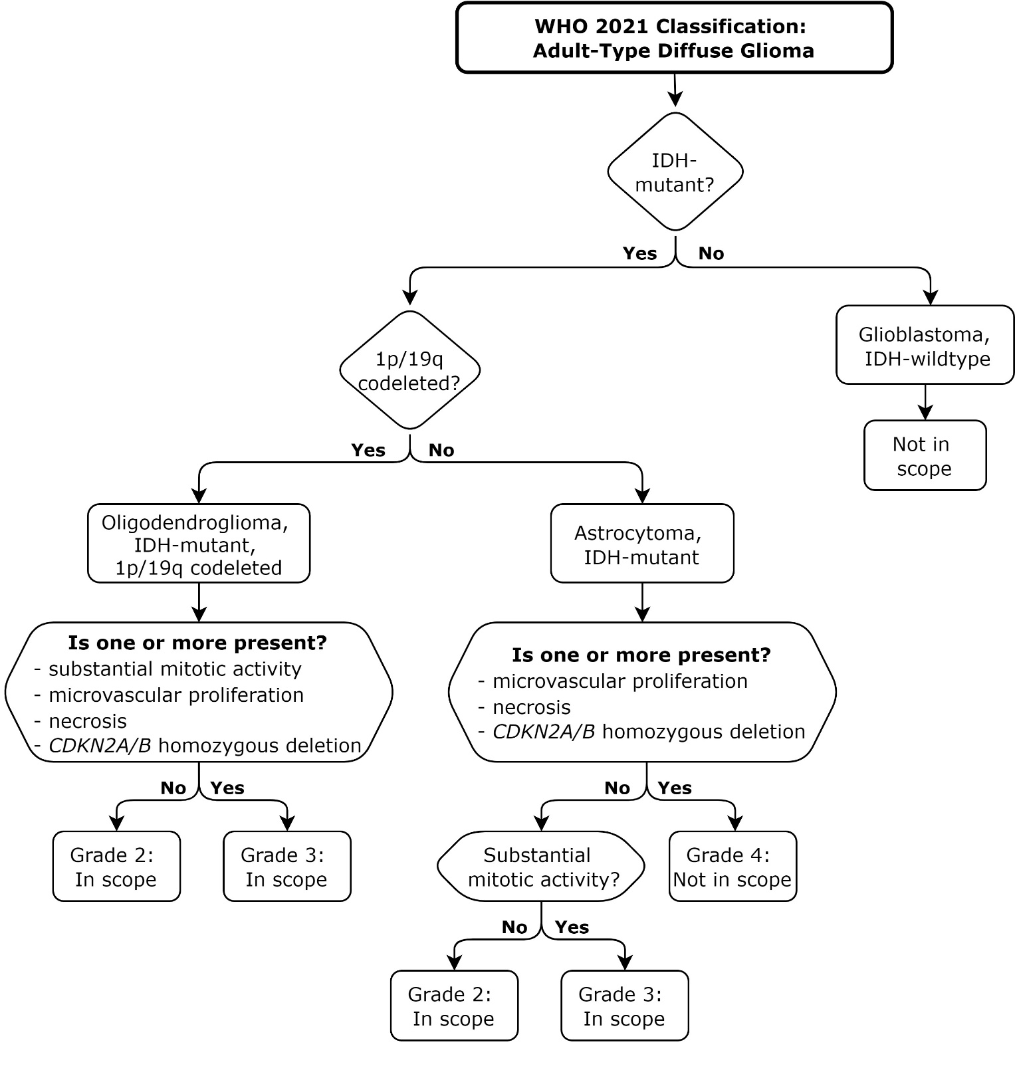
Figure 1. WHO 2021 Classification: Adult-Type Diffuse Glioma Abbreviation: IDH = isocitrate dehydrogenase; WHO = World Health Organization.

Slide 8
Systematic Review
Ovid MEDLINE® search dates: 1/1996 (RCTs, meta-analyses, prospective studies) and 1/2005 (retrospective studies) through 7/2020
Both MeSH terms and text words used
Outcomes: local control, PFS, OS, recurrence rates, acute and late toxicity, and quality of life
Inclusions: Age ≥18 years, diagnosis of WHO grade 2 or 3 glioma
Exclusions: glioblastoma, IDH-wildtype, WHO grade 4; astrocytoma, IDH-mutant, WHO grade 4, astrocytoma with CDKN2A/B homozygous deletion; pediatric-type diffuse low-grade glioma; pediatric-type diffuse high-grade glioma; or circumscribed astrocytic glioma. WHO grade 4 or IDH-wildtype glioma, brainstem glioma, gliomatosis cerebri, disseminated disease, or salvage treatment after initial radiation therapy (RT).
1842 studies identified → 286 abstracts retrieved → 134 articles included and abstracted into evidence tables

Slide 9
Rating Strength of Recommendation
ASTRO’s recommendations are based on evaluation of multiple factors including the quality of evidence (QoE) and panel consensus, which, among other considerations, inform the strength of recommendation. QoE is based on the body of evidence available for a particular key question and includes consideration of number of studies, study design, adequacy of sample sizes, consistency of findings across studies, and generalizability of samples, settings, and treatments.
Strength of Recommendation | Definition | Overall QoE Grade | Recommendation Wording
Strong | Benefits clearly outweigh risks and burden, or risks and burden clearly outweigh benefits. All or almost all informed people would make the recommended choice. | Any (usually high, moderate, or expert opinion) | “Recommend/ Should”
Conditional | Benefits are finely balanced with risks and burden or appreciable uncertainty exists about the magnitude of benefits and risks. Most informed people would choose the recommended course of action, but a substantial number would not. A shared decision-making approach regarding patient values and preferences is particularly important. | Any (usually moderate, low, or expert opinion) | “Conditionally Recommend”

Slide 10
Rating Quality of Evidence
Overall QoE Grade | Type/Quality of Study | Evidence Interpretation
High | 2 or more well-conducted and highly generalizable RCTs or meta-analyses of such trials. | The true effect is very likely to lie close to the estimate of the effect based on the body of evidence.
Moderate | 1 well-conducted and highly generalizable RCT or a meta-analysis of such trials OR 2 or more RCTs with some weaknesses of procedure or generalizability OR 2 or more strong observational studies with consistent findings. | The true effect is likely to be close to the estimate of the effect based on the body of evidence, but it is possible that it is substantially different.
Low | 1 RCT with some weaknesses of procedure or generalizability OR 1 or more RCTs with serious deficiencies of procedure or generalizability or extremely small sample sizes OR 2 or more observational studies with inconsistent findings, small sample sizes, or other problems that potentially confound interpretation of data. | The true effect may be substantially different from the estimate of the effect. There is a risk that future research may significantly alter the estimate of the effect size or the interpretation of the results.
Expert Opinion† | Consensus of the panel based on clinical judgement and experience, due to absence of evidence or limitations in evidence. | Strong consensus (≥90%) of the panel guides the recommendation despite insufficient evidence to discern the true magnitude and direction of the net effect. Further research may better inform the topic.
Notes:
†A lower quality of evidence, including expert opinion, does not imply that the recommendation is conditional. Many important clinical questions addressed in guidelines do not lend themselves to clinical trials but there still may be consensus that the benefits of a treatment or test clearly outweigh its risks and burden.
Note: ASTRO’s methodology allows for use of implementation remarks meant to convey clinically practical information that may enhance the interpretation and application of the recommendation. While each recommendation is graded according to recommendation strength and QoE, these grades should not be assumed to extend to the implementation remarks.

Slide 11
Consensus Methodology
Modified Delphi approach
Task force members rated their level of agreement for each recommendation via consensus survey
5-point Likert scale from “strongly disagree” to “strongly agree”
Consensus defined using pre-specified threshold of ≥75% (≥90% for expert opinion recommendations) agreement
Recommendations for which consensus is not achieved are removed or are revised and re-surveyed.
Recommendations achieving consensus edited with substantive changes after the first round are also re-surveyed.

Slide 12
KQ 1: What are the indications and optimal timing for RT in adult patients with newly diagnosed or previously unirradiated IDH-mutant grade 2 and grade 3 diffuse glioma based on risk stratification?

Slide 13
KQ 1: Indication and timing for RT
KQ1 Recommendations | Strength of Recommendation | Quality of Evidence
Oligodendroglioma, IDH-mutant and 1p/19q codeleted
For patients with oligodendroglioma, IDH-mutant, 1p/19q codeleted, WHO grade 2, <4-6 cm tumor, with gross total resection (defined as <1 cm residual tumor on MRI) and age <40 y, close surveillance alone is recommended. | Strong | Low
2. For patients with oligodendroglioma, IDH-mutant, 1p/19q codeleted, WHO grade 2, with high-risk features, either RT with sequential chemotherapy or RT with concurrent/sequential chemotherapy is conditionally recommended. Implementation remark: High-risk features include any of the following: subtotal resection, age ≥40 y, tumor size ≥4-6 cm, tumor crosses midline, refractory seizures, or presurgical neurological symptoms from tumor. | Conditional | Low
3. For patients with oligodendroglioma, IDH-mutant, 1p/19q codeleted, WHO grade 3, with any extent of surgery, either RT with sequential chemotherapy or RT with concurrent/sequential chemotherapy is recommended. | Strong | Moderate

Slide 14
KQ 1: Indication and timing for RT (con’t)
KQ1 Recommendations | Strength of Recommendation | Quality of Evidence
Astrocytoma, IDH-mutant
4. For patients with astrocytoma, IDH-mutant, WHO grade 2, <4-6 cm tumor, with gross total resection (defined as <1 cm residual tumor on MRI) and age <40 y, close surveillance alone is conditionally recommended. | Conditional | Low
5. For patients with astrocytoma, IDH-mutant, WHO grade 2, with high-risk features, either RT with sequential chemotherapy or RT with concurrent/sequential chemotherapy is conditionally recommended. Implementation remark: High-risk features include any of the following: subtotal resection, age ≥40 y, tumor size ≥4-6 cm, tumor crosses midline, refractory seizures, or presurgical neurological symptoms from tumor. | Conditional | Low
6. For patients with astrocytoma, IDH-mutant, WHO grade 3, with any extent of surgery, either RT with sequential chemotherapy or RT with concurrent/sequential chemotherapy is recommended. | Strong | Low

Slide 15
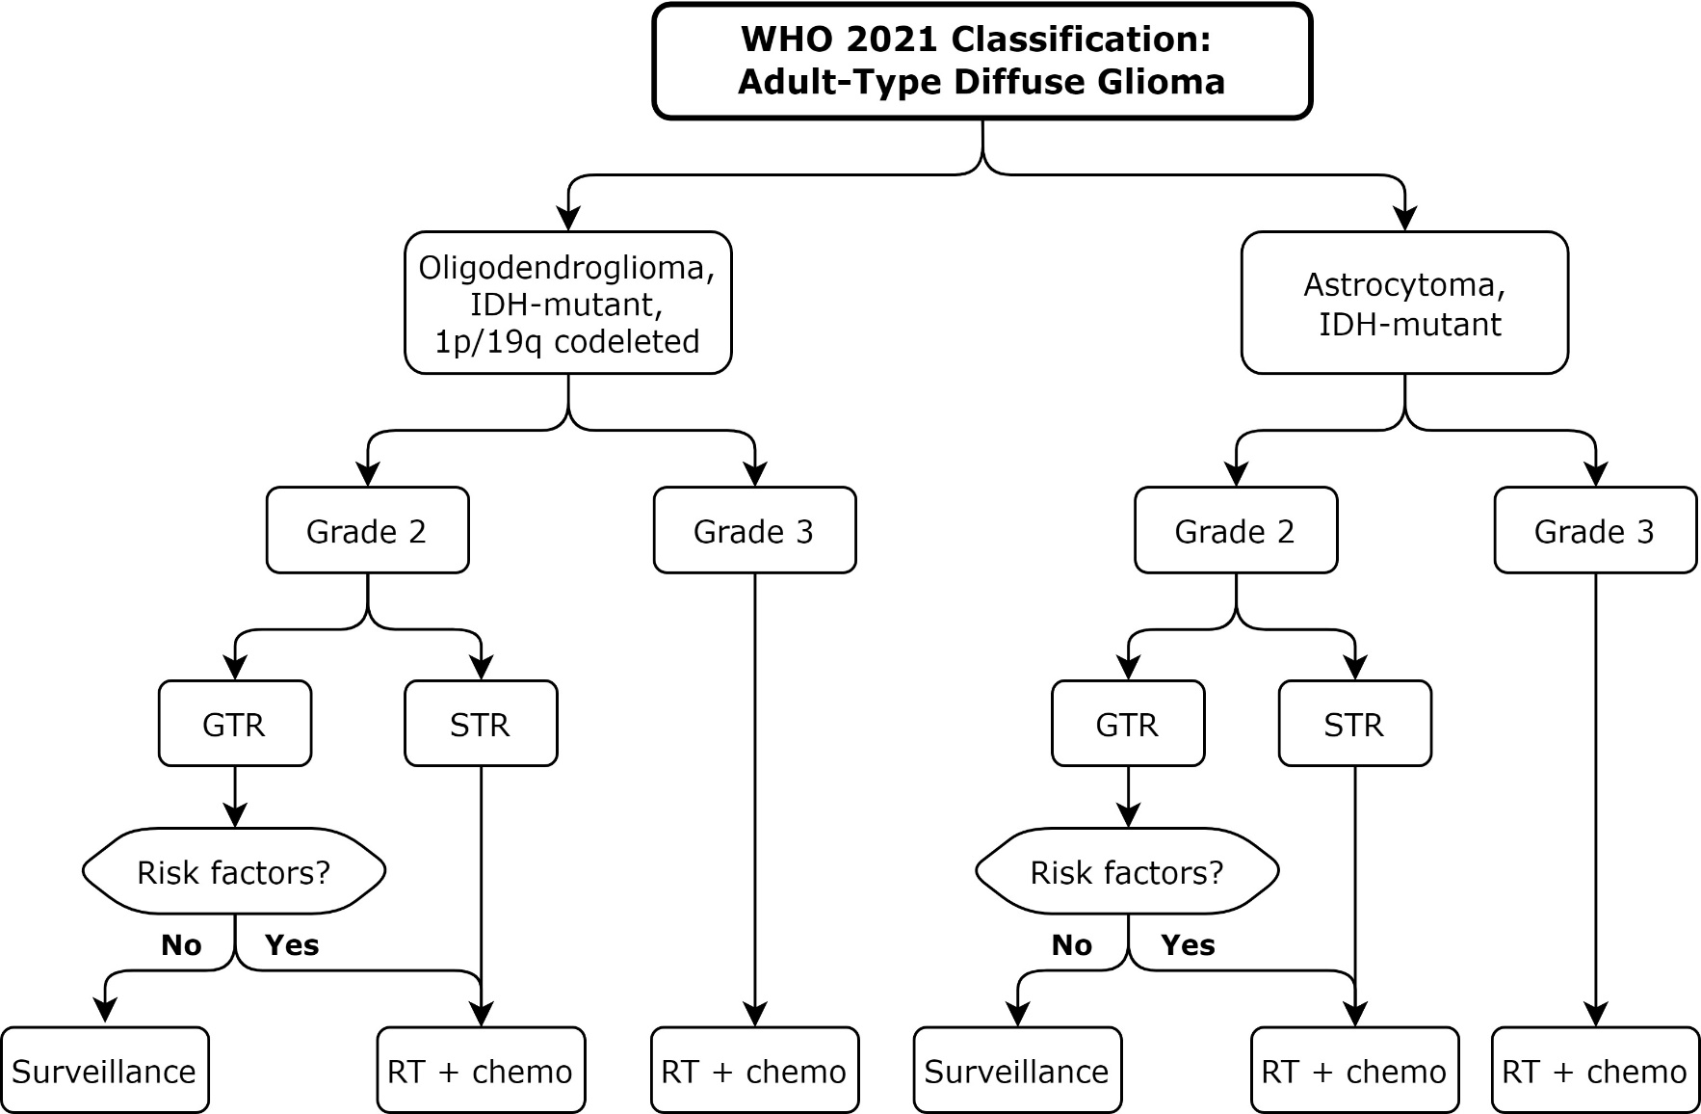
Figure 2. IDH-Mutant Diffuse Glioma – Indications and Timing for RT Abbreviations: chemo = chemotherapy; GTR = gross total resection; IDH = isocitrate dehydrogenase; RT = radiation therapy; STR = subtotal resection (including biopsy); WHO = World Health Organization. RT + chemo = RT with sequential chemotherapy or RT with concurrent/ sequential chemotherapy.

Slide 16
KQ 2: What is the optimal dose of RT and target volume for adult patients with IDH-mutant grade 2 and grade 3 diffuse glioma based on risk stratification?

Slide 17
KQ 2: Optimal dose of RT and target volume based on risk stratification
KQ2 Recommendations | Strength of Recommendation | Quality of Evidence
1. For patients with oligodendroglioma, IDH-mutant, 1p/19q codeleted, WHO grade 2 and astrocytoma, IDH-mutant, WHO grade 2, a total prescribed dose of 4500-5400 cGy in 180 cGy daily fractions is recommended. | Strong | High
2. For patients with oligodendroglioma, IDH-mutant, 1p/19q codeleted, WHO grade 3, a total prescribed dose of 5940 cGy in 180 cGy daily fractions is recommended. | Strong | Moderate
3. For patients with oligodendroglioma, IDH-mutant, 1p/19q codeleted, WHO grade 3, a total prescribed dose of 5400-5760 cGy in 180 cGy daily fractions is conditionally recommended as a treatment option. | Conditional | Expert Opinion

Slide 18
KQ 2: Optimal dose of RT and target volume based on risk stratification (con’t)
KQ2 Recommendations | Strength of Recommendation | Quality of Evidence
4. For patients with astrocytoma, IDH-mutant, WHO grade 3, a total prescribed dose of 594-6000 cGy in 180-200 cGy daily fractions is recommended. | Strong | Moderate
5. For patients with astrocytoma, IDH-mutant, WHO grade 3, a total prescribed dose of 5400-5800 cGy in 180-200 cGy daily fractions is conditionally recommended as a treatment option. | Conditional | Expert Opinion
6. For patients with oligodendroglioma, IDH-mutant, 1p/19q codeleted, WHO grade 2 and astrocytoma, IDH-mutant, WHO grade 2, the following target volumes defined by MRI are recommended: GTV = residual FLAIR changes, resection cavity, and any residual tumor enhancement on T1 postcontrast CTV = GTV + 10-15 mm expansion PTV = CTV + 3-5 mm expansion | Strong | Low

Slide 19
KQ 2: Optimal dose of RT and target volume based on risk stratification (con’t)
KQ2 Recommendations | Strength of Recommendation | Quality of Evidence
7. For patients with oligodendroglioma, IDH-mutant, 1p/19q codeleted, WHO grade 3 and astrocytoma, IDH-mutant, WHO grade 3, the following target volumes defined by MRI are recommended: GTV = residual FLAIR changes, resection cavity and any residual enhancement on T1 postcontrast CTV = GTV + 10-15 mm expansion PTV = CTV + 3-5 mm expansion OR, if cone-down/boost is desired: GTV1 = residual FLAIR changes, resection cavity and any residual enhancement on T1 postcontrast GTV2 = residual enhancement on T1 postcontrast and resection cavity CTV1/2 = GTV1/2 + 10-15 mm expansion PTV1/2 = CTV1/2 + 3-5 mm expansion | Strong | Low

Slide 20
KQ 3: What are the optimal RT techniques and field design for adult patients with IDH-mutant grade 2 and grade 3 diffuse glioma?

Slide 21
KQ 3: Optimal RT techniques and field design
KQ3 Recommendations | Strength of Recommendation | Quality of Evidence
For patients with IDH-mutant WHO grade 2 and grade 3 diffuse glioma, IMRT/VMAT is recommended to reduce acute and late toxicity, especially for tumors located near critical OARs. | Strong | Low
2. For patients with IDH-mutant WHO grade 2 and grade 3 diffuse glioma, 3-D CRT is recommended as a treatment option, when IMRT/VMAT is unavailable. | Strong | Moderate
3. For patients with IDH-mutant WHO grade 2 and grade 3 diffuse glioma, proton therapy is conditionally recommended as an option to reduce acute and late toxicity, especially for tumors located near critical OARs. | Conditional | Low

Slide 22
KQ 3: Optimal RT techniques and field design (con’t)
KQ3 Recommendations | Strength of Recommendation | Quality of Evidence
4. For patients with IDH-mutant WHO grade 2 and grade 3 diffuse glioma, optimization of radiation field design is recommended to ensure target coverage and OAR avoidance. | Strong | Moderate
5. For patients with IDH-mutant WHO grade 2 and grade 3 diffuse glioma receiving RT, daily image guidance is recommended. | Strong | Expert Opinion

Slide 23
KQ 4: What are the adverse effects of RT, and subsequent clinical management, for adult patients with IDH-mutant grade 2 and grade 3 diffuse glioma?

Slide 24
KQ 4: Adverse effects of RT
KQ4 Recommendation | Strength of Recommendation | Quality of Evidence
For patients with IDH-mutant WHO grade 2 and grade 3 diffuse glioma, assessment, surveillance, and management by an interprofessional and/or multidisciplinary care team is recommended for toxicity management (Table 7). | Strong | Expert Opinion

Slide 25
KQ 4: Adverse effects of RT Table 7. Multidisciplinary care team management for common toxicities
Toxicity | Management considerations – baseline and ongoing (as needed)
Neurocognitive function | Neuropsychological testing (where available)
Neuroendocrine function | Pituitary function testing for patients with hypothalamic/pituitary axis within the radiation treatment field or with clinical symptoms
Neurological deficit | Rehabilitation medicine (including physical therapy and occupational therapy)
Vision | Acuity and visual field testing for patients with optic pathway within the radiation treatment field or with clinical symptoms
Hearing | Auditory and vestibular testing for patients with cochlea within the radiation treatment field or with clinical symptoms
Permanent alopecia | Wig and hair loss consultation (where available)
Cerebrovascular complications | Vascular medicine consultation (with neurologist and/or neurosurgeon)
Financial/psychosocial | Social services (eg, social worker, adolescent and young adult-life specialist, and financial counsellor)
Quality of Life | Survivorship and supportive care (eg, palliative care provider, onco-psychologist, and mental health counselor)

Slide 26
Key Take Away Messages
Recommendations for adjuvant RT are based on molecular profile, grade, surgical extent, and other risk factors for recurrence.
The guideline required the interpretation of available trial data within the more modern molecular classification of tumors.
This leads to acceptable variation in RT dose, techniques, and field design.

Slide 27
Key Take Away Messages
Impactful late effects of treatment require further work in minimizing unneeded dose and delaying RT where appropriate.
Ongoing trials are important for further personalizing approaches based on molecular profile and assessing techniques for improving quality of life for our patients.

