Slide 1
Hypofractionated Radiation Therapy for Localized Prostate Cancer: An ASTRO, ASCO, and AUA Evidence-Based Guideline Developed in partnership with the American Society for Clinical Oncology and American Urological Association Endorsed by the Society of Urologic Oncology, European Society for Radiotherapy & Oncology, and Royal Australian & New Zealand College of Radiologists

Slide 2
Citation
This slide set is adapted from the Hypofractionated Radiation Therapy for Localized Prostate Cancer Guideline. Published in the November-December 2018 issue of Practical Radiation Oncology (PRO): https://www.practicalradonc.org/article/S1879-8500(18)30247-9/abstract
The full-text guideline is also available on the ASTRO website: www.astro.org

Slide 3
Guideline Task Force
Chairs
Howard Sandler, MD
Scott Morgan, MD, MSc
Members
Karen Hoffman, MD, MHSc, MPH
D. Andrew Loblaw, MD, MSc
Mark Buyyounouski, MD, MS
Daniel Barocas, MD, MPH
Soren Bentzen, DSc, PhD
Michael Chang, MD
Jason Efstathiou, MD, PhD
Patrick Greany, PhD
Per Halvoresen, MS
Bridget Koontz, MS
Colleen Lawton, MD
C. Marc Leyrer, MD
Daniel Lin, MD
Michael Ray, MD, PhD

Slide 4
Task Force Composition
Radiation oncology
Drawn from academic practice, private or community practice, and the Veterans Health Administration system
Include a RO resident and a member of the Guidelines Subcommittee
Related specialties/disciplines
Medical oncology
Surgery
Medical physics
Non-RO physicians are nominated by their respective societies
Patient representative

Slide 5
Radiobiological Rationale for Hypofractionation in Prostate Cancer
High α/β tissue
(rectum)
Surviving Fraction
Low α/β tissue
(prostate ca)
Conventional
Fractionation
Hypo-
fractionation
Dose

Slide 6
Definitions
Conventional Fractionation
Fraction size 180-200 cGy
Moderate Hypofractionation
Fraction size 240-340 cGy
Ultrahypofractionation (SBRT/SABR)
Fraction size ≥500 cGy

Slide 7
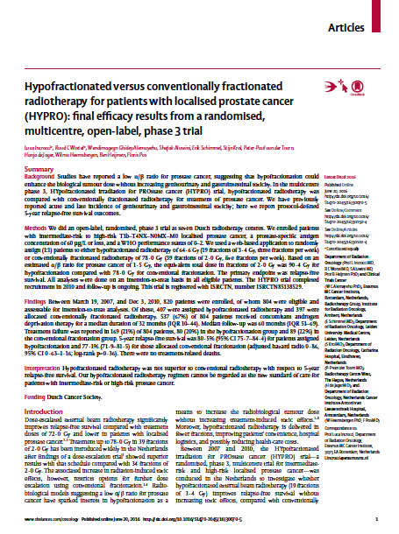
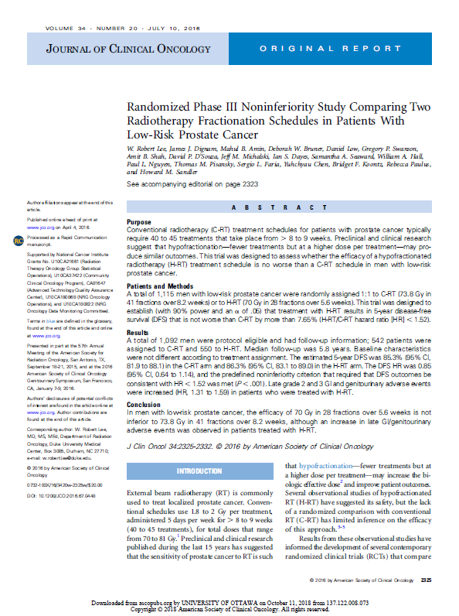
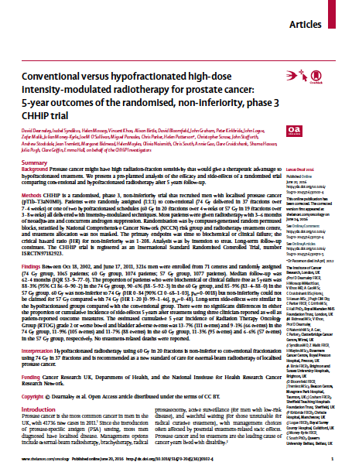
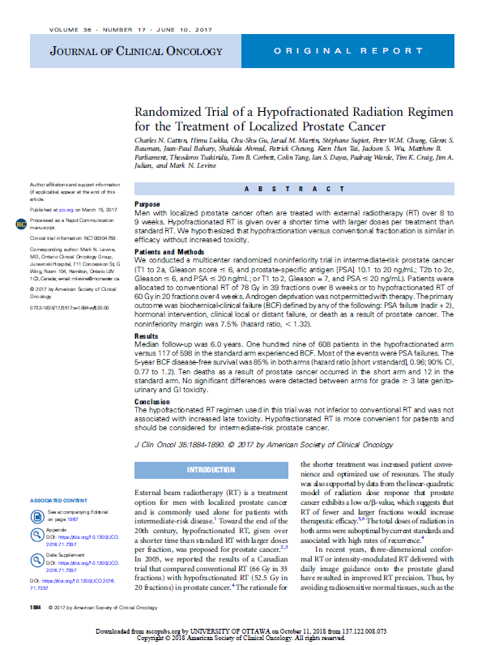
Motivation for Guideline
Publication of 4 large-scale RCTs of moderately hypofractionated prostate EBRT, 2016-17

Slide 8
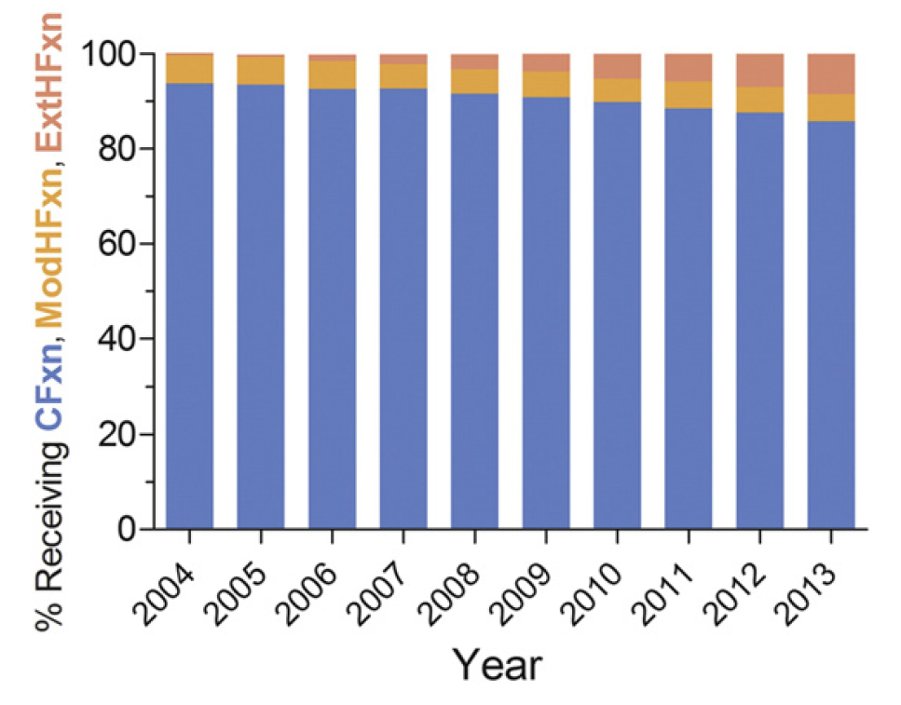
Motivation for Guideline
Increased utilization of ultrahypofractionated EBRT in routine clinical practice
Ultrahypofractionation
Moderate hypofractionation
Conventional fractionation
Stokes PRO 2017; 7: 270-78.

Slide 9
Guideline Scope
To provide recommendations on the use of moderate hypofractionation and ultrahypofractionation in localized prostate cancer with particular reference to oncologic outcomes, toxicity, and quality of life.

Slide 10
Systematic Review
MEDLINE® PubMed - 12/01/2001 – 03/31/2017
Both MeSH terms and text words used
Supplemented with handsearches, including of abstracts from ASTRO, ASCO, ESTRO, and ECCO meetings 01/2014-01/2017 (but abstracts not used to support recommendations)
Outcomes: prostate cancer control, acute and late toxicity, quality of life
Inclusion: Age ≥18 years, localized prostate cancer, treated with hypofractionated EBRT
Moderate hypofractionation: restricted to RCTs or meta-analyses of RCTs
Ultrahypofractionation: RCTs and prospective observational studies with n≥50
Exclusion: post-op EBRT; elective pelvic nodal EBRT; HDR brachytherapy; locally advanced/ metastatic disease; salvage therapy/re-irradiation; lack of clinical outcomes, non-English, case report, not relevant to KQs
480 abstracts retrieved → 61 articles included and abstracted into evidence tables

Slide 11
Grading Recommendations
Strength of Recommendation | Definition* | Quality of Evidence | Recommendation Wording
Strong | Benefits clearly outweigh risks and burden, or risks and burden clearly outweigh benefits. All or almost all informed people would make the recommended choice for or against an intervention. | Any (usually high or moderate) | “Recommend” or “Should”
Conditional | Benefits are finely balanced with risks and burden or appreciable uncertainty exists about the magnitude of benefits and risks. Most informed people would choose the recommended course of action, but a substantial number would not. There is a strong role for patient preferences & shared-decision making. | Any (usually moderate to low) | “Suggest” or “May”
* Andrews J, Guyatt G, Oxman AD, et al. GRADE guidelines: 14. Going from evidence to recommendations: the significance and presentation of recommendations. J Clin Epidemiol. 2013;66(7):719-725.

Slide 12
Grading Evidence
Quality of Evidence | Definition^
High | We are very confident that the true effect lies close to that of the estimate of the effect
Moderate | We are moderately confident in the effect estimate: The true effect is likely to be close to the estimate of the effect, but there is a possibility that it is substantially different
Low | Our confidence in the effect estimate is limited: The true effect may be substantially different from the estimate.
Very Low | We have very little confidence in the effect estimate: The true effect is likely to be substantially different from the estimate.
^ Balshem H, Helfand M, Schunemann HJ, et al. GRADE guidelines: 3. Rating the quality of evidence. J Clin Epidemiol. 2011;64(4):401-406.

Slide 13
Consensus Methodology
Modified Delphi approach
Task force members rated their agreement with each recommendation using an online consensus survey
Five-point Likert scale from “strongly disagree” to “strongly agree”
Consensus defined using pre-specified threshold of ≥75% agreement
Recommendations for which consensus is not achieved are removed or are revised and re-surveyed.
Recommendations achieving consensus edited after the first round are also re-surveyed.

Slide 14
Key Question 1: In patients with localized prostate cancer who are candidates for EBRT, how does moderately hypofractionated EBRT (240-340 cGy per fraction) compare to conventionally fractionated EBRT (180-200 cGy per fraction) in terms of prostate cancer control, toxicity, and quality of life based on:
Prostate cancer risk stratification group?
Patient age, comorbidity, anatomy (e.g., prostate gland volume), and baseline urinary function?

Slide 15
KQ1 Recommendations
Prostate cancer control outcomes: Impact of risk stratification group
KQ1A: In men with low-risk prostate cancer who decline active surveillance and receive EBRT to the prostate with or without radiation to the seminal vesicles, moderate hypofractionation should be offered.
KQ1B: In men with intermediate-risk prostate cancer receiving EBRT to the prostate with or without radiation to the seminal vesicles, moderate hypofractionation should be offered.
Recommendation strength
Quality of evidence
Consensus
Strong
High
100%
Recommendation strength
Quality of evidence
Consensus
Strong
High
100%

Slide 16
KQ1 Recommendations
Prostate cancer control outcomes: Impact of risk stratification group
KQ1C: In men with high-risk prostate cancer receiving EBRT to the prostate, but not including pelvic lymph nodes, moderate hypofractionation should be offered.
Recommendation strength
Quality of evidence
Consensus
Strong
High
94%
Recommendations for or against the use of elective pelvic nodal EBRT in patients with high-risk cancer are beyond the scope of this guideline

Slide 17
KQ1 Recommendations
Prostate cancer control outcomes: Impact of patient age, comorbidity, anatomy, and urinary function
KQ1D: In patients who are candidates for EBRT, moderate hypofractionation should be offered regardless of patient age, comorbidity, anatomy, or urinary function. However, physicians should discuss the limited follow-up beyond five years for most existing RCTs evaluating moderate hypofractionation.
Recommendation strength
Quality of evidence
Consensus
Strong
High
94%

Slide 18
KQ1 Recommendations
Toxicity and quality of life
KQ1E: Men should be counseled about the small increased risk of acute GI toxicity with moderate hypofractionation. Moderately hypofractionated EBRT has a similar risk of acute and late GU and late GI toxicity compared to conventionally fractionated EBRT. However, physicians should discuss the limited follow-up beyond five years for most existing RCTs evaluating moderate hypofractionation.
Recommendation strength
Quality of evidence
Consensus
Strong
High
100%

Slide 19
Key Question 2: In patients with localized prostate cancer who are candidates for EBRT, how do moderately hypofractionated EBRT regimens used in clinical trials compare in terms of prostate cancer control, toxicity, and quality of life and can particular regimens be recommended based on prostate cancer risk stratification group, age, comorbidity, anatomy (e.g. prostate gland volume), and baseline urinary function?

Slide 20
KQ2 Recommendations
KQ2A: Regimens of 6000 cGy delivered in 20 fractions of 300 cGy and 7000 cGy delivered in 28 fractions of 250 cGy are suggested since they are supported by the largest evidentiary base. One optimal regimen cannot be determined since most of the multiple fractionation schemes evaluated in clinical trials have not been compared head to head.
KQ2B:One moderately hypofractionated regimen is not suggested over another for cancer control for specific risk groups and efficacy of moderately hypofractionated EBRT regimens does not appear to be impacted by patient age, comorbidity, anatomy, or urinary function.
Recommendation strength
Quality of evidence
Consensus
Conditional
Moderate
100%
Recommendation strength
Quality of evidence
Consensus
Conditional
Moderate
100%

Slide 21
Key Question 3: In patients with localized prostate cancer who are candidates for EBRT, how does ultrahypofractionated EBRT (≥500 cGy per fraction) compare to conventionally fractionated EBRT (180-200 cGy per fraction) in terms of prostate cancer control, toxicity, and quality of life?

Slide 22
KQ3 Recommendations
KQ3A: In men with low-risk prostate cancer who decline active surveillance and choose active treatment with EBRT, ultrahypofractionation may be offered as an alternative to conventional fractionation.
KQ3B: In men with intermediate-risk prostate cancer receiving EBRT, ultrahypofractionation may be offered as an alternative to conventional fractionation. The task force strongly encourages these patients be treated as part of a clinical trial or multi-institutional registry.
Recommendation strength
Quality of evidence
Consensus
Conditional
Moderate
88%
Recommendation strength
Quality of evidence
Consensus
Conditional
Low
94%

Slide 23
KQ3 Recommendations
KQ3C: In men with high-risk prostate cancer receiving EBRT, the task force does not suggest offering ultrahypofractionation outside of a clinical trial or multi-institutional registry due to insufficient comparative evidence.
Recommendation strength
Quality of evidence
Consensus
Conditional
Low
94%

Slide 24
Key Question 4: In patients with localized prostate cancer who are candidates for EBRT, how do ultrahypofractionated EBRT regimens used in clinical trials compare in terms of prostate cancer control, toxicity, and quality of life?

Slide 25
KQ4 Recommendations
KQ4A: Ultrahypofractionated prostate EBRT of 3500 to 3625 cGy in 5 fractions of 700 to 725 cGy to the planning target volume may be offered to low- and intermediate-risk patients with prostate sizes less than 100 cm3. The key dose constraints in KQ5B should be followed.
KQ4B: Five-fraction prostate ultrahypofractionation at doses above 3625 cGy to the planning target volume is not suggested outside the setting of a clinical trial or multi-institutional registry due to risk of late toxicity.
Recommendation strength
Quality of evidence
Consensus
Conditional
Moderate
88%
Recommendation strength
Quality of evidence
Consensus
Conditional
Moderate
100%

Slide 26
KQ4 Recommendations
KQ4C: Five-fraction prostate ultrahypofractionation using consecutive daily treatments is not suggested due to potential increased risk of late urinary and rectal toxicity.
Recommendation strength
Quality of evidence
Consensus
Conditional
Very Low
100%

Slide 27
Key Question 5: In patients with localized prostate cancer who are receiving moderately hypofractionated or ultrahypofractionated EBRT, how do normal tissue constraints used in clinical trials compare in terms of toxicity and quality of life?

Slide 28
KQ5 Recommendations
KQ5A: At least two dose-volume constraint points for rectum and bladder should be used for moderately or ultrahypofractionated EBRT: one at the high dose end (near the total dose prescribed) and one in the mid dose range (near the midpoint of the total dose).
KQ5B: Use of normal tissue constraints for moderately or ultrahypofractionated EBRT that differ from those of a published reference study is not recommended due to the risk of both acute and late toxicity.
Recommendation strength
Quality of evidence
Consensus
Strong
Moderate
100%
Recommendation strength
Quality of evidence
Consensus
Strong
Low
100%

Slide 29
Key Question 6: In patients with localized prostate cancer who are receiving moderately hypofractionated or ultrahypofractionated EBRT, how do treatment volumes used in clinical trials compare in terms of prostate cancer control and toxicity?

Slide 30
Target Volume Summary
Moderate Hypofractionation:
CTV = Prostate +/- SVs
PTV = CTV + 8-10 mm (3-7 mm posteriorly)
Ultrahypofractionation:
CTV = Prostate +/- SVs
PTV = CTV + 5 mm (3 mm posteriorly)

Slide 31
KQ6 Recommendations
KQ6A: Use of target volume and associated margin definitions for hypofractionated EBRT that deviate from those of a published reference study is not recommended, especially for ultrahypofractionated regimens.
Recommendation strength
Quality of evidence
Consensus
Strong
Low
100%

Slide 32
Key Question 7: In patients with localized prostate cancer who are receiving moderately hypofractionated or ultrahypofractionated EBRT, how does treatment using IGRT compare to treatment not using IGRT in terms of prostate cancer control, toxicity, and quality of life?

Slide 33
KQ7 Recommendations
KQ7A: IGRT is universally recommended when delivering moderately or ultrahypofractionated EBRT.
Recommendation strength
Quality of evidence
Consensus
Strong
Moderate
100%

Slide 34
Key Question 8: In patients with localized prostate cancer who are receiving moderately hypofractionated or ultrahypofractionated EBRT, how does treatment using IMRT compare to treatment with 3-D CRT in terms of prostate cancer control, toxicity, and quality of life?

Slide 35
KQ8 Recommendations
KQ8A: Non-modulated 3-D CRT techniques are not recommended when delivering moderately or ultrahypofractionated prostate EBRT.
Recommendation strength
Quality of evidence
Consensus
Strong
Moderate
100%

