Slide 1
Instructions for Use of These Slides
The purpose of these slides is to serve as a resource that any radiation oncologist can use when speaking about the role of radiation therapy in treating sarcoma
The target audience is residents/fellows in the fields of surgery, medical oncology, pathology and radiology
However, any user is welcome to format the slides as needed to fit your target audience
Please ask attendees to complete either the pre-test or post-test so that we can assess the effectiveness of the slides. If you make significant changes to the content of the slides for your presentation, we prefer that you use the pre-test only.
Pre-test link: https://redcap.link/sarcoma_pre1
Post-test link: https://redcap.link/sarcoma_post1
Primary Author: Matt Spraker, MD, PhD (@SprakerMDPhD)
Peer Reviewers: Sabin B. Motwani, MD, Arash Naghavi, MD, MS, Stephen Rosenberg, MD
Additional Support: The ASTRO Communications Committee and ARRO Communications Subcommittee
Last updated in September 2020 – newer data may impact the accuracy of the content of these slides

Slide 2
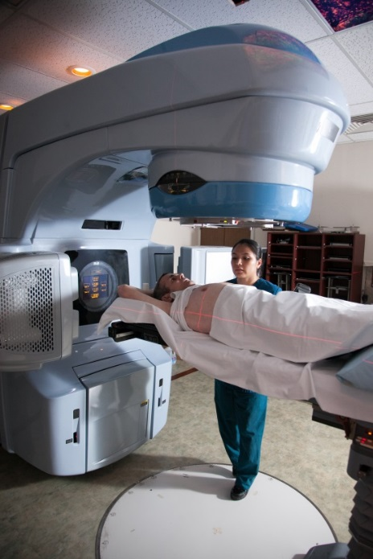
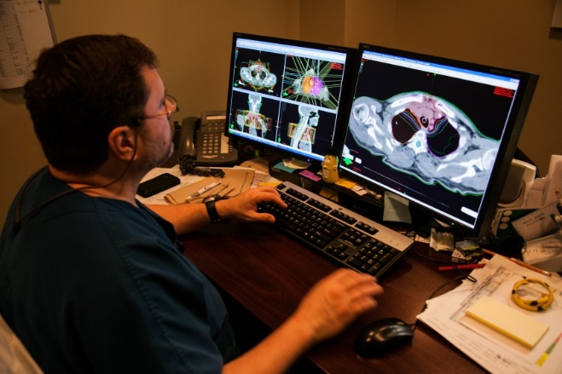
Radiation Therapy As A Component of Multidisciplinary Sarcoma Management

Slide 3
Learning Objectives
Understand the presentation and initial work up of sarcomas
Understand how radiotherapy is used in the treatment of sarcomas
Explore the current open trials evaluating radiotherapy in sarcomas

Slide 4
Preamble to “Sarcoma”
Sarcomas are a rare group of cancers, 13,000+ estimated new cases in 2020
Sarcomas are highly heterogeneous
More than 100 subtypes
Indolent (ex. Desmoid) to aggressive (ex. Angiosarcoma) behavior
Many locations:
59% - extremity, 18% torso/chest wall, 17% retroperitoneum, 9% head and neck
Sarcoma is hard to diagnose, benign soft tissue masses are 100x more common

Slide 5
Outline to Slides
Diagnosing and Staging Sarcoma
Extremity Sarcoma
Retroperitoneal Sarcoma
Desmoid Tumors
Palliative Radiation and SBRT
Current Cooperative Group Trials for Sarcoma
NOT covered: Ewing’s sarcoma, rhabdomyosarcoma and many rare types

Slide 6
Diagnosing and staging sarcoma

Slide 7
Features of a “Bump” That is a Sarcoma
526 patients who presented to a “lumps and bumps” clinic (UK)
Prognostic features for a malignant lesion:
Size > 5 cm (< 5cm best indicator of benign “bump”)
Report of increasing size (increasing size best indicator of “malignancy”)
Pain
Deep location
Johnson et al., Am R Coll Surg Engl, 2001

Slide 8
Imaging Workup of STS
MRI of primary tumor required for extremity/superficial trunk
T1-weighted with and without contrast and T2-weighted sequences
CT of the chest without contrast
CT of the chest, abdomen, and pelvis with contrast for retroperitoneal sarcoma
Many institutions utilize PET/CT for staging
Eary et al., CCR, 1998, 2000

Slide 9
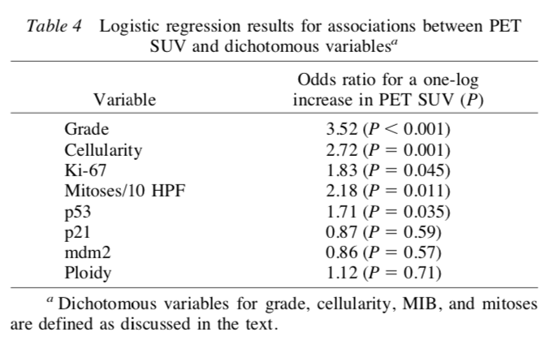
PET Signal and Grade
Tumor FDG metabolic rate and SUV associated with grade in STS and bone sarcoma
PET/CT used to target a biopsy of suspected high-grade components of heterogeneous STS (ex. Dedifferentiated liposarcoma)
Eary et al., CCR, 1998, 2000

Slide 10
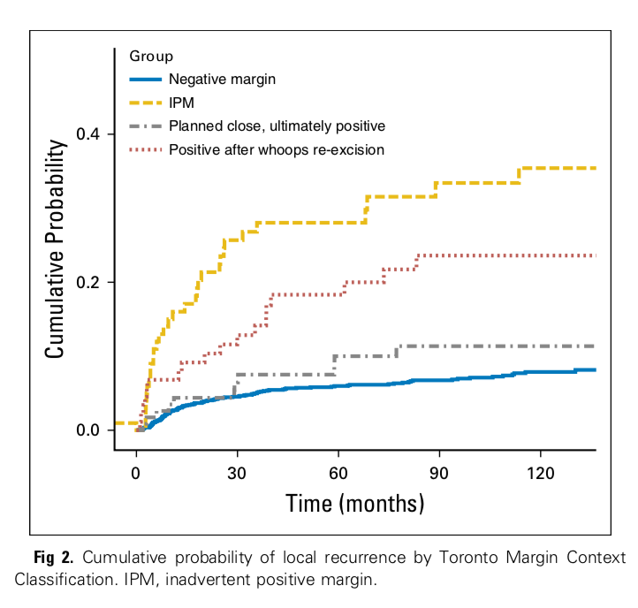
Workup and Diagnosis
Biopsy is required before any therapy
International Guidelines recommend multidisciplinary evaluation prior to any therapy
Due to rarity, misdiagnosis and unplanned procedures are common!
Gundle et al., JCO, 2018

Slide 11
Biopsy and Pathology
Incisional biopsy is the historical standard, but CT-guided core needle biopsy is now commonly used
97% sensitive for malignancy (vs benign) and 86% accurate for grade
FNA is not sufficient for histotype diagnosis, but may be useful in diagnosing recurrence
Expert pathologist review IS REQUIRED as histotyping is increasingly driving therapeutic decision making
Strongly consider sending slides for review at a high-volume center
Strauss et al., J Surg Onc, 2010

Slide 12
AJCC 8th Edition Staging
T-staging
Sarcoma Type | T1 | T2 | T3 | T4
Extremity and Retroperitoneum | <5 cm | 5-10 cm | 10.1-15 cm | >15 cm
Head and Neck | ≤ 2 cm | >2 cm to ≤ 4 cm | >4 cm | Invasion (a versus b)
Arising in abdominal organs | Localized | Extension beyond organ | Invades another organ | Multifocal
N-staging | N0 vs N1
Mstaging | M0 vs M1
Note: Staging also includes FNCLCC grade (1-3)
Differentiation
Mitotic Count
Necrosis

Slide 13
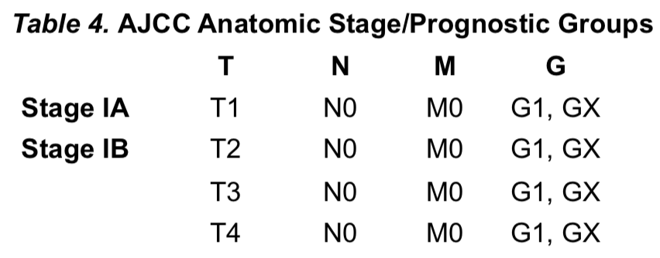
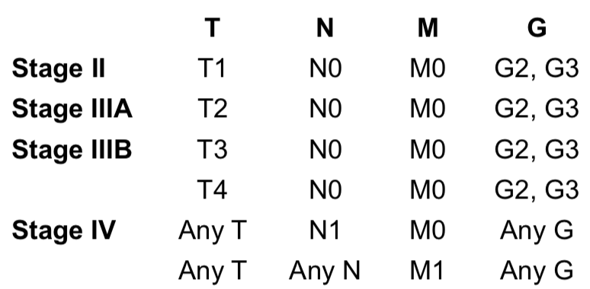
Extremity
Not routinely
Yes, probably
Need to discuss with a radiation oncologist?
Always

Slide 14
Extremity and Superficial Trunk Sarcomas
Why are extremity and superficial trunk or “chest wall” grouped?
Similar prognostic factors and outcomes in numerous case series
Grouped by AJCC and NCCN
Extremity/Chest Wall Treatment Pathways
Low-grade – managed with surgery alone in most cases (not further discussed)
Small (<5 cm), high-grade
Large, high-grade (high-risk)
Unresectable

Slide 15
Evolution of Radiotherapy Use in STS
Limb-sparing surgery + Radiation offers similar outcomes to amputation

Slide 16
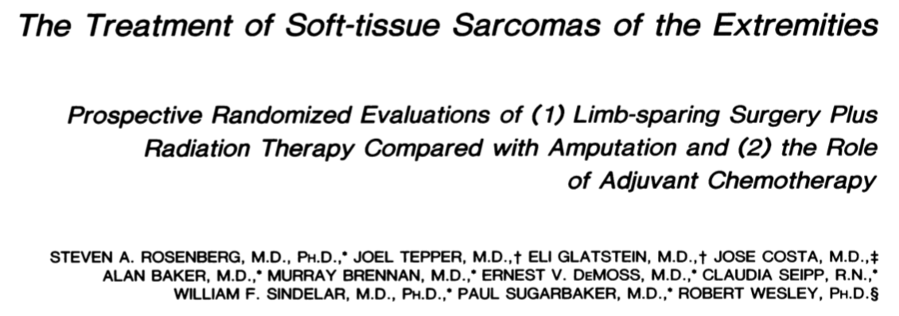
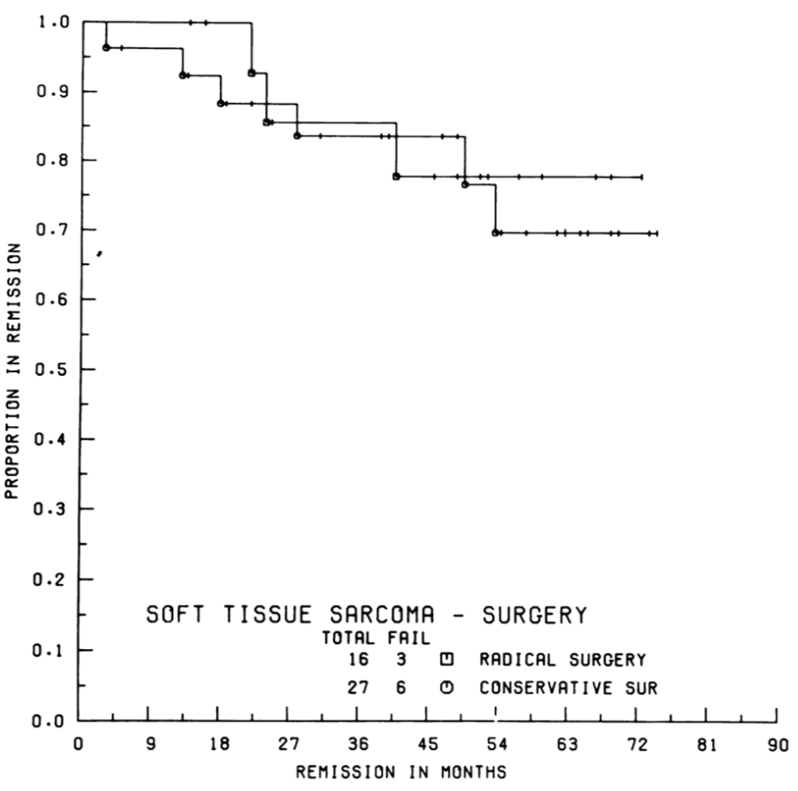
N=43; median follow up 4 years, 8 mos
No difference in QoL
5 year DFS: 78% (amp) vs 71% (sx-rt), p=0.75
5 year OS: 88% (amp) vs 83% (sx-rt), p=0.99
Trend toward worse LR: 0 (amp) vs 3 (sx-rt), p=0.06
2/3 LR recurrences also had DM
P=0.75
Rosenberg et al., Ann Surg, 1982
Notes:
DM=distant metastasis

Slide 17
Evolution of Radiotherapy Use in STS
Limb-sparing surgery + Radiation offers similar outcomes to amputation
Limb-sparing surgery + Radiation offers better outcomes than limb-sparing surgery alone
Rosenberg et al., Ann Surg., 1992 | 5 yr local control: 71% vs 78%
Yang et al., JCO, 1998 | 10 yr local control: 100% vs 81%

Slide 18
Randomized study of limb-sparing surgery with or without radiation
High-grade sarcomas (N=91) | RT + Chemo versus Chemo alone
Low-grade sarcomas (N=50) | RT versus observation
Median follow up of 9.6 years
Improved local control with RT versus no RT (both p<0.05)
No difference in distant metastasis or overall survival (75%)
Worse QoL noted with RT (ROM, stiffness, edema)
”…although post-op RT is highly effective at preventing LRs, selected patients with extremity STS may not require adjuvant XRT after LSS”

Slide 19
Poor QoL After Radiotherapy?
Although field sizes cannot be quoted for different tumors, the field, in our opinion, should allow at least a 10 cm margin both proximally and distally to the tumor mass for the initial field, even for low grade tumors
Fields in then
Fields now
Tepper et al., IJROBP, 1981

Slide 20
Modern Radiotherapy Fields are Smaller
Pre-operative radiotherapy, smaller fields are safe
Local recurrence rates only 7-11%
Late grade 2+ toxicity rates only 10-14%
Persistent wound healing toxicity rates of 30-37% in the pre-operative setting
Trial | Prox-Dist Extent | Radial Extent | Rx | Citation
NCIC SR2 | 5 cm | Not well defined | 50 Gy in 25 fx | O’Sullivan et al., Lancet, 2002
RTOG 0630 | 2-3 cm | 1-1.5 cm | 50 Gy in 25 fx | Wang et al., JCO, 2015
Candian IMRT | 4 cm | 1.5 cm | 50 Gy in 25 fx | O’Sullivan et al., Cancer, 2013

Slide 21
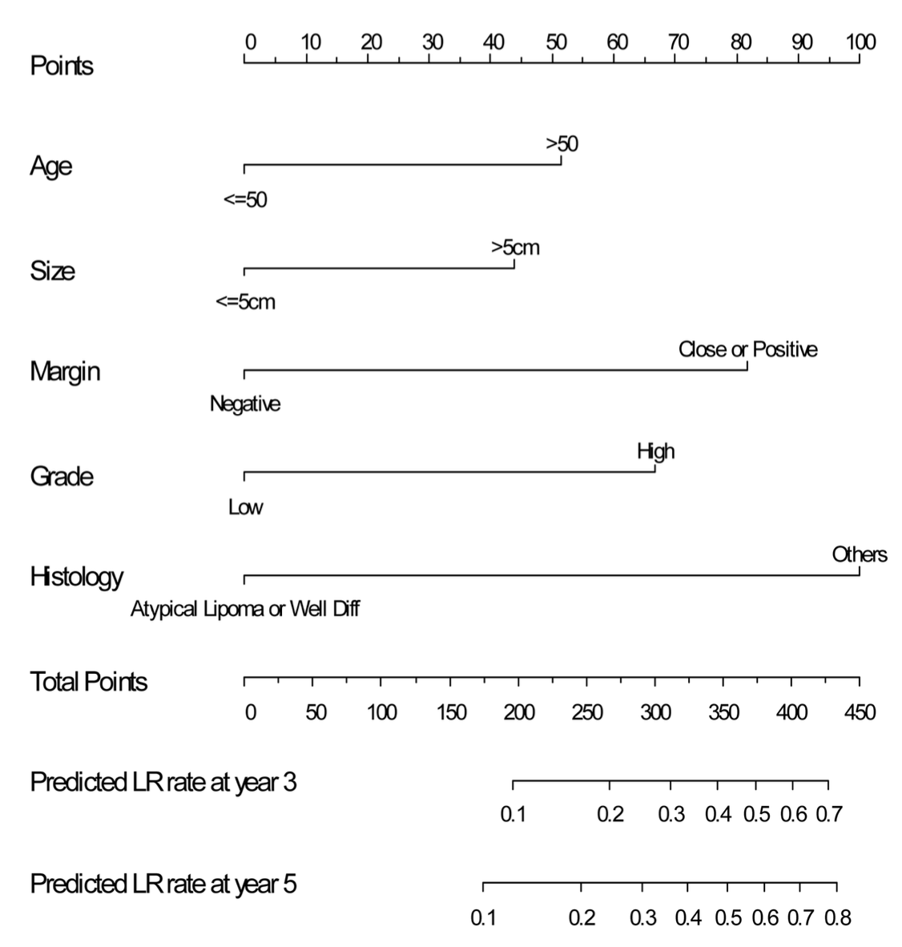
Prognostic Factors for Recurrence
Large retrospective studies define independent risk factors for local recurrence, PFS and OS
Prognostic factors for LR (MSKCC nomogram)
Age >50 years (RR 1.6)
Presenting with LR (RR 2.0)
Positive margins (RR 1.8)
Fibrosarcoma histology (RR 2.5)
MPNST (RR 1.8)
Cahlon et al., Ann Surg, 2012

Slide 22
Prognostic Factors for OS
Multicenter effort to create two, externally validated nomograms for OS and DMFS
Created the Sarculator App
Now includes externally validated dynamic nomogram to predict survival for patients in surveillance up to 3 years
Callegaro et al., Lancet Oncol, 2017
Callegaro et al., eClin Med, 2019

Slide 23
Small, High-grade Sarcomas
For stage II (T1G2-3) tumors, surgery + radiation is generally recommended
Select patients may receive surgery alone based on prospective data
De novo T1 G2-3 STS resected with a minimum 1 cm margin**
5 year and 10 year local recurrence rates of 7.9% and 10.6%
Note 10-year local recurrence rate for high grade STS is 16.7%
If positive margin present, re-resection is required if feasible with low morbidity
Pisters et al., Ann Surg, 2007
Notes:
**Note: It is important to highlight that a wide local excision performed by an expert surgeon with a minimum of a 1 cm margin from gross disease is required to achieve these control rates. This is not the standard approach for all institutions. It is also important to highlight that 11/12 recurrences overall, and 5/6 in the R0 subgroup, were intermediate to high grade tumors. The audience should understand that even with a 1cm wide local excision, there is a >15% local failure rate in small high-grade sarcomas.
It is important to balance this risk of local failure with the expected risk of toxicity with radiotherapy, distant metastasis, and expected overall survival.

Slide 24
Resectable, High-risk (T2-4 G2-3) Sarcomas
Treated with surgery with pre- or post-operative radiotherapy
Compared in NCIC SR2 Randomized Trial
Pre-op 50 Gy in 25 fractions (N=94) versus Post-op 60-66 Gy in 30-33 fractions (N=96)
Powered to detect a decrease in wound complication rate for pre-operative radiotherapy from 30%, stopped early for higher rate
No difference in local/regional recurrence, PFS or OS
Symptom profile differed considerably
O’Sullivan et al., Lancet, 2002

Slide 25
Pre- vs Post-operative EBRT
Pre-operative radiotherapy had a higher wound complication rate
Overall rate pre vs post: 35% vs 17%
Location dependent
Upper extremity pre vs post: 6% vs 0%
Lower extremity pre vs post: 35% vs 25%
Bias toward secondary closure with pre-op (did not affect complications)
Post-operative radiotherapy had a higher radiation toxicity rate
Grade 2+ radiation dermatitis pre vs post: 36% vs 68%
Higher grade 2+ late toxicity rate, which is associated with worse QoL
O’Sullivan et al., Lancet, 2002
Davis et al., JCO, 2002
Davis et al., Radiother and Oncol, 2005

Slide 26
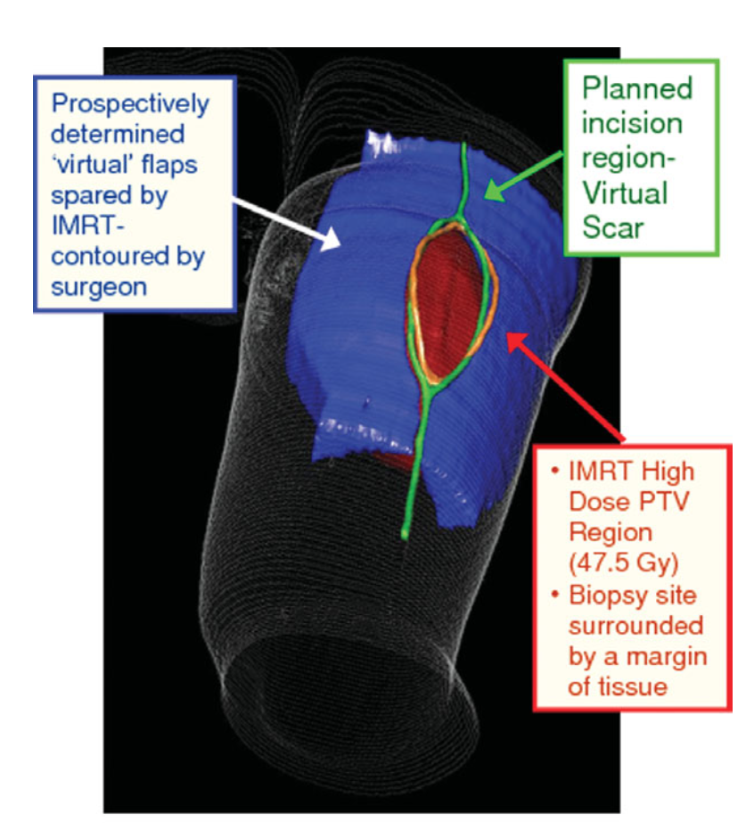
IMRT vs 3-D CRT
Retrospective data shows improved toxicity and LC with IMRT versus 3-D CRT
5yr LC: 94% vs 85%, p=0.05
Radiation dermatitis(Grade 2+) : 32% vs 49%, p=0.002
Edema: 8% vs 15%, p=0.05
IMRT supported by single arm phase II study from Toronto
30% wound complication rate versus 43% historical control (NS)
Lower rates of re-operation
Low rates of flap closure
4 year local failure rate = 7%
O’Sullivan et al., Cancer, 2013
Folkert et al., JCO, 2014

Slide 27
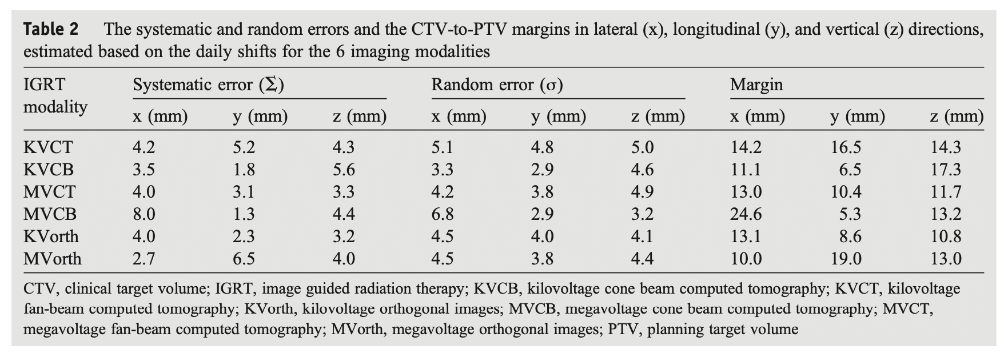
Daily Imaging is the Standard of Care
RTOG 0630 was a single arm study of pre-op radiotherapy with small fields
1.5 cm radial, 2-3 cm proximal/distal, most using 0.5 cm PTV
Estimated that a 1.5 cm PTV would be needed without daily imaging
Li et al., PRO, 2016

Slide 28
Hypofractionation for Extremity/ Superficial Trunk Sarcoma
Numerous hypofractionation strategies have been employed, recent studies include:
UCLA 6 Gy x5 | Kalbasi et al., Clin Can Res, 2019
Polish 5 Gy x5| Kosela-Patercyzk et la., EJSO, 2014
OHSU 3.5 Gy x8 (high-risk with ifosfamide) | Lu et al., Ann Surg Onc, 2018
Surgery within 1 week of completion of RT
Wound comp rate = 32%, Late tox rate = 15%
Local recurrence = 19%
First prospective study
Polish prospective trial of 5 Gy x5 using 3-D CRT
For an excellent review of hypofractionation see
Haas et al. Radioth and Oncol, 2016

Slide 29
Brachytherapy
HDR brachytherapy delivered via temporary catheters placed after resection of STS
Brachytherapy includes low-dose rate (LDR), pulsed dose rate (PDR), high-dose-rate (HDR), and intra-operative radiotherapy (IORT)
LDR (40-200cGy/hour) vs
HDR (>1200cGy/hour)
Adjuvant monotherapy or boost after EBRT
Useful for re-irradiation
American Brachytherapy Society publishes detailed guidance
ABS Consensus Statement for Sarcoma Brachytherapy |Naghavi et al. ABS 2017|
Notes:
Monotherapy is defined as one definitive treatment.
Naghavi, A. O., Fernandez, D. C., Mesko, N., Juloori, A., Martinez, A., Scott, J. G., . . . Harrison, L. B. (2017). American Brachytherapy Society consensus statement for soft tissue sarcoma brachytherapy. Brachytherapy. doi:10.1016/j.brachy.2017.02.004

Slide 30
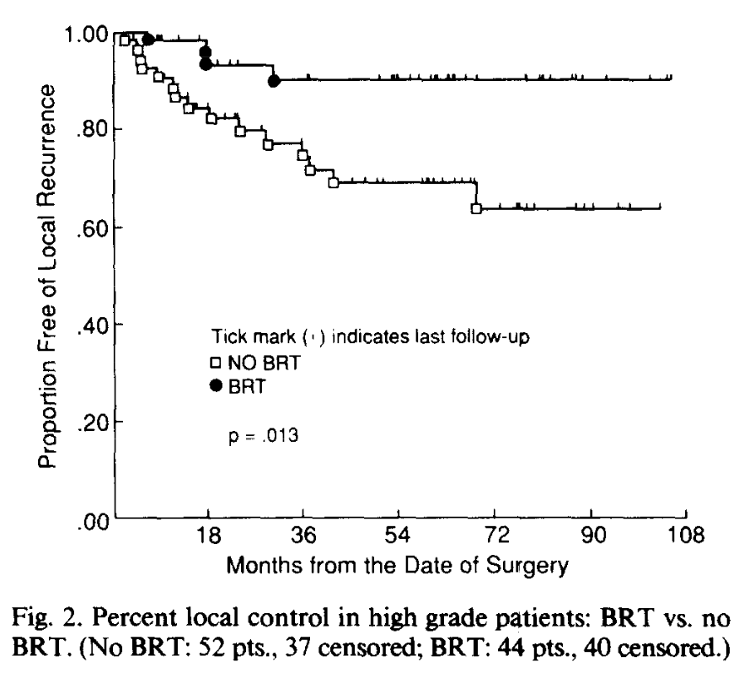
Randomized Trial of Adjuvant Brachytherapy
Randomized trial (N=126) at MSKCC from 1982-1987
Patients with de novo sarcoma s/p oncologic resection enrolled
LDR via Ir-192, GTV prior plus 2 cm, 42-46 Gy over 4-6 days
At 5 years, brachy versus no brachytherapy:
Local control: 82 vs 67% (p<0.05)
Benefit limited to high-grade tumors but study underpowered to address this subgroup
Benefit unclear with positive margins
No difference in DM, OS
Notes:
these seeds were left at a rate of 40-200cGy/hour
Reference: Pisters et al JCO 1996

Slide 31
Case Examples of Radiotherapy Use for Resectable STS
Pre-operative IMRT: large, high-grade sarcoma of the proximal upper extremity
Post-operative IMRT: large, high-grade sarcoma of the thigh, smoker, co-morbid uncontrolled diabetes
Peri-operative re-irradiation with IORT or brachytherapy: localized recurrence of a small, high-grade myxofibrosarcoma of the calf
Pre-operative or post-operative proton therapy: history of prostate cancer, now with a resectable radiation-associated sarcoma of pelvic floor musculature

Slide 32
Unresectable Sarcomas
If tumor cannot be resected with acceptable functional outcomes, there are a range of options:
Induction therapy
Definitive radiation or chemoradiation
Amputation with planned prosthesis
Induction therapy can include:
Chemotherapy and/or radiotherapy (used as previously discussed)
Chemoradiation therapy | 50 Gy in 25 fractions with adriamycin and ifosfamide

Slide 33
Basis for Chemoradiation for Sarcoma
Old strategy for high-risk sarcoma with good success but high toxicity
RTOG 9514 tested interdigitated chemoRT with Mesna (M), Adriamycin (A), Ifosfamide (I) and Dacarbazine (D)
Very high-risk group eligible (high grade, tumor > 8 cm)
5 year local and distant failure rates only 22% and 28% respectively
RT 22 Gy/11 fx
Surgery
RT 16 Gy
(if + margin)
MAID
MAID

Slide 34
Definitive Radiation for Unresectable Sarcomas
Supported by retrospective studies
Studies primarily used 3-D CRT, high-dose fields more conformal today
Radiation dose to >63 Gy associated with good control
Excellent outcomes also seen with 60 Gy RT + ifosfamide
5 year LC 60% versus 20%
Estimated 5 year LC 70%
Eckert et al., Rad Onc, 2010
Kepka et al., IJROBP, 2012

Slide 35
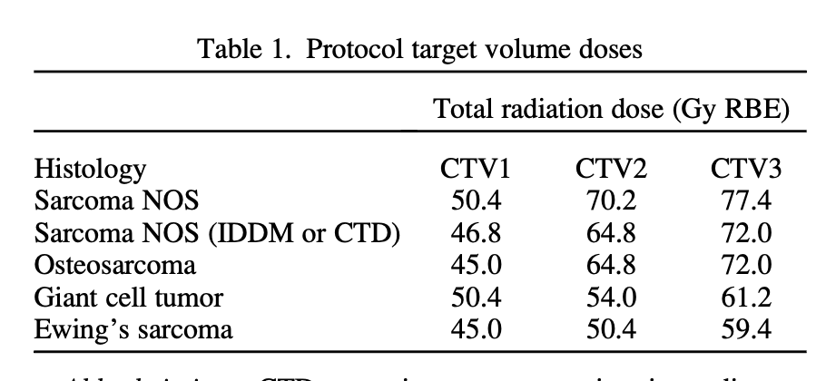
High-dose RT for Sarcoma of Spine
Phase II study of patients with spine sarcoma with extraosseous extension or paraspinal sarcomas
Patients treated with a mix of 3-D conformal, IMRT and passive-scattered proton therapy
Shrinking fields treated to high dose with excellent local control
Chen et al., Spine, 2013
Kabolizadeh et al., IJROBP, 2017

Slide 36
High-dose RT for Sarcoma of Spine
Age 16+, spine/paraspinal sarcomas, surgery and RT recommended
N=50, median follow up 7.3 years
5 year LC: 85.4%, improved for:
Primary vs local recurrence
R0 vs other
Grade 3-4 toxicity approx. 20% at 10 years
See Chowdhry et al., Radiother and Oncol, 2016 for a detailed analysis of spinal cord toxicity
Kabolizadeh et al., IJROBP, 2017

Slide 37
Retroperitoneal Sarcoma

Slide 38
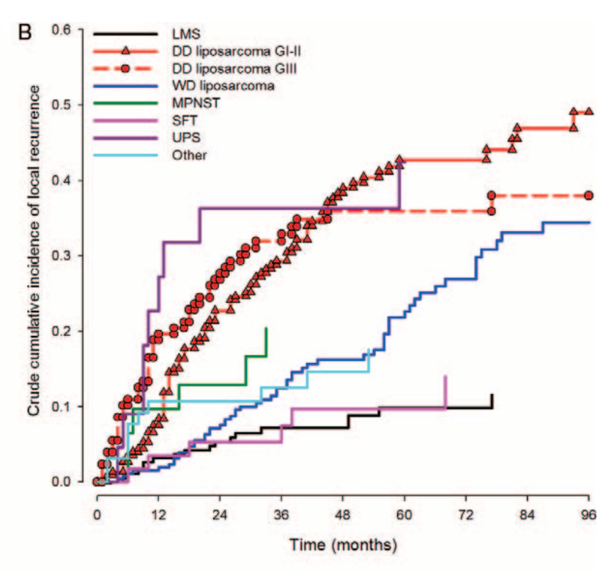
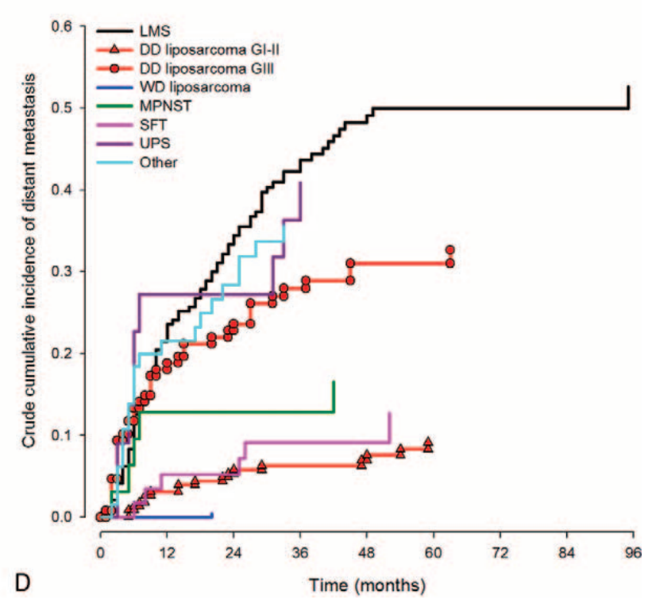
RP Sarcoma Basics
Relatively asymptomatic, often present large (median >15 cm)
Mix of histologies: 60% liposarcoma, 20% leiomyosarcoma, 20% other
Liposarcoma versus Leiomyosarcoma
Stoechle et al., Cancer, 2001
Gronchi et al., Ann Surg, 2016

Slide 39
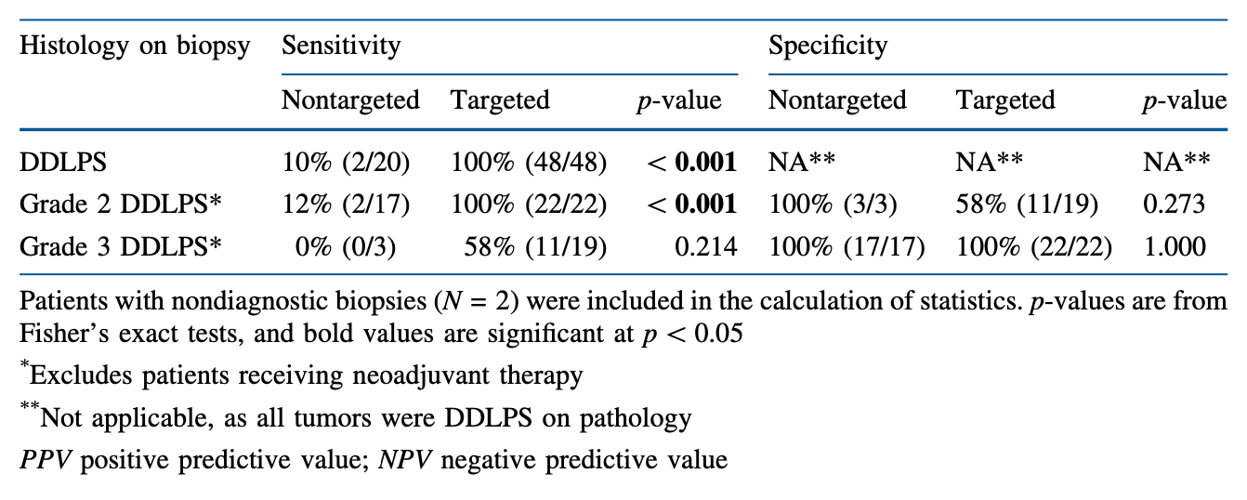
Diagnostic Challenges in RP Sarcoma
Biopsy prior to resection is strongly recommended (TARPSWG)
Can be high grade discordance between biopsy and resection (>30%)
Image-guided biopsy improves accuracy
Solid portion
PET avid portion
Tirotta et al., Ann Surg Onc, 2020

Slide 40
Retroperitoneal Sarcoma Therapy
Surgical resection is the cornerstone of therapy
Often includes resection of involved visceral organs (mean 1-2)
Positive margins are common
Adjuvant radiotherapy and chemotherapy are controversial
Radiotherapy is delivered before or perioperatively with brachytherapy
Post-op radiotherapy is strongly discouraged except in select cases

Slide 41
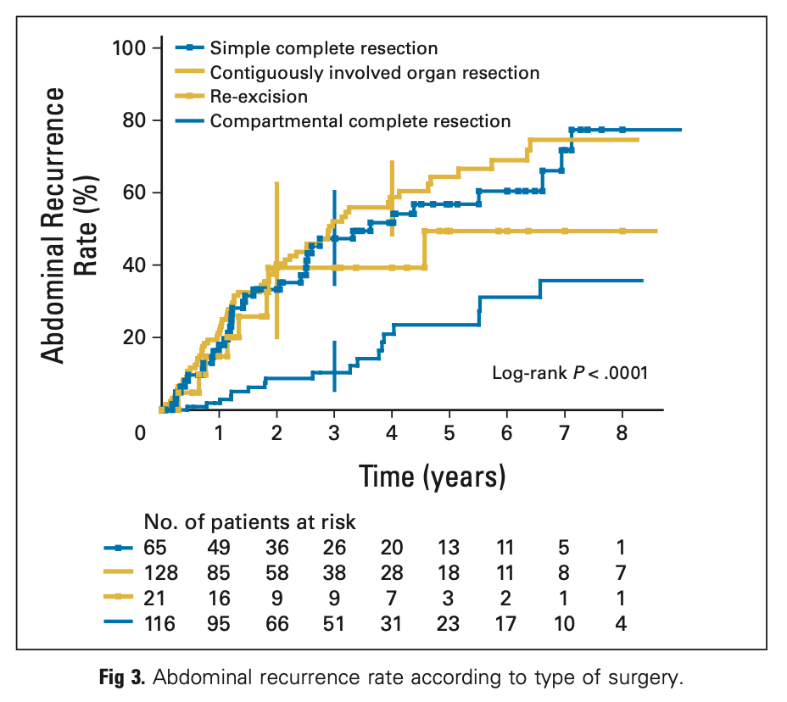
Surgical Resection of RP Sarcoma
Complicated resections, best outcomes at high-volume centers
Significant (but acceptable) serious toxicity at high volume centers
Grade 3 13% | Grade 4 5% | Grade 5 2%
R1, R2 resection, and tumor spill strongly associated with poor survival
“Compartmental resection” associated
with best disease control + survival
Radiotherapy may benefit most in expected close/+margin resections
Bonvalot et al., JCO, 2009
Gronchi et al., Ann Surg, 2016

Slide 42
Radiotherapy in RP Sarcoma
Most studies have given pre-operative radiotherapy with or without perioperative brachytherapy
Generally, 45-50 Gy with 10-12 Gy brachytherapy (catheter, IORT)
ACOSOG Z9031 prospectively tested pre-op IMRT with IORT
5 year local recurrence and overall survival 26% and 72% respectively

Slide 43
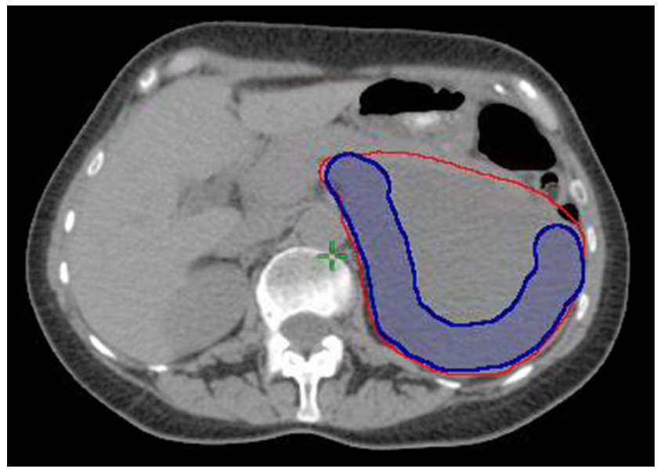
IMRT or Proton Therapy with SIB
Modern approach uses 25 fraction EBRT with SIB
50 Gy in 25 fractions with SIB to high-risk CTV of 57.5 Gy (Tzeng et al., 2006)
High-risk CTV must be defined with surgeon
High variability between Rad Oncs (Baldini et al., Ann Surg Onc, 2015)
Multicenter phase I/II trial seeking to escalate dose to high-risk CTV with IMRT or protons (NCT01659203)
Notes:
Tzeng, C. W., Fiveash, J. B., Popple, R. A., Arnoletti, J. P., Russo, S. M., Urist, M. M., . . . Heslin, M. J. (2006). Preoperative radiation therapy with selective dose escalation to the margin at risk for retroperitoneal sarcoma. Cancer, 107(2), 371-379. doi:10.1002/cncr.22005

Slide 44
The STRASS Trial
Randomized trial of pre-op RT (50.4 Gy with IMRT) + surgery versus surgery alone
N=266, de novo RP sarcoma of any histology, deemed resectable
Primary endpoint composite ARFS
Radiographic local progression during RT (this was later changed)*
Radiographic distant progression during RT
Peritoneal metastasis found at surgery
Macroscopic residual disease left in at surgery
Local relapse
*At the first unplanned interim sensitivity analysis, outcome was changed so that local progression on RT was not considered progression if R0/R1 resection possible
A second unplanned interim sensitivity analysis defined no event if the surgery was R0/R1 despite local progression on radiotherapy OR medically unfit according to the surgery operability criteria
Notes:
With the recent publication (Bonvalot et al, Lancet oncology 2020), it is important to emphasize that AFRS included “radiographic progression”, which accounted for 15/19 of their local “events” who continued on to a macroscopic resection.
Second sensitivity analysis was performed that was more clinically relevant.

Slide 45
The STRASS Trial
Similar outcome in both groups (no RT vs RT)
3 yr ARFS: 58.7% vs 60.4%
3 yr modified ARFS: 58.7% vs 66%
Fit for surgery only: 62.2% vs 71.3%
Liposarcoma subgroup: 60.4% vs 71.6%
3 year OS: 84.6% vs 84%
Important critiques: lower dose RT, high rate of protocol violations/toxicity, confusing composite endpoint
Possible benefit in certain patients with liposarcoma, but longer follow-up is required
Conventional pre-op RT (50 Gy) should not be offered on a routine basis
Notes:
In this post-hoc second sensitivity analysis, RT added a 10%ARFS benefit for liposarcoma (65.2% vs 75.7%), but looking at the KM curve, it should be noted that the curves begin to diverge to 20% at 5 years. So longer follow up is required for us to assess the absolute benefit in liposarcoma long-term.

Slide 46
Desmoid tumor

Slide 47
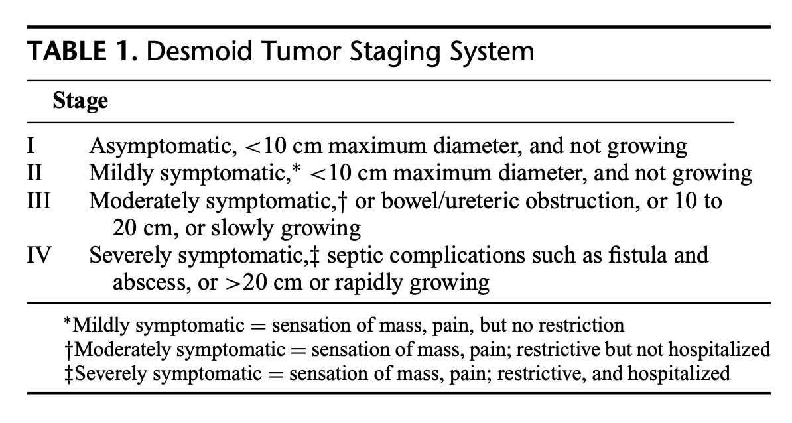
Desmoid Tumor Basics
Rare cancers, 3% of soft tissue tumors
Most are sporadic, but 5-15% of desmoids due to FAP or Gardner Sx
Can be associated with high-estrogen states, such as pregnancy
10-15% can regress spontaneously, no OB complications reported in literature
Some may be driven by APC gene and beta-catenin mutations (Wnt pathway)
Cleveland Clinic Staging System
Quintini et al., Ann Surg, 2012

Slide 48
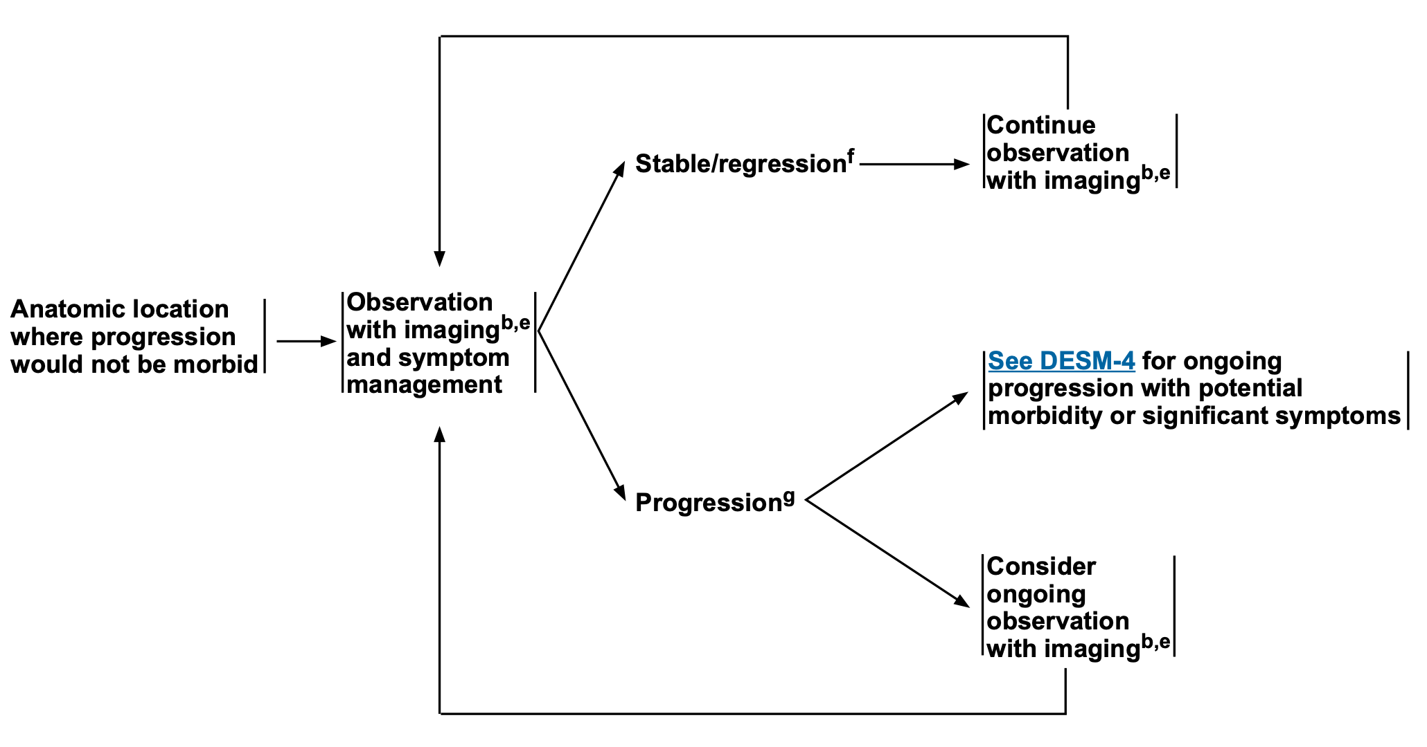
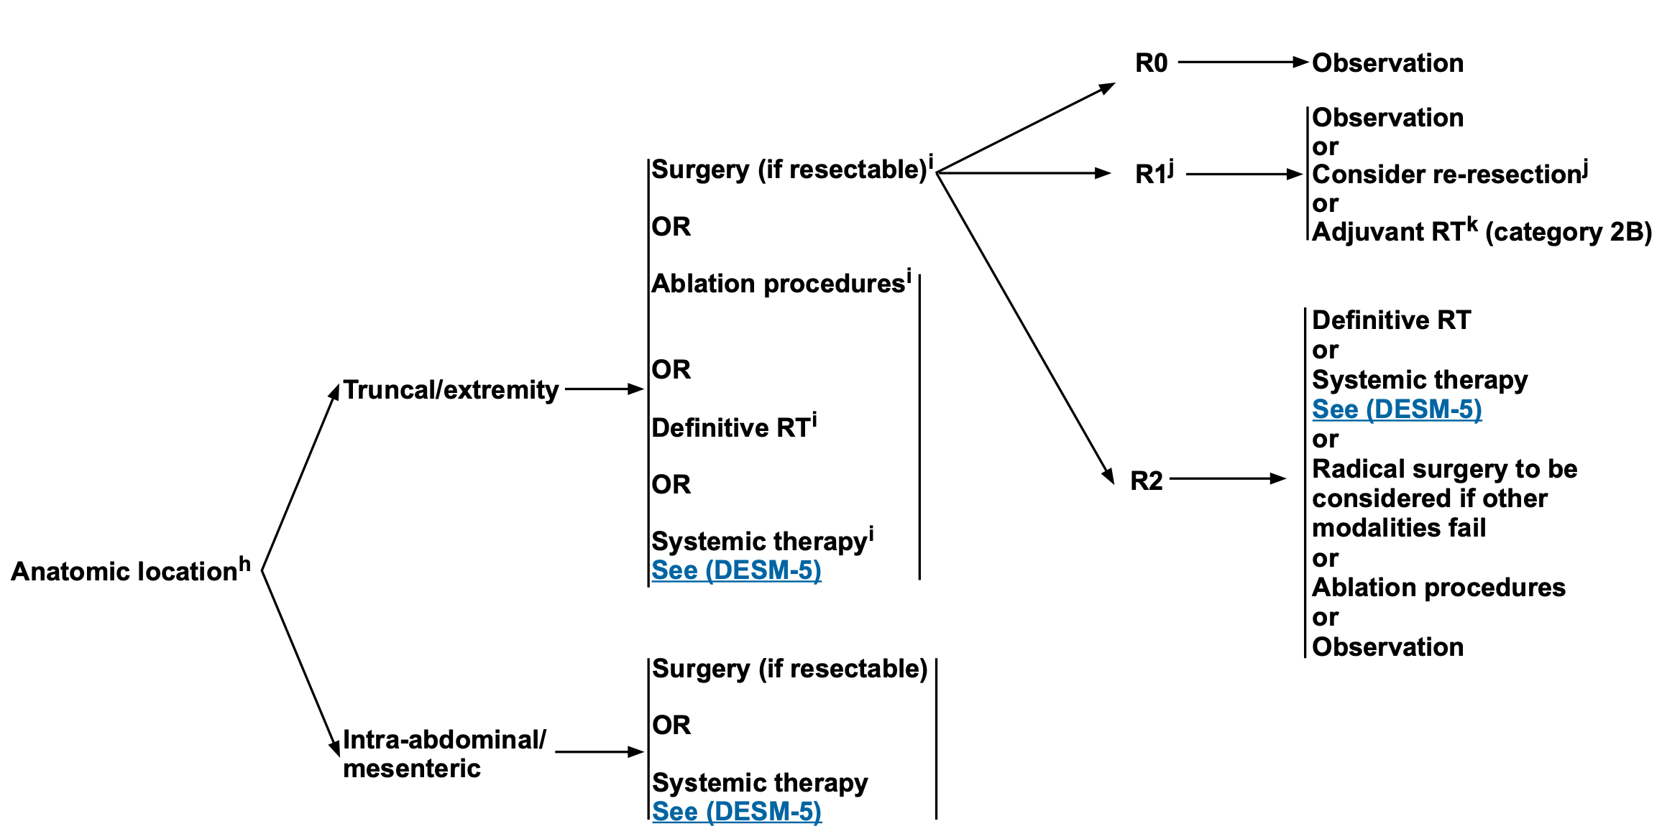
Therapy for Desmoid Tumors
Treatment highly individualized, multidisciplinary management strongly recommended
Many can be managed with active surveillance
On diagnosis
On progression
NCCN Soft Tissue Sarcoma v.2.2020

Slide 49
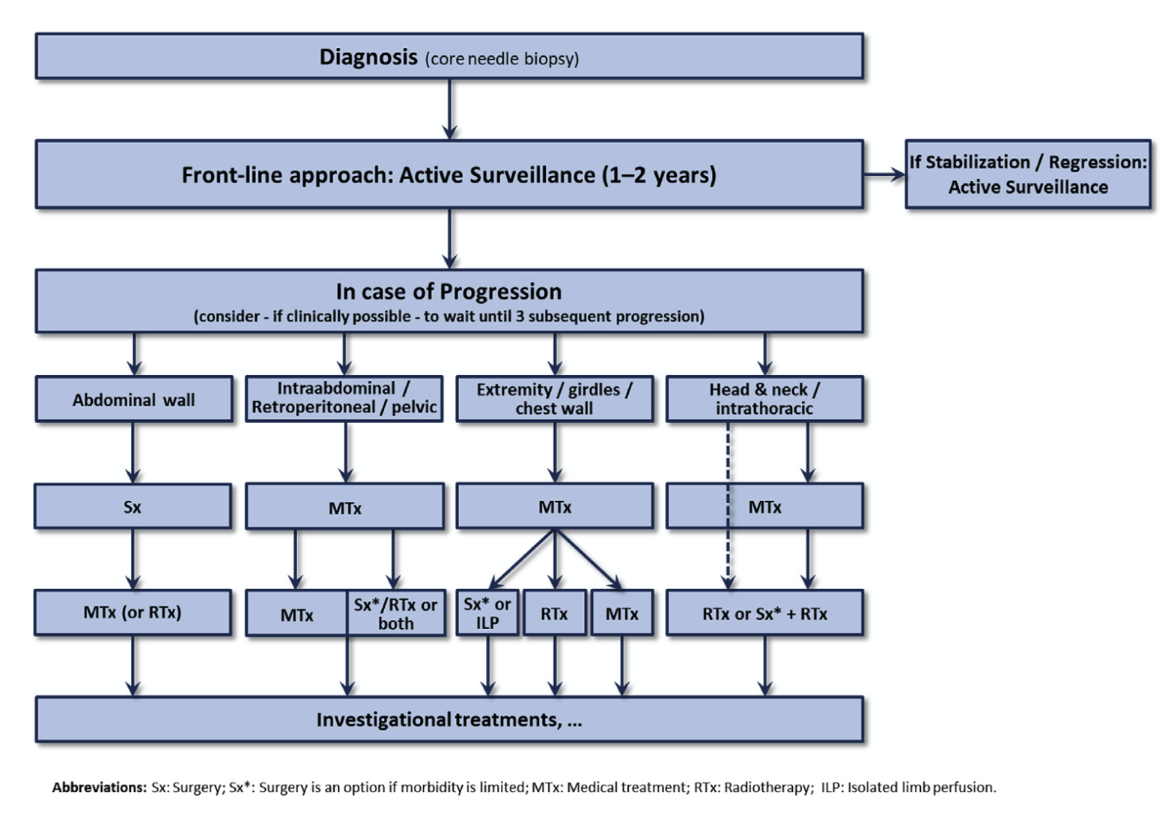
Therapy for Desmoid Tumors
Desmoid Tumor Foundation international consensus document:
Excellent literature review
Treatment guidelines
https://dtrf.org/consensus-paper/

Slide 50
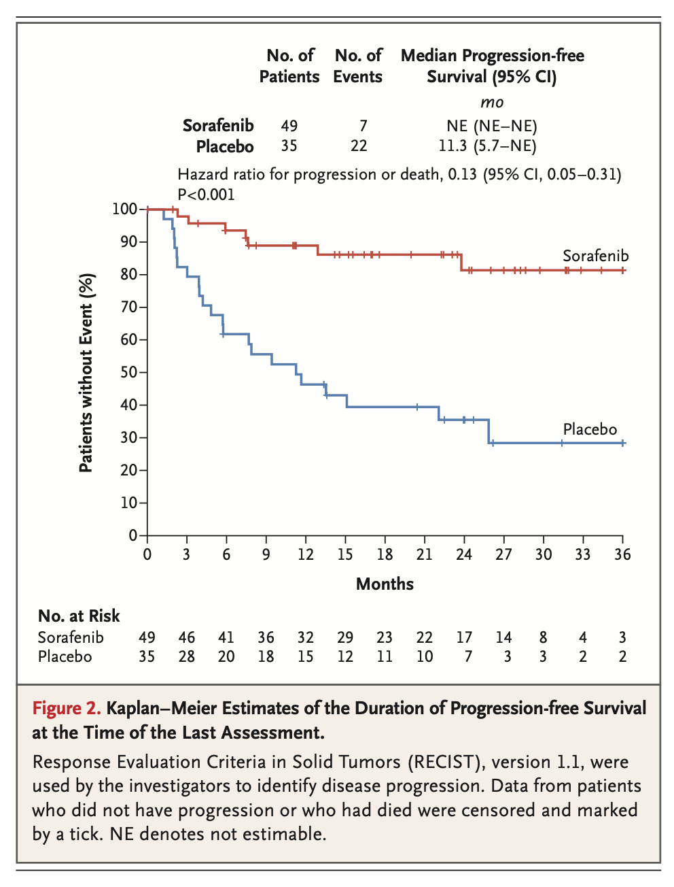
Sorafenib for Desmoid Tumors
Double-blind phase III multicenter trial
87 patients with inoperable or recurrent/progressive desmoid
Sorafenib 400 mg daily versus placebo (with cross-over at progression)
Primary end point: PFS
Objective response rate 33%, median time to response 9.6 mos
47% grade 3+ toxicity (rash, fatigue, GI)
Gounder et al., NEJM, 2018

Slide 51
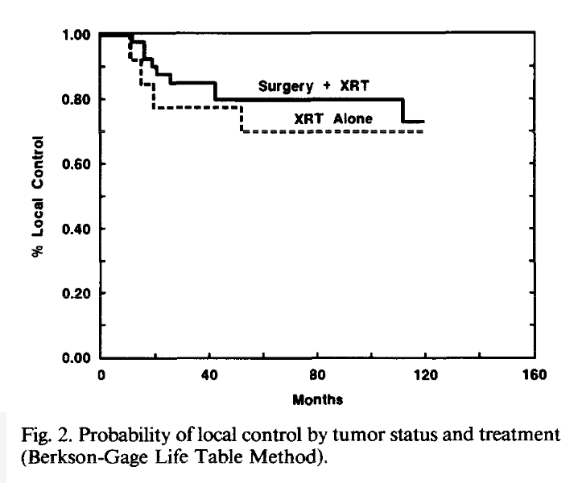
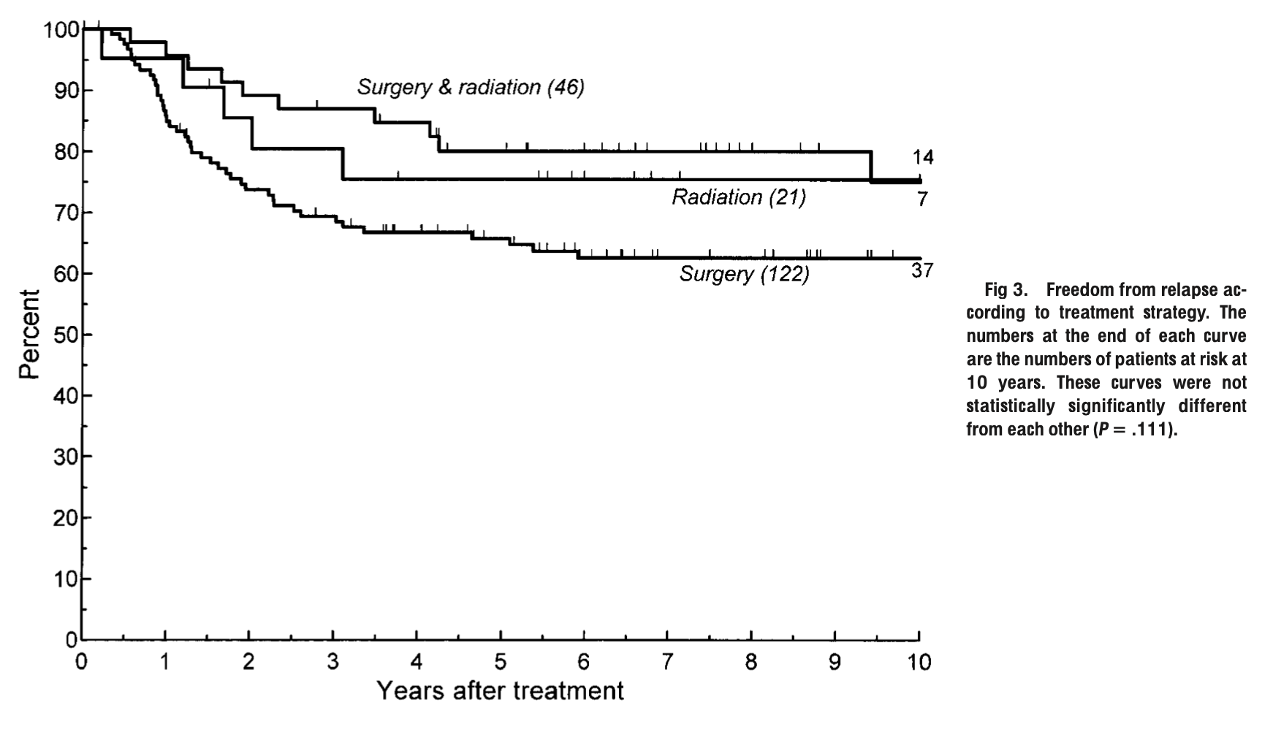
Radiotherapy for Desmoid Tumor
Radiotherapy (RT): Definitive or neoadjuvant/adjuvant RT
Preferred dose is 50-56 Gy in 1.8-2 Gy fractions
Addition of RT likely does not improve local control when resected with negative margins, BUT…
Close/positive margins: Surgery +RT > Surgery alone
5y LC: Surgery + RT = RT alone (75-85%)
Surgical management of desmoids requires consideration of extent of the tumor, symptom burden from the tumor, and potential morbidity of surgery and is best handled by a surgeon experienced in management of these tumors
Radiotherapy for intra-abdominal desmoid tumor should be avoided
Sherman et al., IJROBP, 1990
Ballo et al., JCO, 1999
Notes:
There is now a push for definitive RT for cases that surgical margins would be close/positive

Slide 52
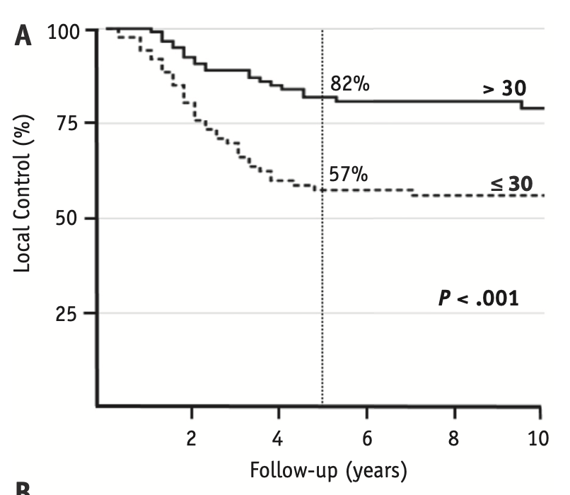
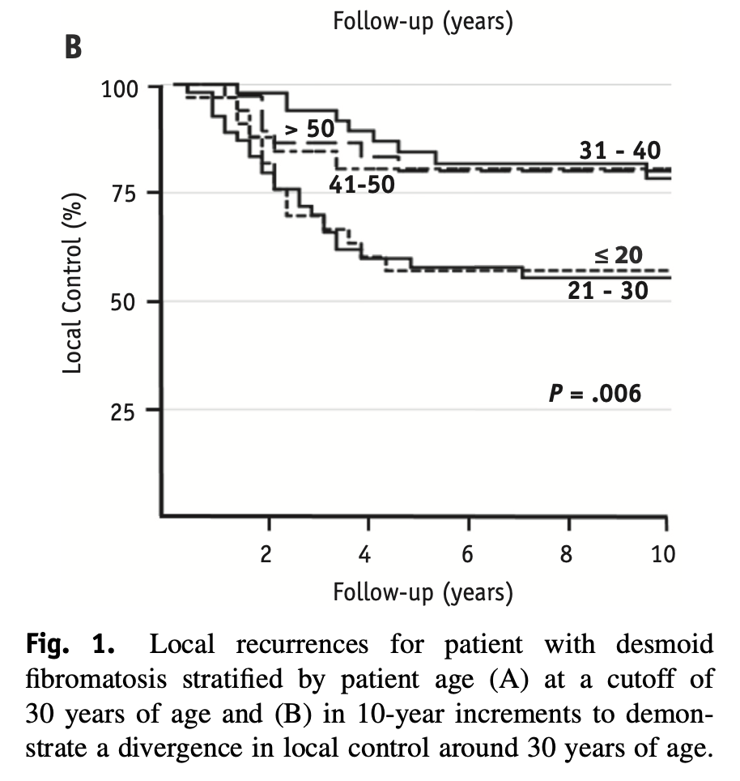
Radiotherapy for Desmoid Tumor
Strong evidence for age disparity in local control
Not RT-related, seen in surgical series
No obvious connection to tumor mutational status
Strong motivation to save RT as a “last resort” in young patients!
Bishop et al., IJROBP, 2018

Slide 53
Radiotherapy use in metastatic sarcoma

Slide 54
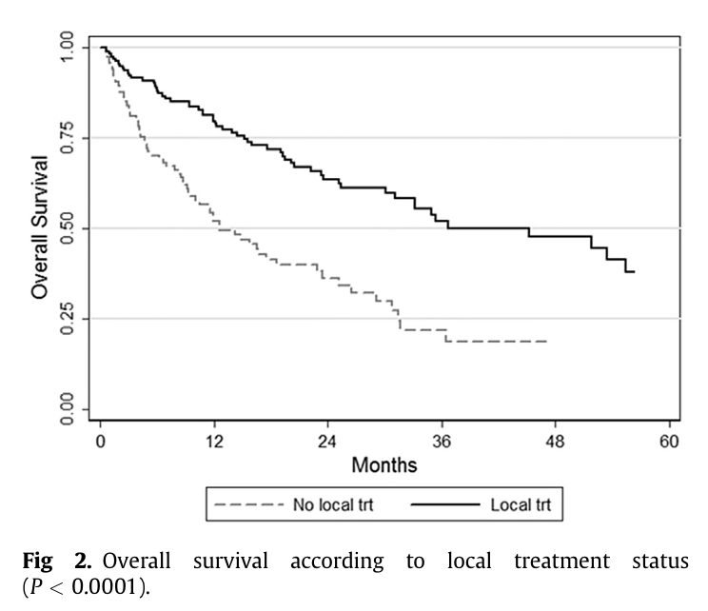
Radiotherapy for Oligometastatic Disease
Retrospective data supports use of ablative therapy for patients with sarcoma and 1-5 metastasis
Local therapies should be selected via multi-disciplinary discussion
Surgery
SBRT
IR ablation
Falk et al., Clin Oncol, 2015

Slide 55
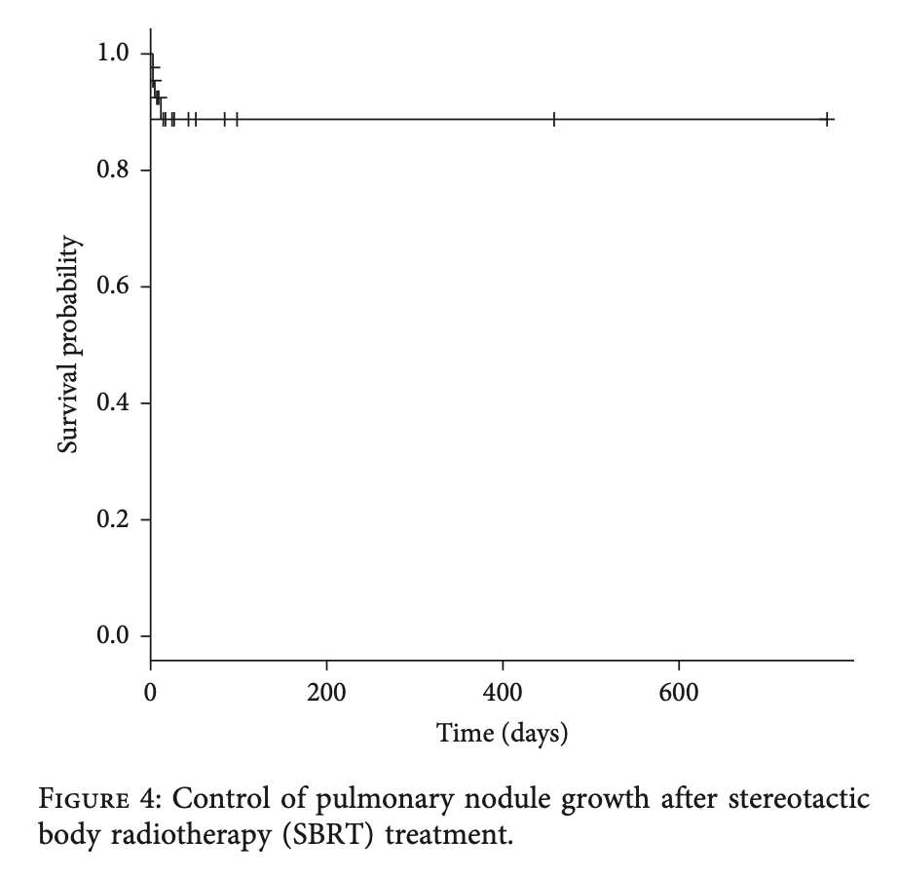
SBRT in Metastatic Sarcoma
Growing excitement for SBRT in (oligo)metastatic disease
Numerous case series show SBRT is safe and effective for sarcoma lung metastases
Lung mets: many consider BED >100 (a/b 10) (Navarria et al., 2015), but doses as low as 50Gy/10fractions provide >90%LC (Lindsay et al., 2018)
EQD2 ≥50Gy considered ablative(Falk et al., 2015)
BED (a/b 10) >48 associated with 2 year local control of spine sarcoma (66 vs 20%) (Bishop et al., 2017)
BED (a/b 4) >=50 associated with improved pain relief in sarcoma (Tween et al 2019)
Local control 80-90+% at 1-2 years
Mehta et al., Sarcoma, 2013
Navarria et al., Eur J Cancer, 2015
Baumann et al., JSO, 2016
Notes:
Bishop, A. J., Tao, R., Guadagnolo, B. A., Allen, P. K., Rebueno, N. C., Wang, X. A., . . . Ghia, A. J. (2017). Spine stereotactic radiosurgery for metastatic sarcoma: patterns of failure and radiation treatment volume considerations. J Neurosurg Spine, 27(3), 303-311. doi:10.3171/2017.1.SPINE161045
Falk, A. T., Moureau-Zabotto, L., Ouali, M., Penel, N., Italiano, A., Bay, J. O., . . . Groupe Sarcome Francais-Groupe D'etude Des Tumeurs, O. (2015). Effect on survival of local ablative treatment of metastases from sarcomas: a study of the French sarcoma group. Clin Oncol (R Coll Radiol), 27(1), 48-55. doi:10.1016/j.clon.2014.09.010
Lindsay, A. D., Haupt, E. E., Chan, C. M., Spiguel, A. R., Scarborough, M. T., Zlotecki, R. A., & Gibbs, P. C. (2018). Treatment of Sarcoma Lung Metastases with Stereotactic Body Radiotherapy. Sarcoma, 2018, 9132359. doi:10.1155/2018/9132359
Navarria, P., Ascolese, A. M., Cozzi, L., Tomatis, S., D'Agostino, G. R., De Rose, F., . . . Scorsetti, M. (2015). Stereotactic body radiation therapy for lung metastases from soft tissue sarcoma. Eur J Cancer, 51(5), 668-674. doi:10.1016/j.ejca.2015.01.061
Tween, H., Peake, D., Spooner, D., & Sherriff, J. (2019). Radiotherapy for the Palliation of Advanced Sarcomas-The Effectiveness of Radiotherapy in Providing Symptomatic Improvement for Advanced Sarcomas in a Single Centre Cohort. Healthcare (Basel), 7(4). doi:10.3390/healthcare7040120

Slide 56
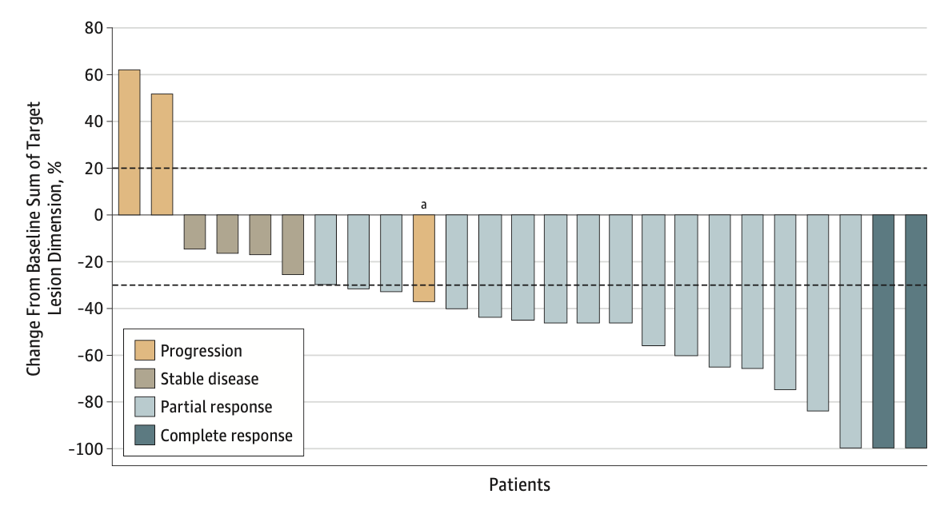
Chemoradiotherapy in Metastatic Sarcoma
TRASTS - Phase I/II prospective study of Trabectadin and Radiotherapy
Eligibility: Metastatic STS progressed on 1 line of chemotherapy
Trabectadin 1.5 mg/m² with radiotherapy 30 Gy in 10 fractions
60% ORR (central review), median PFS of 9.9 months
Up to 40% grade 3-4 hem toxicity
Good option to start/continue chemo or for multiple mets
Beware: no OS data, no QoL data
Martin-Bronto et al., JAMA Onc, 2019

Slide 57
MultiCenter “National” studies of radiation for sarcomas

Slide 58
Sarc 032 – randomized phase II study of adding immunotherapy
Extremity and “Limb girdle”/shoulder eligible
Histology restricted: pleomorphic sarcoma, undifferentiated sarcoma, myxofibrosarcoma
NRG DT-001 – phase I-II study of adding AMG-232
Extremity and Retroperitoneal Cohorts
Genotype-directed therapy
Randomized:
RT → Surgery
RT + Pembro → Surgery → Pembro
Single arm, dose escalation of drug:
If wild-type p53 → stay on drug
If mutant p53 → stop drug

Slide 59
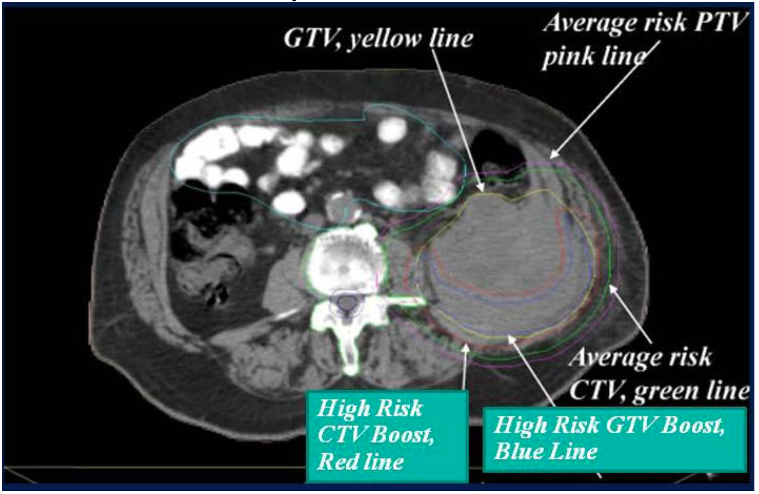
MGH SIB for RP Sarcoma – phase I-II study of image-guided IMRT or IMPT dose-escalationResectable RP sarcoma eligible
Pre-op radiotherapy to 50.4 Gy in 28 fractions with SIB to high-risk CTV defined by Rad Onc and Surgeon
Dose escalation:
57.5 Gy --> 63 Gy in 28 fractions
63 Gy in 28 fractions deemed safe

Slide 60
Supplemental Slides

Slide 61
Hypofractionation Using 30 Gy in 5 Fractions
UCLA – single-arm phase II study of adult patients with STS planning neoadjuvant RT then surgical resection
Radiotherapy 30 Gy in 5 fractions daily, fields per RTOG 0630
Primary endpoint: grade ≥ 2 radiation-associated tox (i.e. fibrosis, lymphedema)
Results
2 year local recurrence: 5.7%
Grade 2 dermatitis: 8%
Grade 2 late tox: 16%
No grade 3 or greater toxicities
No significant decline in TESS or MSTS
Kalbasi et al., Clin Can Res, 2016

Slide 62
Wound Complications Associated with Pre-op RT
Kalbasi et al., Clin Can Res, 2016

