Slide 1
APEx Program
Opportunities for quality improvement with APEx Accreditation

Slide 2
Agenda
Introduction
Review of current practice data
The role of accreditation
ASTRO’s APEx – Accreditation Program for Excellence
Discussion

Slide 3
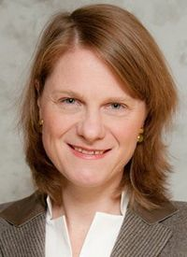
“In the current environment of expanding demands on providers and practices, accreditation can serve to align priorities, unify processes and elevate the practice in ways both measurable and immeasurable.”
- Jean Wright, MD
Johns Hopkins University

Slide 4
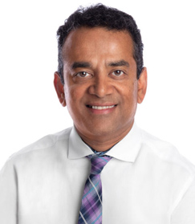
“The APEx journey was a rewarding process and I honestly believe this enhances the safety and quality of care provided to our patients."
— Raj Varadhan, PhD
Minneapolis Radiation Oncology

Slide 5
Review of Current Practice Data
Ideas for discussion
Recent safety incidents
Current interdisciplinary peer review processes
Last review date of internal processes and procedures
Discussion of practice safety culture

Slide 6
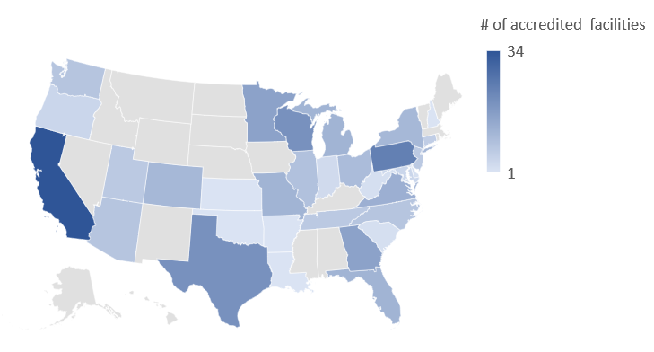
ASTRO’s APEx - Accreditation Program for Excellence
As of January 2023
Notes:
APEx is a recognized radiation oncology accrediting body in all 50 states and 41 VA practices. APEx has seen tremendous growth in recent years and is the fastest growing radiation oncology accreditation program in the U.S.
In a recent APEx evaluation survey, 97% of practice staff said they were likely or very likely to recommended APEx to a colleague.

Slide 7
APEx Process
Application
Self-Assessment
Facility Visit
Preparations
Facility Visit
Determination
Notes:
The APEx Process is different than ACR or ACRO in that it includes the Self-Assessment as an internal review phase. This step would allow us to measure current processes against national standards and make any adjustments prior to the facility visit.

Slide 8
Why APEx?
APEx was developed by radiation oncology professionals for radiation oncology practices.
Fastest growing accrediting body for radiation oncology with 100% return rate for practices seeking reaccreditation.
Focuses on the entire radiation oncology team and quality improvement, not just appropriateness criteria.
Objective reviews with transparent results.
Notes:
The APEx program was designed to be transparent, objective and focused on quality improvement rather than a peer-review process. Practices going through APEx will review the consistency of processes, documentation and communication throughout the program. This standardization, when understood and performed by an entire team, leads to the reduction of variation and an increase in high-quality, safe patient care.
While the APEx Standards focus on quality and safety, they are not intended to prescribe processes for individual ROPs. When implementing the APEx Standards, each facility will develop a program customized to their patients and processes based on guidance from ASTRO, AAPM, etc. The expectation is that the standards will provide the structure for quality improvement, allowing ROPs their own flexibility and innovation in determining how they demonstrate compliance through clear documentation.

Slide 9
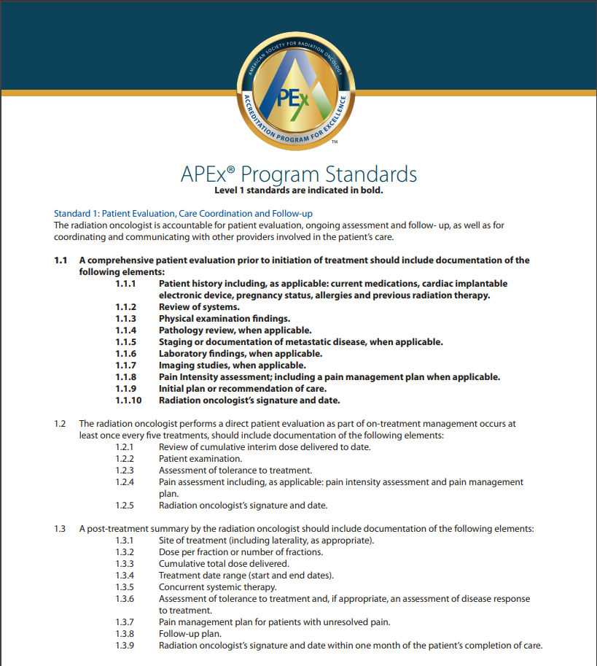
APEx Standards
Based on widely accepted consensus documents:
ASTRO’s Safety is No Accident: A Framework for Quality Radiation Oncology and Care
AAPM Task Group Reports
Federal requirements (HHS, NRC, CMS)
Assesses all members and aspects of a radiation oncology practice.
Interdisciplinary peer review for all disciplines
Culture of Safety
Emergency preparedness
Nationally recognized equipment QA standards
Patient-centric (education, consent, feedback)
Notes:
While the APEx Standards focus on quality and safety, they are not intended to prescribe processes for individual ROPs. When implementing the APEx Standards, each facility will develop a program customized to their patients and processes based on guidance from ASTRO, AAPM, etc. The expectation is that the standards will provide the structure for quality improvement, allowing ROPs their own flexibility and innovation in determining how they demonstrate compliance through clear documentation.

Slide 10
Current APEx Practice Statistics
As of January 202
Notes:
APEx was created to be scalable to account for different practice size, location and settings. ROPs must be located within the United States.

Slide 11
APEx Accreditation benefits
Implementation of peer review for all professions.
Updating process to include documentation of positive and pertinent negative results - means never assuming.
Updating overall workflows to increase safety stop points, which can lead to safer practice.
Notes:
Many facilities have used the APEx Program for different reasons. Some wanted to set up their practice to create workflows based on standards, while some wanted to verify that their processes were valid. Either approach works within the APEx Program. Overall, facilities have stated that the process has made them take a deeper look at their processes to improve their safety and learning opportunities for their staff. This slide shows some of the success stories from APEx accredited facilities on the benefits of the program.

Slide 12
Multi-facility benefits
APEx makes it easy to align practices under one standard.
Ability to add additional satellites during accreditation cycle and confirm process alignment.
Notes:
To qualify for a multi-facility practice application, satellites must all meet each qualification.
Follow common policies/procedures (SOP) for key evidence indicators.
Located within 50-miles from the main facility.
Medical director, who is a radiation oncologist, responsible for each facility.
Practices that have satellites outside the 50-mile radius could be included for a possible additional application fee, depending on the circumstance and approval by ASTRO.
The APEx Program has a pathway for multi-facility applicants to ensure that all facilities follow the same policies and procedures. Using the APEx Standards as a guide, facilities can align with the requirements while seeking accreditation.

Slide 13
Self-Assessment
Internal review conducted by your practice.
Consists a review of medical records and practice policy and procedure documents.
Feedback reports help identify areas for process and quality improvement before the facility visit.
Notes:
Practices conduct an internal review called the Self-Assessment. This section allows facilities to assess consistent documentation in medical records and review the policy and procedure documents. Practices must reach at least 85% compliance in each area before being deemed ready for the facility visit. Practices are allowed up to multiple attempts in each section to demonstrate compliance, but most practices achieve this within the first or second attempt. Each attempt offers the practice a feedback report which highlights areas of non-compliance. These feedback reports can be utilized by the practice to strengthen their processes before the next attempt or before the facility visit.
Only the main facility will complete the Self-Assessment, as the satellites should be following the same procedures.
At no point during the APEx process will PHI ever be entered into the APEx Portal or shared with ASTRO staff.

Slide 14
How Is the Facility Visit Conducted?
Surveyors review each facility and interview key personnel.
Conducted virtual or in-person
Main and satellite(s) conducted on the same day.
Surveyors are there to gather objective findings.
Determinations are not given during the facility visit.
Notes:
Each location will be assessed by the APEx Surveyors. Main or single locations will be assessed by at least a radiation oncologist and medical physicist, which take a full day to complete. Any additional satellites will be assessed by at least one medical physicist, usually completed in half a day's time. If there are multiple satellites, these will be paired together when possible or additional surveyors will be sent.
APEx Surveyor’s main responsibility is to gather information to submit back to ASTRO. They do not make the determination and therefore your practice will not know your results on the day of the facility visit.

Slide 15
APEx Determinations
The Practice Accreditation Subcommittee:
A multidisciplinary group representing the entire radiation oncology team.
All members are active APEx Surveyors.
Determinations are based on blinded determination reports.
Notes:
The findings of the APEx Surveyors are submitted through the APEx Portal and blinded reports are submitted to the Practice Accreditation Subcommittee for review. The Practice Accreditation Subcommittee is a multi-disciplinary committee of radiation oncology professionals who are trained APEx Surveyors working full time in radiation oncology. The voting process can take 4-6 weeks.

Slide 16
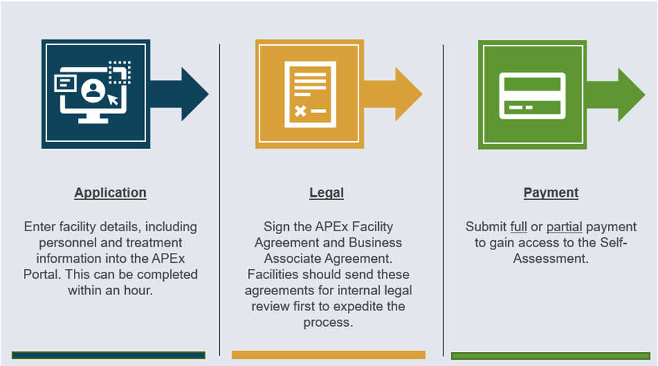
Application Process

Slide 17
How Long Does It Take?
Practice Driven
ASTRO Driven
Month 1
Month 2
Month 3
Month 4
Month 5
Month 6
Month 7
Month 8
Month 9
Application and Payment
Send Legal Agreements
for Review
Self-Assessment:
Document Uploads
Document Upload Review
Self-Assessment:
Medical Records Review
Self-Assessment:
Interview Preparation
Facility Visit Preparation
Determination
Notes:
The APEx Program can be flexible with your practice’s needs, depending on the time and effort you put forward in certain sections of the program. The application information could be completed in a single day, followed by signing of legal agreements within the APEx Portal. The payment, if sent by mail takes 2-3 weeks to clear the bank. Once ASTRO receives notification of your payment, your practice is granted access to the Self-Assessment phase of the program.
As already mentioned, during the Self-Assessment, it is recommended to start with the Document Upload section. This section can take the longest to complete for two of the following reasons. 1) Your practice may need to create or update documents for compliance and 2) once submitted, the documents are reviewed which can take 4-6 weeks to complete. During the review period, you can complete the other two sections of the Self-Assessment, the Medical Record Review and Interview Preparation. Each medical record takes about 45 minutes to complete the questions within the APEx Portal. So, if you did a single medical record each day, this process would take you about a month to complete. The Interview Preparation takes about 1 hour and can be completed at anytime through out this time period.
Once deemed ready for the facility visit, your practice will sign in and select potential facility visits dates. Depending on your timeframe, you could select dates within the first couple of available weeks, or over the first few months – depending on the availability of your staff. Once the facility visit is finalized and conducted, it takes an additional 4-6 weeks to receive your final determination.
Throughout that whole process, your practice has control of major portions of the process.

Slide 18
How Much Does APEx Cost?
Application Fees
Type of Fee | 3-year | 4-year
Main Facility | $9,500 | $13,000
Qualifying Satellite | $3,000 | $4,000
Extra Distance Fee | $3,000
ASTRO offers two payment options:
Full
Partial
ASTRO accepts:
Check
Credit card
Wire transfers.
Notes:
APEx now gives you the option to select your accreditation cycle length with a different price for each. It all depends on what your practice needs. The entire cost of APEx is paid upfront, so there are no additional fees due later for the facility visit.
ASTRO has two options when paying your application fee. The first is to pay the full payment during the application phase of the program. Second, your practice can choose to pay at least 50% of the application fee during the application phase and the remining balance would be paid anytime before scheduling the facility visit. It is your practice’s choice which will work best for you.

Slide 19
Why Select APEx Accreditation?
Provides feedback before the facility visit.
Focused on quality improvement not physician peer review.
Promotes teamwork within the ROP.
Objective review.
Flexibility to meet the needs of your practice: payment options, 3- or 4-year accreditation cycle, and mid-cycle satellite additions.
Accredited by ASTRO.
Notes:
As a recap, the APEx program was designed as a quality improvement program for your practice and can be used by all types and sizes of radiation oncology practices. The program offers transparent feedback before scheduling a facility visit. Using the program's feedback reports, your practice can work on compliance issues seen during the Self-Assessment and either adjusting compliance before the facility visit or knowing what will need to be adjusted.
Practices within the APEx program succeed when they have buy-in from the entire team. Sometimes, to show compliance, processes or training needs to change. By having the entire team on board for APEx accreditation, your practice will create high-quality, safe practices for the patient's treatment within your department.
By selecting the APEx accreditation program, you will receive an objective review of your practice, as the surveyors are there to collect the information and then send it to the Practice Accreditation Committee to complete the final vote. The reports are blinded and therefore determined based on their merit in compliance with the evidence indicators.
While APEx accreditation is valid for a 4-year accreditation cycle, we understand that some practices may need to select a 3-year accreditation cycle to meet regulatory requirements. ASTRO offers the flexibility for your practice to select what fits best for you and your department's needs. You also get the prestige to advertise that you are accredited by the leading organization for radiation oncology practices, ASTRO.

